Slide 1
Computer Hardware
The ‘stuff you can touch’
Notes:
Keep in mind, hardware is the equipment, software are the programs. Hardware typically includes:
Input
Processor
Output
Storage

Slide 2
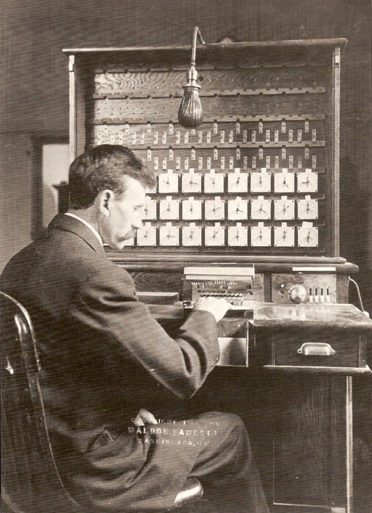
Evolution of Computer Hardware
Abacus counting machines
Babbage’s difference engine
Hollerith’s tabulating machine
ABC computer
ENIAC
Notes:
With the advent of the use of tools (think of an ape putting a stick into an ant hill to collect ants for food), we look for more efficient ways to do things. Computer hardware is just an extension of this concept. Early “computing machines” included something as simple as an abacus. The development of computer hardware took off during the 20th century, as electronic technology continued to improve.

Slide 3
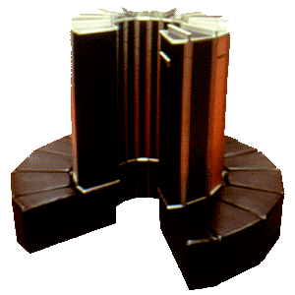
Categories of Computer Hardware
Supercomputers
Mainframe computers
Minicomputers
Server
Workstation
Microcomputers
Desktop
Laptop
Mobile computers (phones)
Notes:
It can always be difficult to try and “classify” different things, because you will have problems defining the boundaries of the categories. However, computers are typically grouped into these categories, partly due to the “market”, partly due to academics, etc.
The image is the Cray Supercomputer from 1976. Seymour Cray was a leader/innovator of supercomputers during the 1970s. These are the fastest, most powerful computers at any particular time.
http://www.computermuseum.li/Testpage/Cray-1-Supercomputer-1976.htm

Slide 4
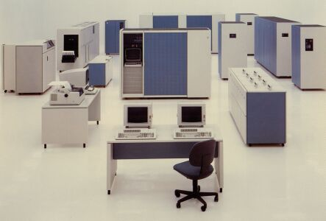
Differences in categories
Hardware
Input
Process(or)
Output
Storage
Software
Systems
Applications
Users
Price
Vendors
Notes:
When comparing computers, it’s helpful to look at the characteristics of each type of computer.
The image on this slide is of an IBM mainframe computer – typically used for “large corporate applications”.
See http://used-mainframes.com/welcome-to-used-mainframes-com/ for the image.

Slide 5
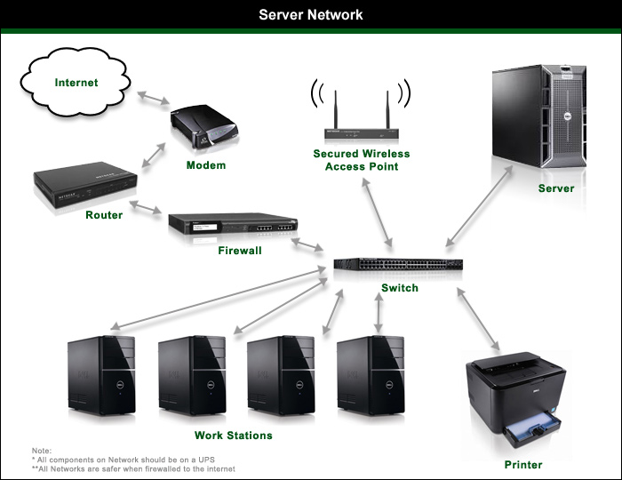
It’s about the network…
Sharing resources
Sharing data
Sharing expertise
Notes:
Using a computer is important, but it’s really about building the network so users can share & access information. The trouble is, this network needs to be reliable & cost efficient.

Slide 6
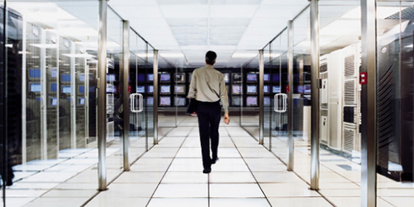
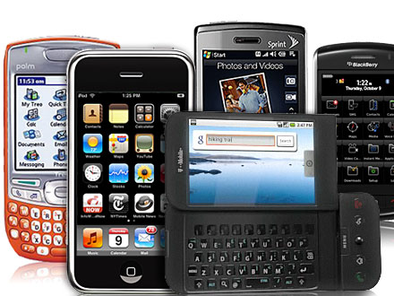
And who controls it…
Centralization
Decentralization
Notes:
Controlling the hardware, software, and data is a key issue. Older systems focused on centralized control, but PC’s broke that mold, and mobile devices break it down even more

Slide 7
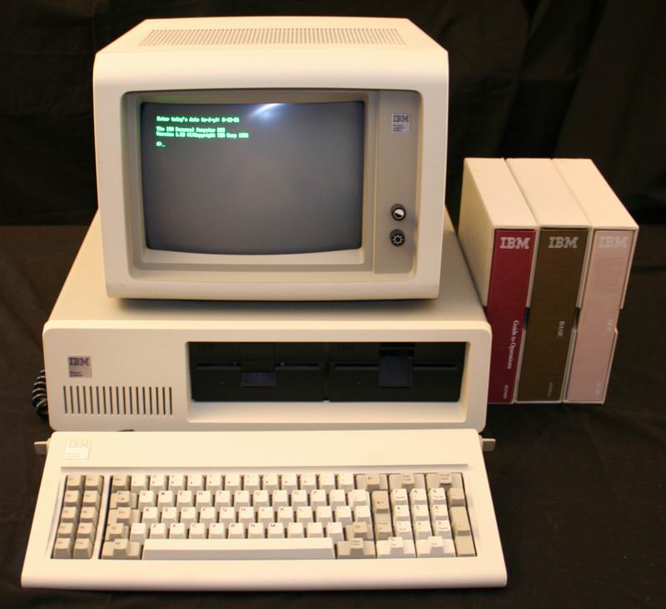
And the cost
Category | Cost
Supercomputers | Multi-Millions
Mainframes | Millions
Servers | Thousands
PC’s | Hundreds
Mobile | Free?
Notes:
On a “per unit” basis, obviously mobile and PC based systems will be cheapest, but you need to look at how many users each machine will host, as well as the service per month. A frequent term used to analyze this cost is TCO – Total Cost of Ownership.

Slide 8
Comparing the types
Category | Hardware | Software | Users | Price | Vendors
Supercomputers
Mainframes
Mini/Servers
PC
Mobile
Notes:
Hardware looks at input, process, output, storage, and communication, as well as the physical location of the hardware
Software looks at systems vs. applications
Prices are really more of a range

Slide 9
Key terms
Supercomputer
Mainframe
Minicomputer
Server
PC
Mobile
TCO
CPU
RAM
I/O
O/S
Notes:
Don’t worry if you don’t get all of these terms down pat right away, because we’ll look at them a number of times, however, here are a few key ones that you should start getting familiar with.

