Slide 1
Internet History
Compiled by Prof. Wm Hitchcock
Notes:
Make sure you view this slide in PPT design mode so you can read the comments.

Slide 2
Need for Internet
Stand alone computers
Need for sharing resources
Physical vs. Virtual access
Security issues
Centralized vs. Decentralized communication
Circuit switched
Packet switched
Notes:
During the 1960’s, the United States was in a “Cold War” with the Soviet Union. The military understood the need to protect it’s communication network, so they were very interested in building a system that wouldn’t be so centralized. One way to do this was to move away from a “circuit switched” model of telecommunications (used by the only U.S. telephone system at the time, AT&T) and utilize a “packet switched” network, which takes a message, breaks it into smaller packets, and re-assembles them at the receiving end to complete the communication.

Slide 3
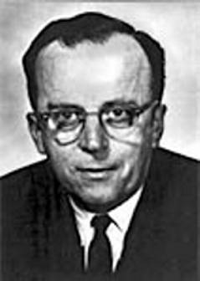
1960’s – call for networks
J.C.R. Licklider
Intergalactic system:
“A network of such [computers],
connected to one another by wide-band communication lines
[which provided] the functions of present-day libraries together
with anticipated advances in information storage and retrieval and [other] symbiotic functions.”
Notes:
Licklider is one of the “key people in CS” – a visionary in networking, AI, etc.

Slide 4
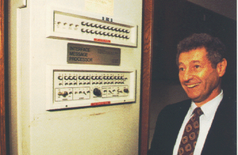
The Internet (1969)
Four IMP nodes connecting
UCLA (Leonard Kleinrock)
SRI Stanford Research Institute (Doug Englebart)
UCSB
Univ of Utah
Notes:
During the 1960’s-1990’s, several different communication networks were created to share computer resources. Many of these were proprietary (e.g. set up by one company to share information among their different plants/locations) and some were research/government funded.
The creation of “The Internet” occurred in 1969, when 4 computers were connected using a processor called an “IMP – Interface Message Processor”.
Side note: SRI International (Doug Englebart – creator of mouse interface) is a huge lab est. by Stanford

Slide 5
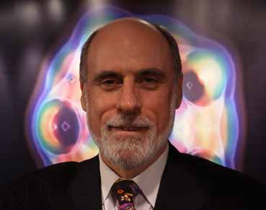
TCP/IP (1970’s)
The standardized “rules” for transmitting data over the internet
Utilizes the “packet switched” concept
Notes:
TCP/IP – Transmission Control Protocol / Internet Protocol is what any computer connected to the internet needs to use to communicate with other machines on the network. This standardized the sharing of information, making it easier for the rapid growth of the network.
The photo in this slide is of Vint Cerf – Stanford, MCI, Google, recognized as the key person that came up with TCP/IP (and is known as a “internet visionary” – the term “surf the ‘net” was claimed to be a play on his name.

Slide 6
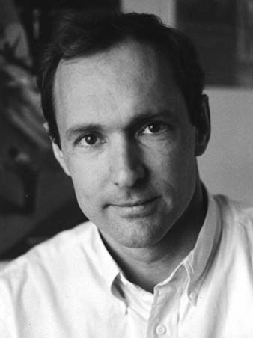
1980s/1990s HTML
Need for standardized language to separate format from content
HTML created by CERN scientist Tim Berners-Lee
Notes:
Before the creation of HTML, most “internet content” was just text based (or shared files). HTML is the format for most of the web pages that you see. While there are some other formats for displaying content on a web browser, HTML became the standard “language of choice”, largely because it’s non-proprietary, it’s easy to create, and it’s “small”. If you look at the size of some of the web pages we create using a simple text editor (and enter the <html> tags), you’ll see that the file size is much smaller than if you created the same content in something like a Word Processing application.

Slide 7
1990’s Mosaic/Netscape
First web browser (combined text & graphics)
Marc Andreessen – UI@Champaign-Urbana
NCSA
Netscape was the 1st commercial browser
Jim Clark (venture capitalist)
Notes:
Marc Andreessen is credited with leading a small group of graduate students at the University of Illinois @Champaign-Urbana to develop the first web browser – a software application which allowed web pages to show text and images. They made this software available for free, and students everywhere began downloading it onto their computers and using it to “surf the web”. Once Marc graduated and left his job at the NCSA (National Center for Supercomputing Applications), he joined with venture capitalist Jim Clark (Clark had the money, Andreessen the plan) to form Netscape. When Netscape went public (and had launched the first “commercial” web browser), it became a Billion $ company faster than any company in history.
Photo of Marc Andreessen – creator of the first “web browser”

