Slide 1
Hardware & Processor Pioneers
A primary on some of the key developments in computer technology from the 1930’s through the 1990’s
Notes:
NOTE: these are just a few of the key developments. If you get a chance, search Google and/or Wikipedia to learn more about computer history.

Slide 2
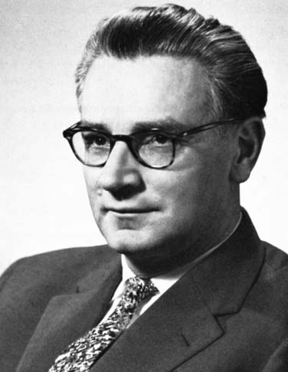
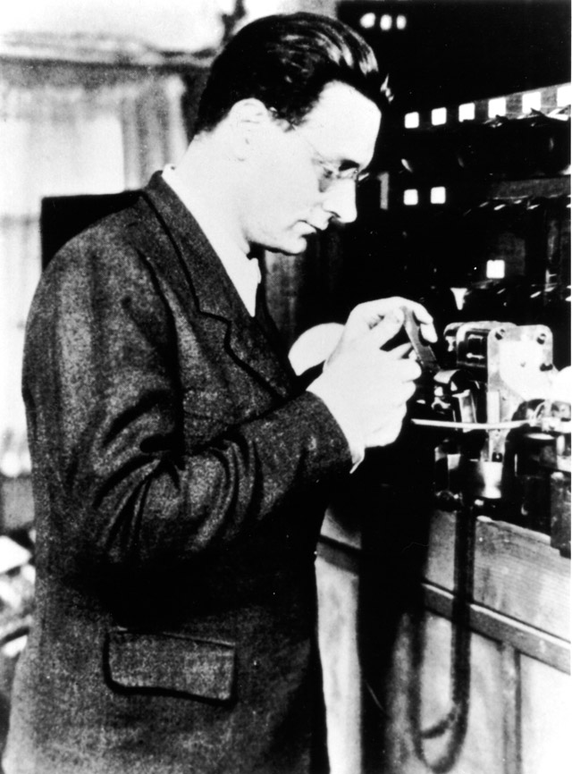
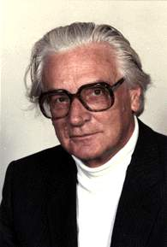
Notes:
Konrad Zuse, German computer pioneer, utilized binary design on computers during the 1930’s. Modern computers use this digital design (rather than analog devices – not to say analog devices aren’t useful, but most devices are now going “digital” – it makes sharing of information much easier).

Slide 3
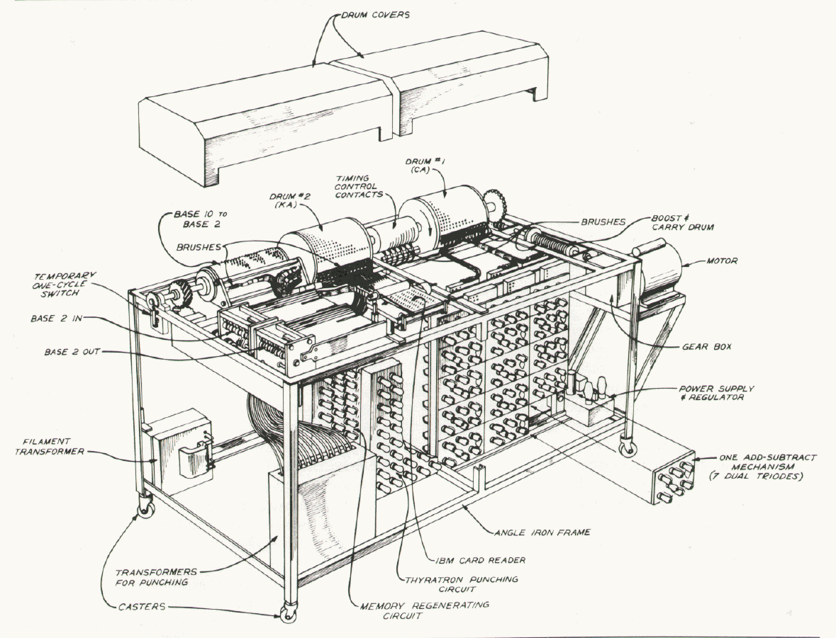
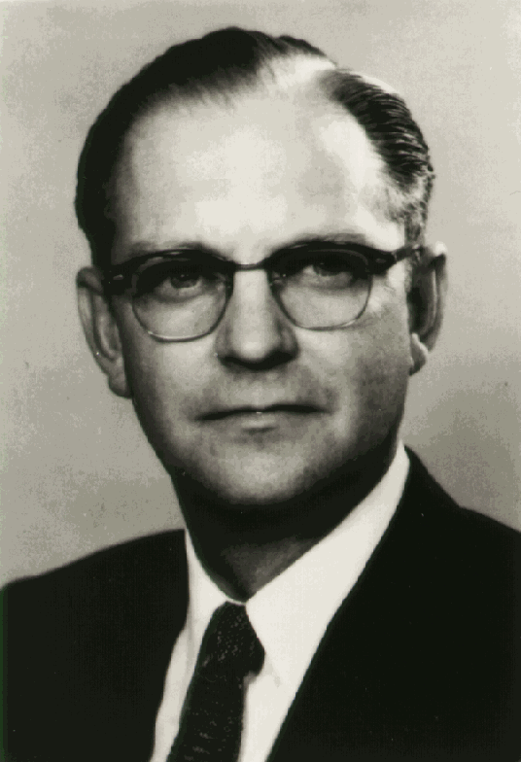
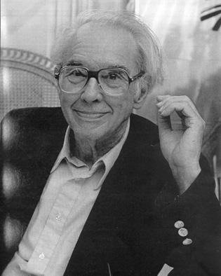
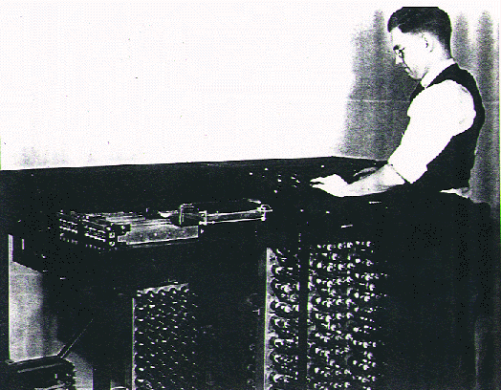
Notes:
John Atanasoff & Clifford Berry – created the ABC computer at Iowa State University, an early electronic computer (late 1930’s). Image at top shows main components of computer. L-R Atanasoff, Berry @ computer, Berry

Slide 4
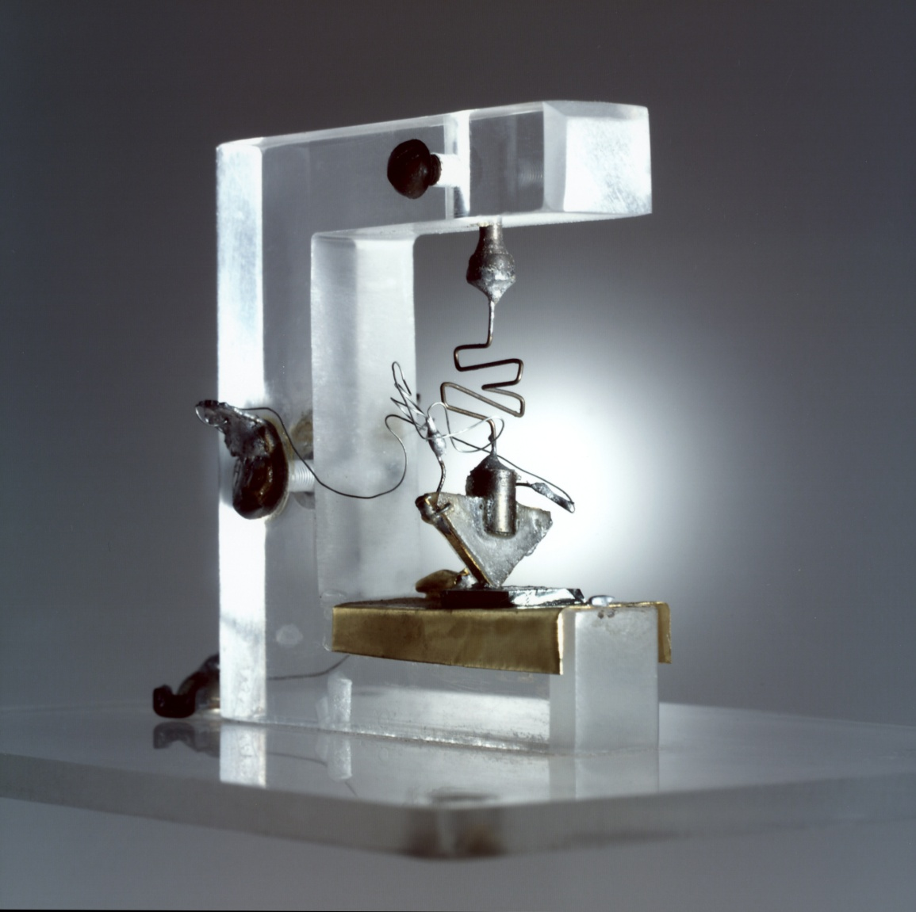
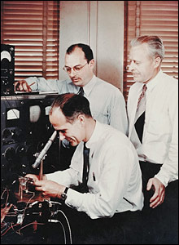
Notes:
William Shockley, John Bardeen and Walter Brattain, with a model of the 1st transistor. The transistor was created at the Bell Labs, the foremost commercial research lab at the time during the 1940’s. The Bell Labs were part of AT&T (American Telephone & Telegraph). The transistor led to much smaller, sturdier electronics, replacing the larger, more fragile, less durable vacuum tubes.

Slide 5
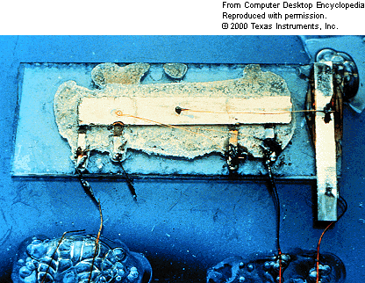
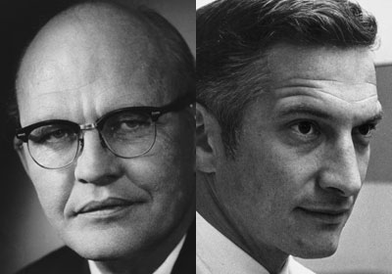
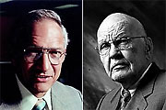
Notes:
Jack Kilby (TI) and Robert Noyce (Fairchild Semiconductor) – and Noyce & Kilby. Credited with creating/manufacturing the 1st integrated circuit. While transistors revolutionized electronics, they still had to be individually wired into circuits. Integrated circuits eliminated this need to assemble the components individually. While the first IC had the equivalent of less than 10 transistors, within 20 years, firms were manufacturing them with the equivalent of THOUSANDS of transistors.

Slide 6
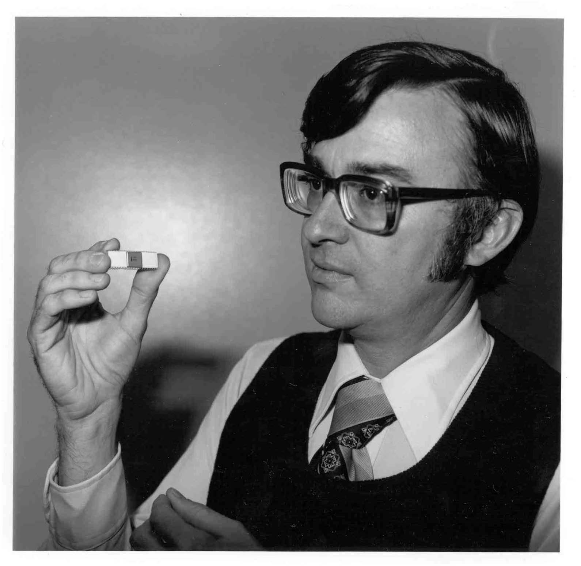
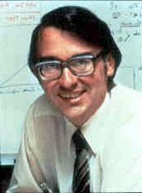
Notes:
Dr. Ted Hoff, credited with the 1st micro-processor. Hoff worked for Intel corporation, and built this “computer on a chip”, the Intel 4004 along with engineers Federico Faggin and Stan Mazor. Before this time, computers were built out of several components/chips. With the development of a single IC based micro-processor, consumer electronics designers were able to create cheap calculators, etc.

Slide 7
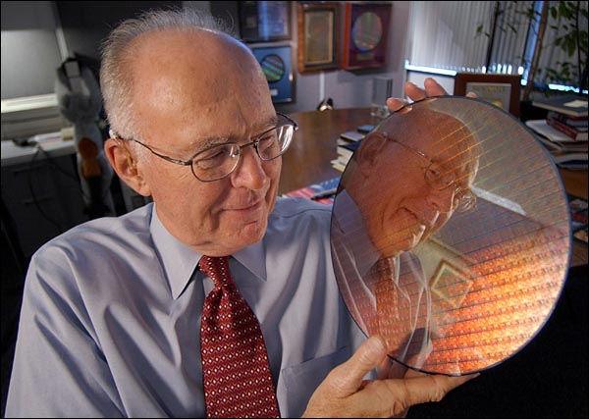
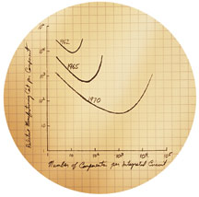
Notes:
Gordon Moore (co-founder of Intel) holding a silicon wafer – sketch of “Moore’s law” – Moore’s law demonstrated how the performance of microprocessors would increase, yet the cost would decrease; “power doubles every 18 months, and the cost goes down”.
Y axis = relative Mfg Cost per component, X axis = number of components per Integrated Circuit
Lines = 1962, 1965, 1970 technology Axis scaled 1, 10, 10^2, 10^3, 10^4, 10^5

