Slide 1
IT Systems architecture
An overview of information technology systems
Notes:
The Information Technology (IT) department in an organization is typically thought of as a “support” function; it supports the organization in accomplishing it’s tasks (as opposed to a “core” function, it which it does the primary task of the organization, such as manufacturing, or selling. A CIO (Chief Information Officer) or CTO (Chief Technology Officer) often heads up this department. Ultimately, the CIO/CTO is responsible for all the IT systems in the organization, and this set of slides looks at the main components & resources the CIO/CTO has to manage.

Slide 2
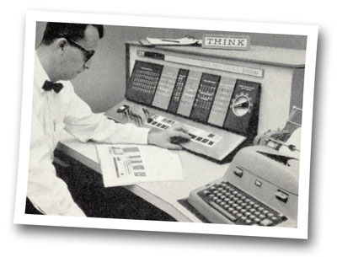
Evolution of IT Department
Data Processing (DP)
Electronic Data Processing (EDP)
Management Information Systems (MIS)
Information Systems (IS)
Information Technology (IT)
Notes:
Computer departments didn’t really materialize until there were actual computers in businesses/organizations, which started to happen in the 1950s. Early systems typically performed accounting/payroll functions, hence the computers were often housed in these areas. Once the computerization of organizations began to take hold in the 1950s and 1960s, separate departments were formed. The DP (Data Processing) department was one early name.
This image is from a 1963 journal, showing a system engineer monitoring an IBM computer. Notice the word “Think” above the computer; this was a trademark of Thomas J. Watson Sr., a CEO of the IBM corporation. http://en.wikipedia.org/wiki/Think_(IBM)

Slide 3
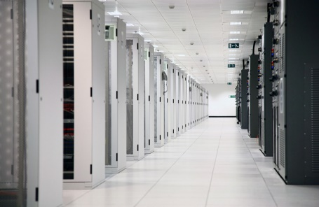
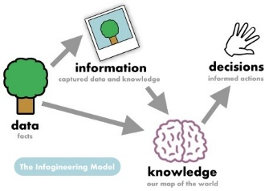
Components of IT systems
Hardware/Software
Data/Information
People/Procedures
Notes:
One approach to thinking about what it is that makes up an IT system, is to group it into the main components. The CIO/CTO will typically manage/work with 3 basic resources:
The computer system/network itself, all the hardware and software
The storage/maintenance of data to it’s transformation into information
The people within and outside the IT department, and the procedures used to keep the system(s) running

Slide 4
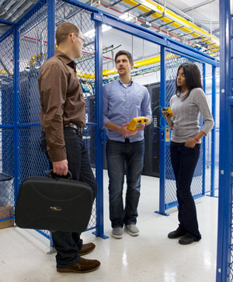
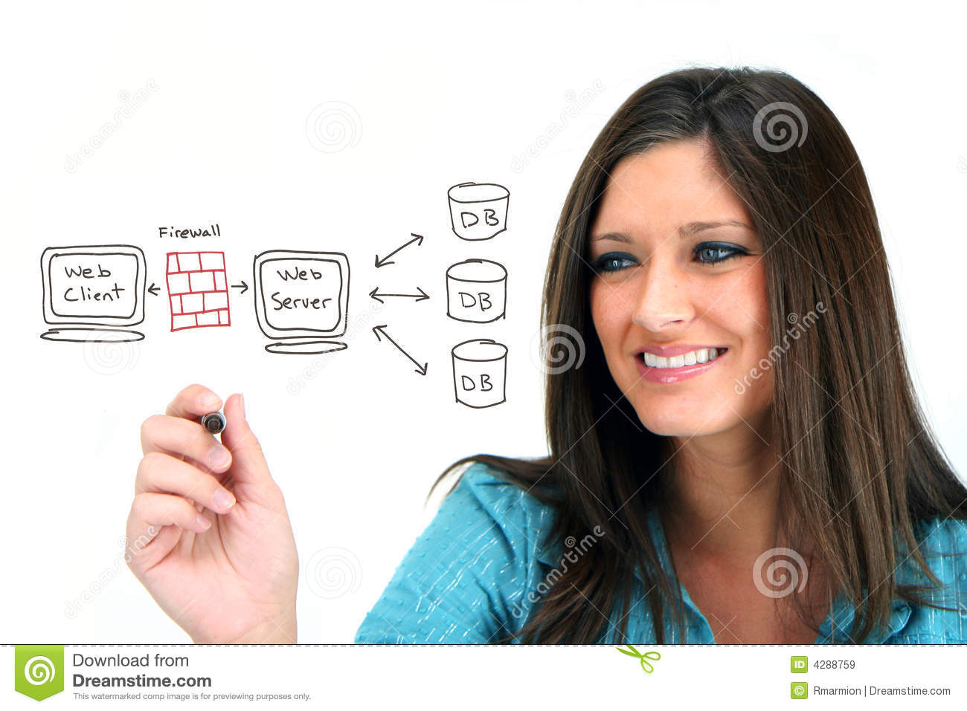
Hardware and Software
Hardware
Systems engineers
Network engineers
Software
Programmers
Database analysts
Notes:
The hardware and software is what people typically think of when they talk about computers. And this is typically how departments are split; the hardware staff either design the components/network and keep the equipment running, and the software side develops the applications, and keep the data organized.

Slide 5
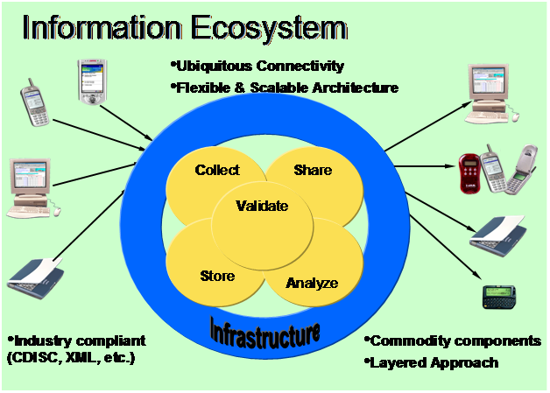
Data to Information
Data cleansing
Data validation
Data availability
Summarization
Applications
Notes:
The IT department is responsible for the storage & maintenance of the organization’s data. It’s a long process to ensure that the data is valid, available, and retained as required by law & by organizational standards.
The IT systems use this data as input, and it is transformed into information via the applications.

Slide 6
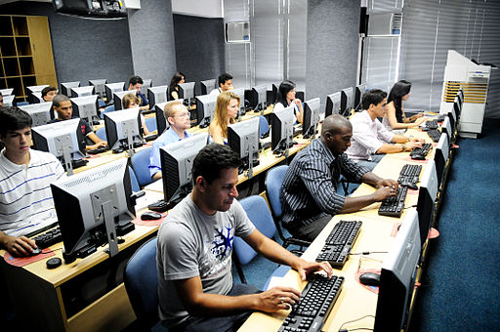
People and Procedures
Users
IT Staff
Training
Operations
Notes:
There are two main groups of people, the IT staff, and those outside the department (the users). The User community includes those people that run the systems, use the systems, managers that request systems, etc.
The IT staff includes management (CIT/CTO), and typically the hardware group and the software group.

