Slide 1
Windows File Structure
Storing data on your computer & network
Notes:
Year after year, one of the most basic concepts of working with computers is understanding how to save files, and how to locate them. This set up slides hopes to reduce some of the “mystery” of saving & retrieving files

Slide 2
Storage devices
Hardware
Hard drive
Flash drive
Tape
File server (HD)
SAN
NAS
Software
System software
Windows
Mac
Linux
Notes:
The concept of storing files is the same on any computer – the file consists of the data itself, plus the “metadata”, the “data about the data”. This information needs to be stored on a physical device – somehow a series of 1’s and 0’s are written onto a disk or tape.
The problem is, a human has a hard time understanding the physical aspect of the file, so a “logical reference” to this data is created. It’s these “logical references” that we know better as the file name.

Slide 3
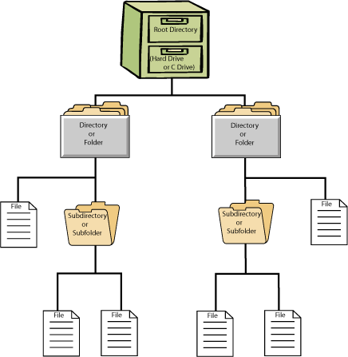
Full Path name
Drive
Directory
File Name
File Type
Notes:
On a Microsoft Windows system, we store files using a “full path name”, meaning you describe the file in terms of it’s logical location, the name of the particular file, and the type of file that it is.
Each “drive” is “mapped” to a physical device, e.g. on older Windows systems, the “A:” drive was the main floppy disk drive, “B:” a second floppy drive, and the “C:” drive the hard drive.
The “directory” is often called a “folder” or “sub-directory” or “sub-folder”
The “file type” is also called a “file extension”

Slide 4
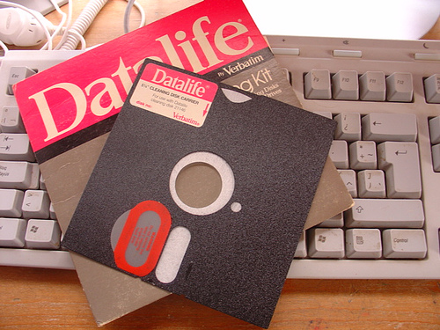
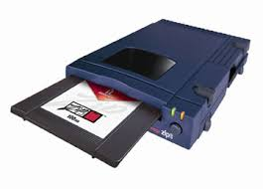
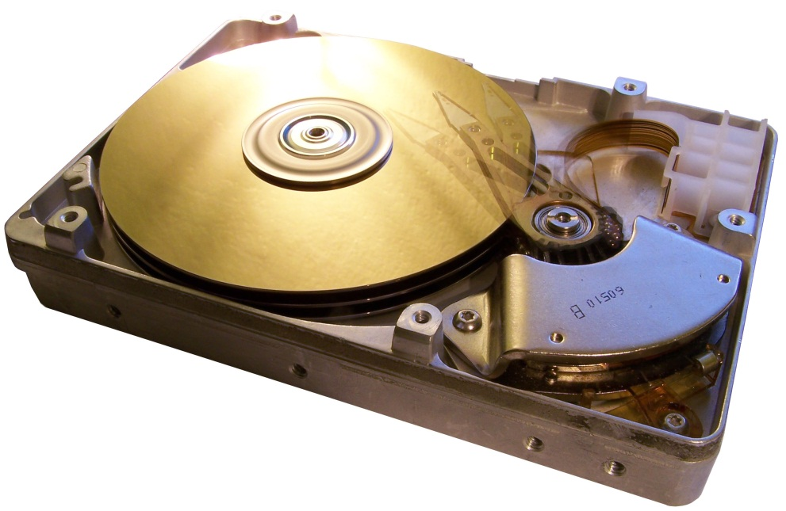
Drives
A:
B:
C:
D:
E:
F: - Z:
I:\myweb
Notes:
As mentioned on the prior slide, drive mappings often go back to the original IBM PC/MS DOS systems in use during the 1980’s. The earliest of systems had one or two 5 ¼” 360KB floppy disk drives, and these were mapped to the A: and B: drives respectively. When PC hard drives were first introduced, these 20MB devices were mapped to the C: drive.
D: and E: drives typically didn’t appear until the 1990’s, as these were assigned to various “optical” and/or “external” storage systems such as CD-ROM, Iomega Zip drives, and later DVD drives
F: - Z: drives were typically mapped to networked storage – a way to share data (and share storage resources) on a LAN
The I: drive at Loras is a “shared storage space”, and the “myweb” folder is connected to a web server to server .html files.

Slide 5
File names, types, associations
File names
Original 8.3 system
256 chars
Wild card chars
File type/extension
MS Office
.docx
.xlsx
.pptx
Web
.html
.css
.js
Notes:
In early systems (MS FAT systems), users were limited to 8 characters for the file name, and 3 characters for the file type, these being separated by a period (.). This is why it’s best NOT to use periods in file names, because the computer may “associate” the next 3 characters following the period as the file type/extension.
MS Windows tries to “associate” application programs with specific file types; generally this works (e.g. you double click on a file, and it “opens” in the correct application), however, sometimes these associations get “messed up” (e.g. a user just renames a file with a new file type/extension thinking this will change the file correctly, but it DOESN’T). That’s why it is best to start the application, then click File, Open, and browse to where you stored the file.

Slide 6
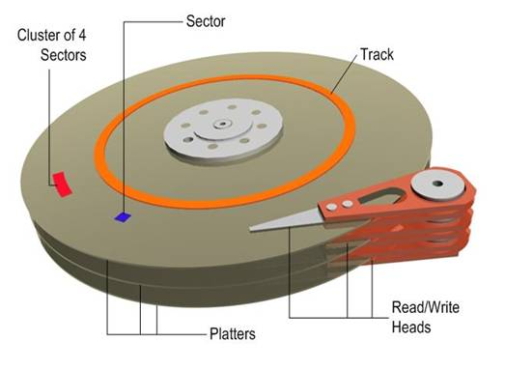
Physically storing the file
Drive
Surface
Track
Segment
Block
Fragmentation
De-fragmentation
Notes:
When files are stored on a hard drive, they are “written magnetically” onto the recording surface of the disk. The operating system has software that does this for us – it figures out which physical drive to store the file on, the particular disk surface, the “track” on the disk surface, and the particular location on this track.
Files are “allocated” so much space on a drive. If they don’t use all that space, it is “wasted”, hence best not to make too many small/undersized files. If the file exceeds this space, it is written to another area on the disk drive, hence the file becomes “fragmented”.
Excessive problems with either one of these cases can lead to poor disk performance (your computer seems “slow”), so running a “de-fragmentation” utility can help to fix this.

Slide 7
Key terms
Drive
(drive) Mapping
Root (directory)
Directory
Folder
Sub-Directory
File Name
File Type
File Extension
A:
B:
C:
D:
E:
F:-Z:
I:\myweb
Notes:
Don’t worry if you don’t get all of these terms down pat right away, because we’ll look at them a number of times, however, here are a few key ones that you should start getting familiar with.

