Slide 1
Retail Survey for University Avenue
Julie Kemp, Trevor Chicoine
Anthony Egging, Kyle Schaffer

Slide 2
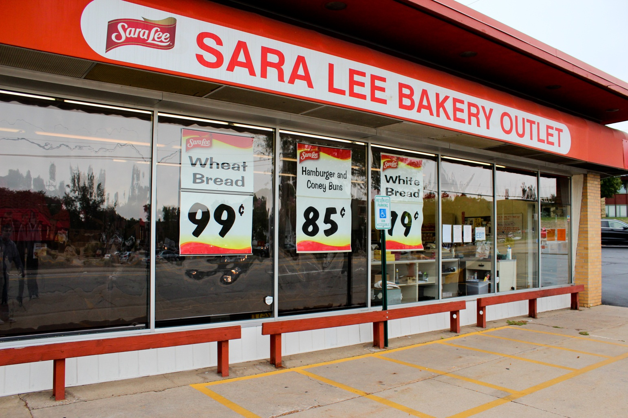
Sara Lee Bakery Outlet
2197 University Avenue
Notes:
The store is designed to attract college students. The store is located diagonally across from University of Dubuque.
The first impression of the store is simple. The store gets their point, low prices, across and allows a sneak peek into their store.
After entering the store you are able to see the full inventory of the store.
The 3 best elements are as follows: deals displayed in the window, easy to navigate the store, low prices
3 worst elements: limited parking, limited hours, items sold close to expiration date.
I would improve the store by offering better parking.

Slide 3
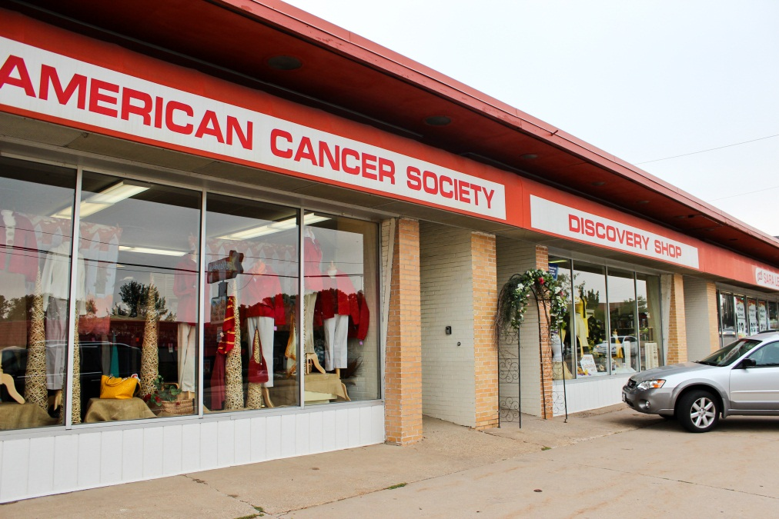
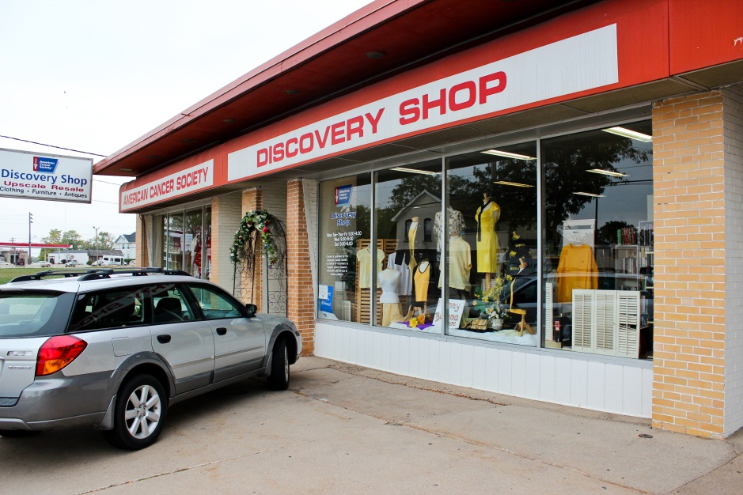
American Cancer Society Discovery Shop
2197 Univeristy ave.
Notes:
The store is designed to appeal to the general public and those that want to help the American Cancer Society.
The first impression of the store is that it has nice clothing because of the way they display them in the windows.
The proceeds from the sales of the donated clothing goes to the research of the American Cancer Society. The store offers a wide range of things at decent prices.
3 best elements: Great window displays, low prices, wide selection
3 bad elements: terrible parking, limited hours, displays don’t show enough variety
If I were to improve it I would put more variety in the window and better advertise hours.

Slide 4
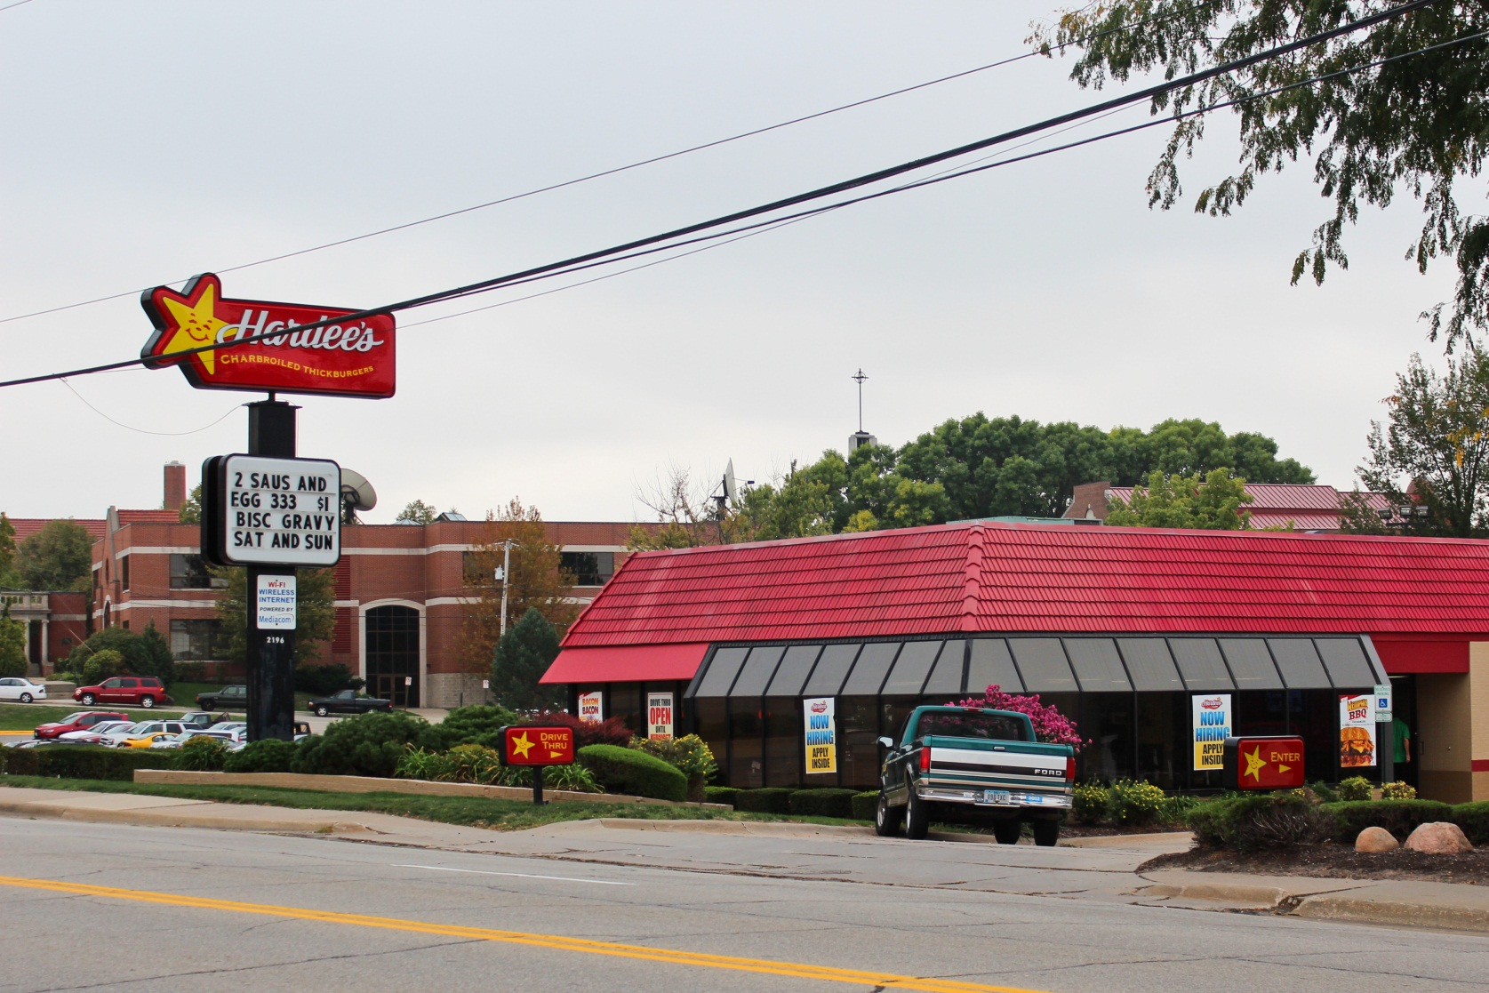
Hardees
2196 University Ave
Notes:
The store is appealing to the general public.
The first impression of the store is fast food.
After inspecting you see that they offer deals for college students.
3 best elements: good parking, good college deals, good location
3 bad elements: The restaurant isn’t very clean, not very healthy choice of food, difficult to leave when there is a lot of traffic
Make the entrance and exit of the parking lot easier to navigate.

Slide 5
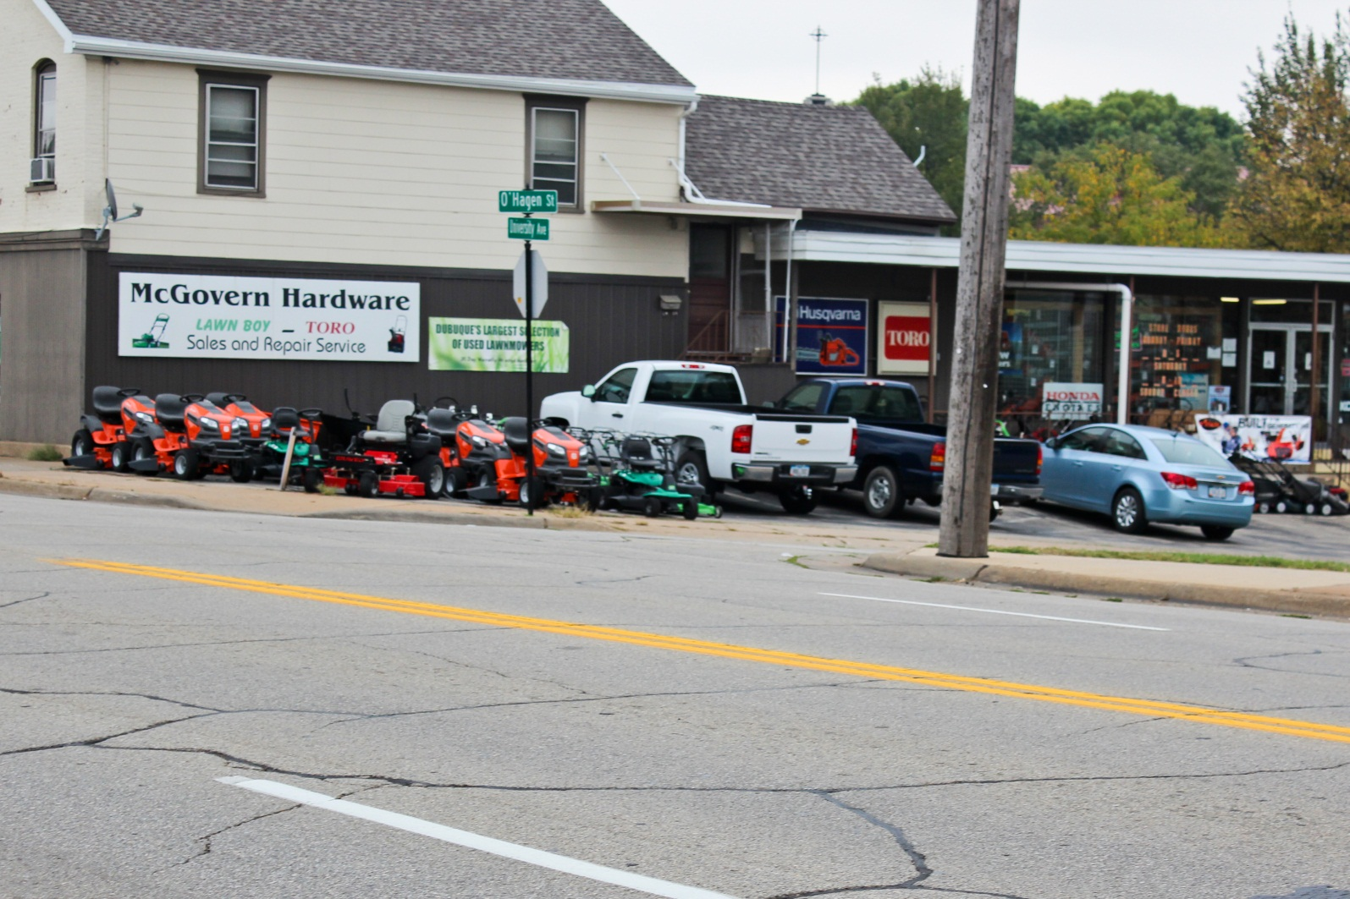
McGovern Hardware
2220 University Avenue
Notes:
The store is set to appeal middle class males. The display outside is quite helpful when wanting to browse the machinery in person rather than online.
Busy, the machinery makes the parking lot look like a lot of traffic.
Upon entrance of the store you see hand tools, smaller machinery, and other equipment.
3 good elements: nicely displayed products, easy to get to, decent parking
3 bad elements: narrow market, the store front is not on the main drive so it’s not as promoted, high prices
I would improve the store by moving the store to the front of the block to better display the products

Slide 6
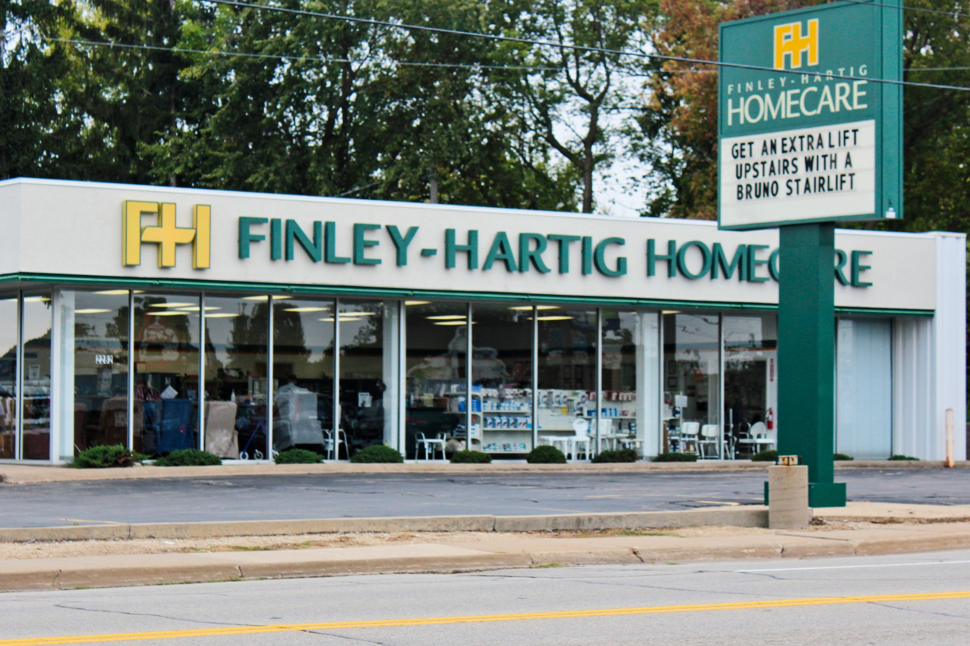
Finley-Hartig Homecare
2282 University avenue
Notes:
The store attracts those seeking specialty products for their homes.
My first impression of the store was made by their sign, so I thought it was for individuals with disabilities/injured people.
After going in it seems to be a store set to sell products that make everyday tasks easier.
3 good elements: Sign that attracts attention, good window display, ideal parking
3 bad elements: pricey, can’t enter from University Ave, hours not posted very well.
I would improve entrance to the parking lot.

Slide 7
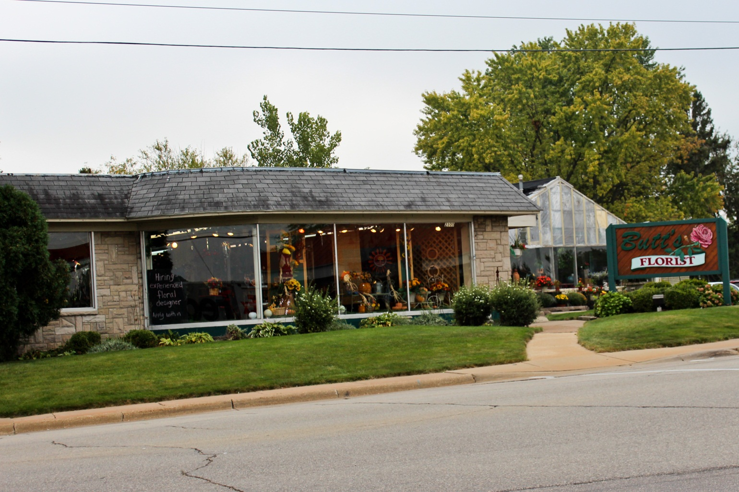
Butt’s Florist
2300 University avenue
Notes:
The store is targeting any/everyone
The first impression is a positive one.
The store is filled with nice displays and great deals on flowers
3 good elements: great window display, easy parking, easy entrance to lot and store itself
3 bad elements: poor weekend hours, cramped interior, low lighting
I would open the store up a little and have more space to walk around

Slide 8
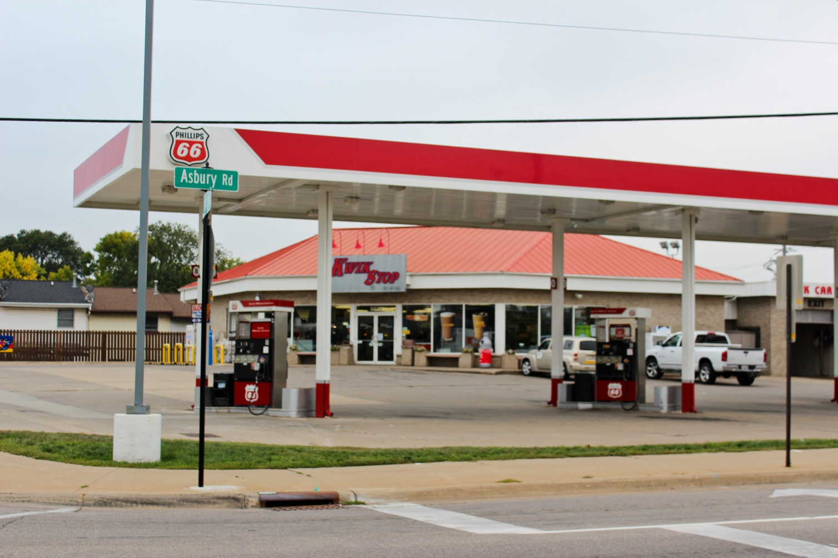
Kwik Stop
2335 University Avenue
Notes:
The store is targeting everyone
My first impression is that it’s a convenience store.
It is a standard convenience store
3 good elements: plenty of parking, free air for tires, good location for store
3 bad elements: gas pumps are not easy to exit from when the parking lot is busy, difficult to enter and exit the lot when there is a lot of traffic, higher prices on goods
I would make the pumps more accessible.

Slide 9
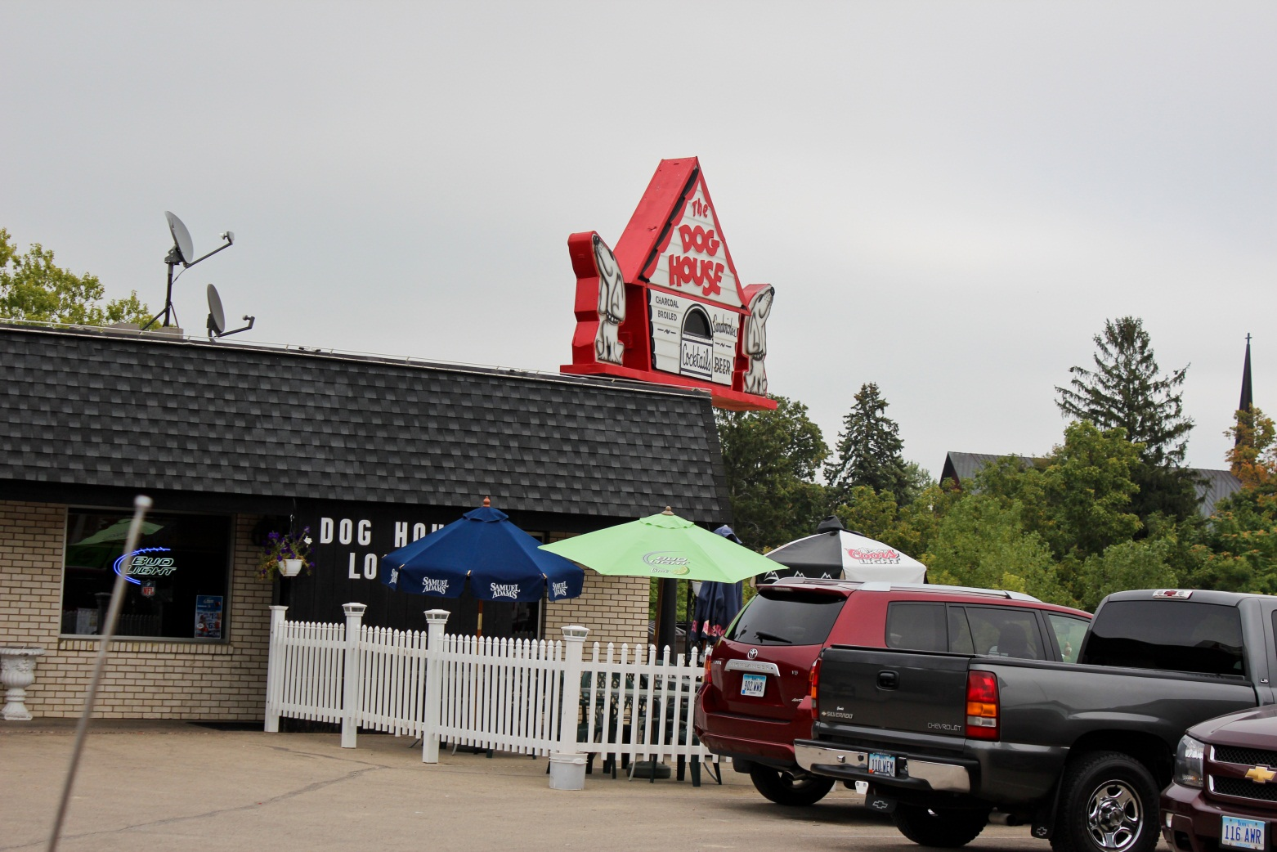
The dog house
1646 asbury road
Notes:
Targeting adults 21+
First impression is that it is a fun environment because of their sign
3 good elements: ideal placement (corner of the street), easy parking, very easy to find
3 bad elements: parking lot is a little cluttered, the outdoor seating is kind of shady with the mismatching umbrellas, hours aren’t really posted.
I would get a bigger parking lot, make the outdoor area better, and open the building up.

Slide 10
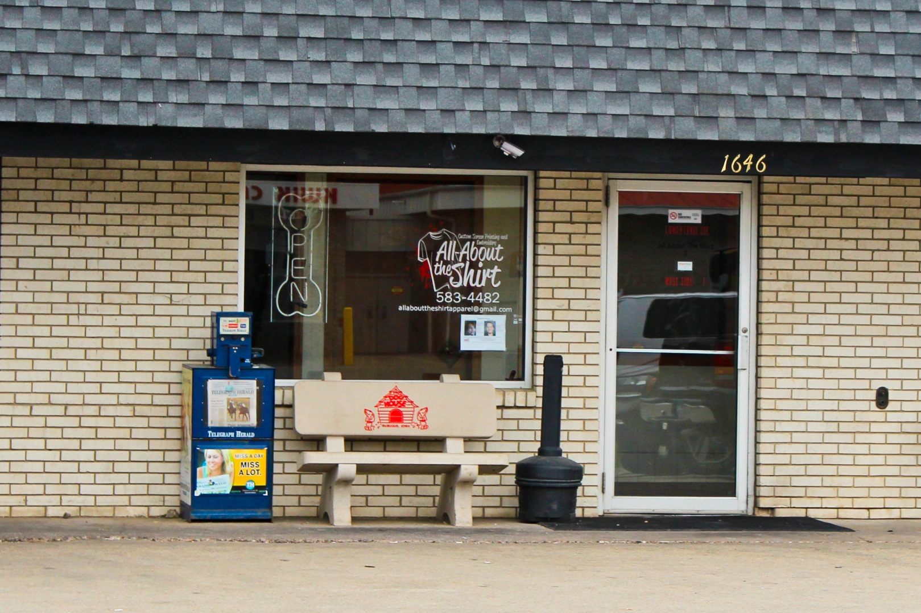
All about the shirt
1646 asbury road
Notes:
Not sure who they are targeting
My first impression is “Where is the store???”
You learn that the store is very small and a very small operation
3 good elements: good location between a donut store and bar, good parking, cool logo
3 bad elements: not a very good store, poor signs, overall not a great location to have a store like this.
I would move it to it’s own building to show displays of what they can offer

Slide 11
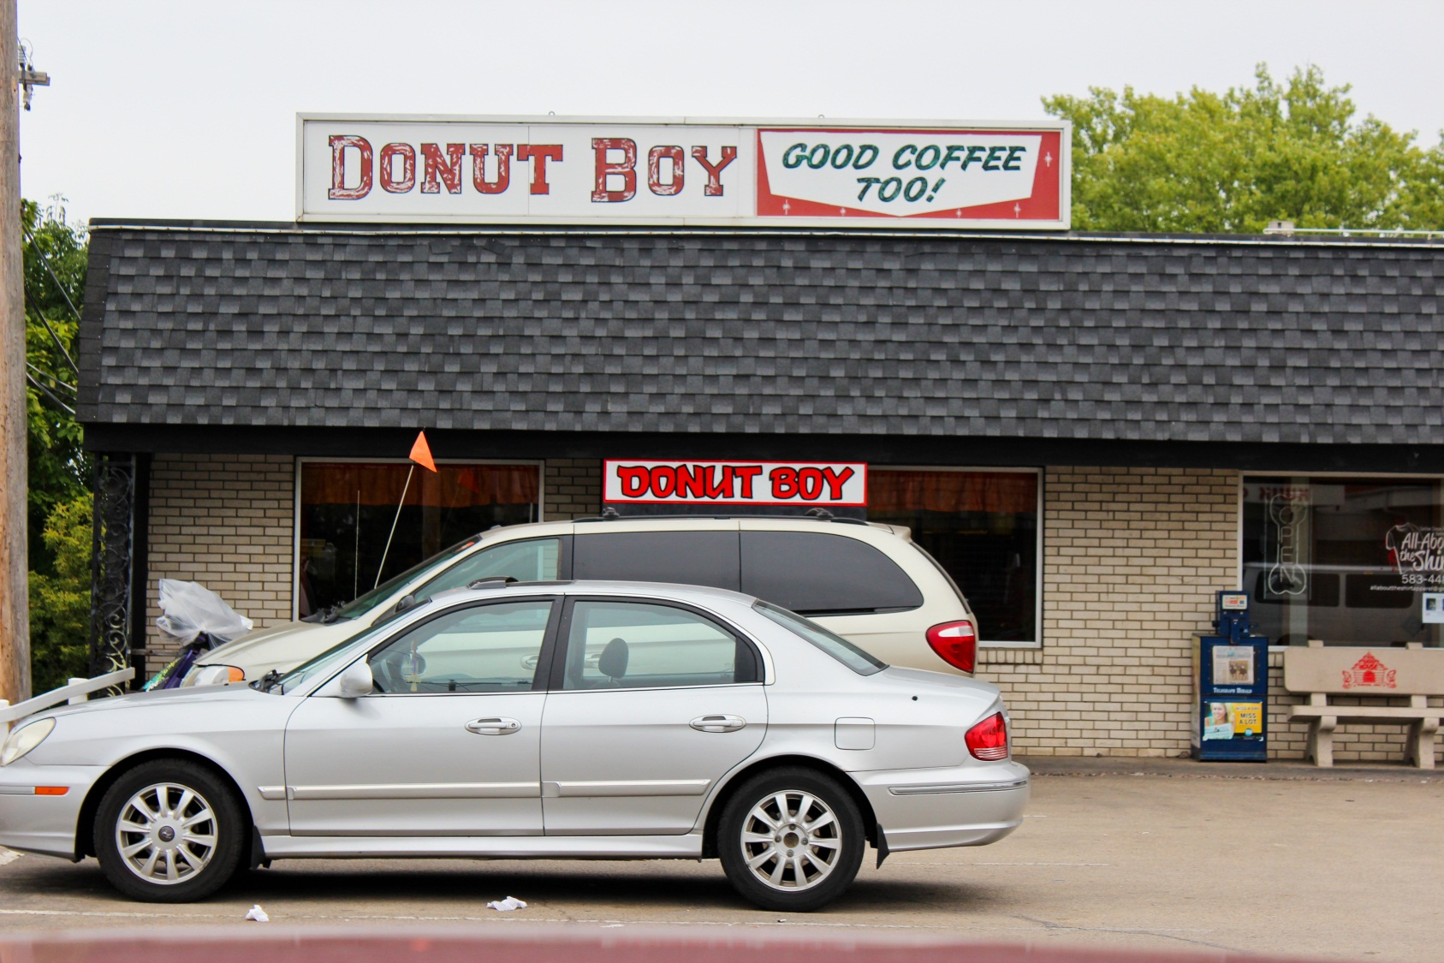
Donut boy
1646 asbury road
Notes:
Targeting everyone
My first impression is the smell of donuts, YUM!
After walking in you see a wide variety of options
3 good elements: easy to find, delicious smell, decent parking
3 bad elements: limited hours, strange entrance, interior is very old
I would update the seating and use better display cases inside

Slide 12
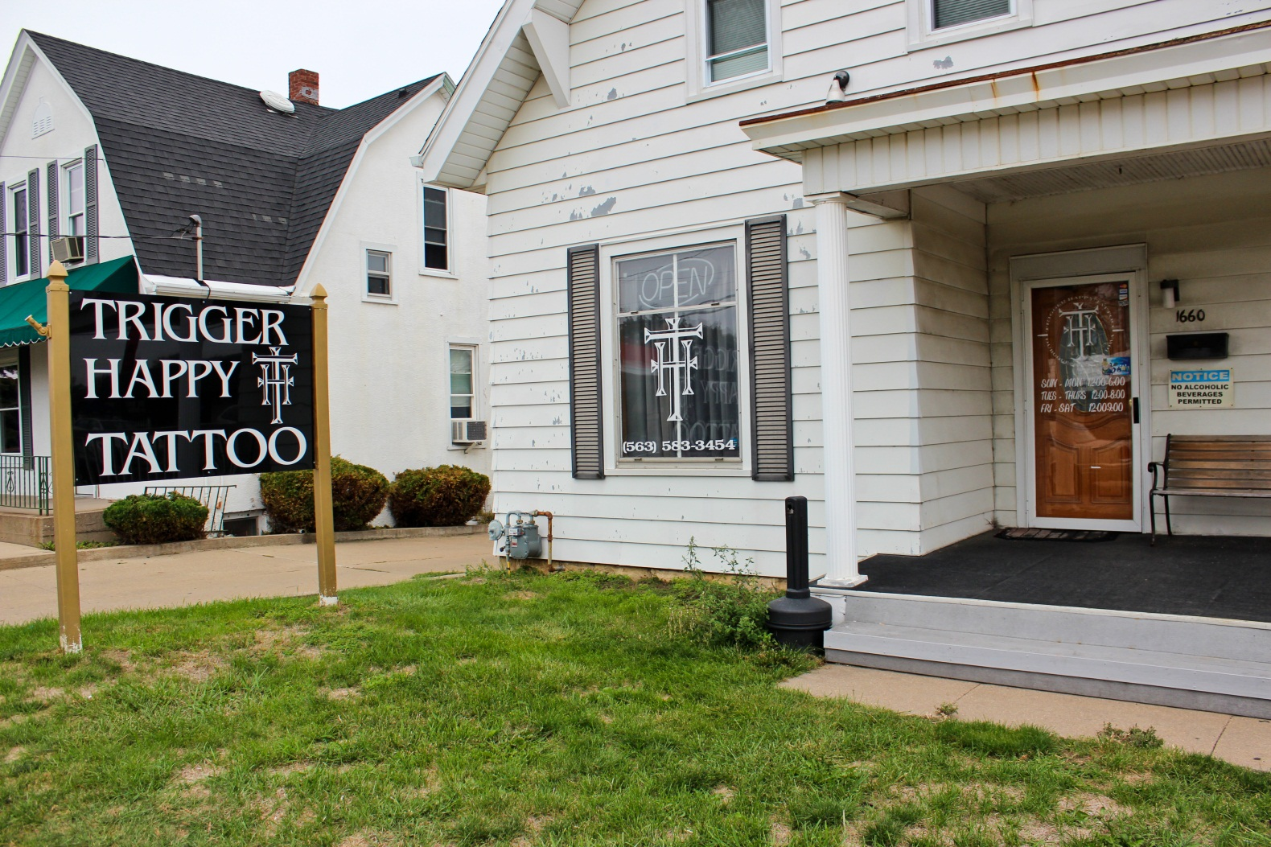
Trigger happy tattoo
1660 asbury road
Notes:
Targeting those wanting to get a tattoo
My first impression is that this is a shady operation. The house is kind of run down and not very inviting.
3 good elements: easy to see sign, hours posted on the front door, easy to find
3 bad elements: can’t see into the business, the house is completely closed up, the house is run down
The house needs to be updated in a big way on the outside to make it more inviting

Slide 13
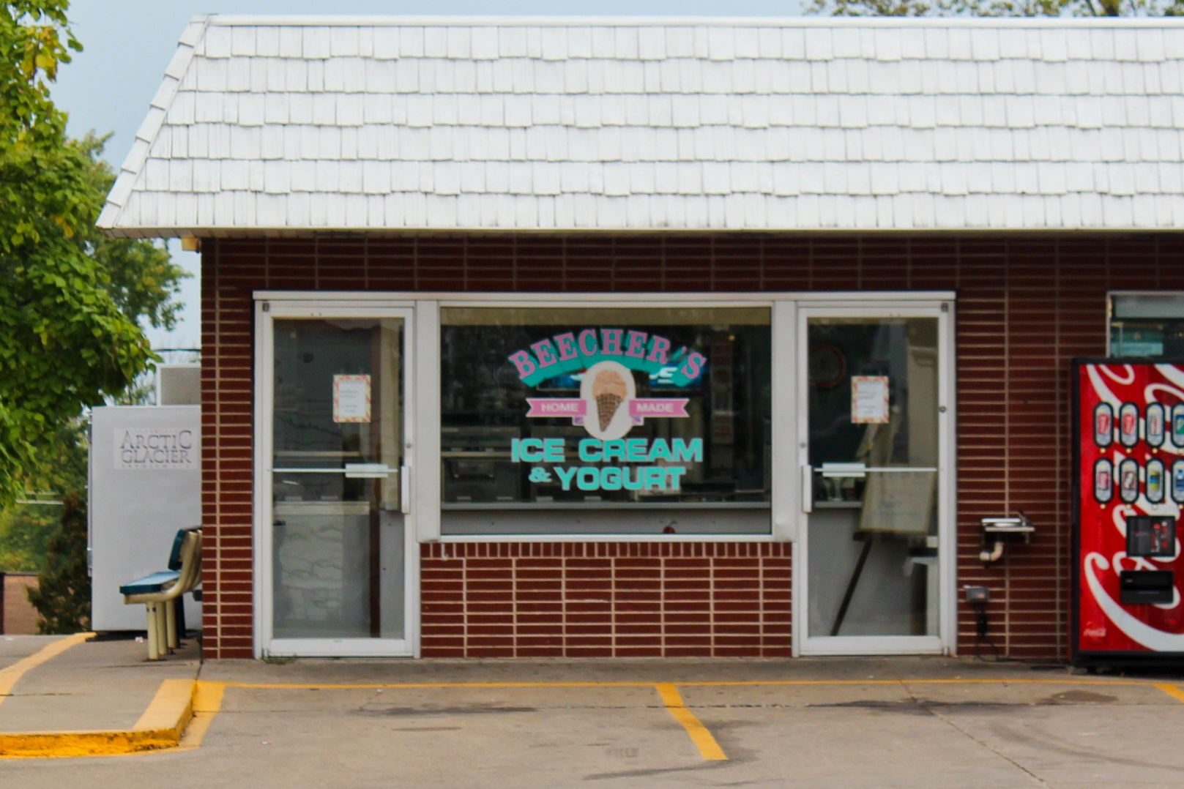
Beecher’s
1691 asbury road
Notes:
Targets everyone
My first impression is that it is inviting
You learn that it is a small business that is geared towards the local community.
3 good elements: friendly staff, great display, easy to find
3 bad elements: very small, not open year round, they don’t accept credit cards
I would update payment methods to accommodate cards

Slide 14
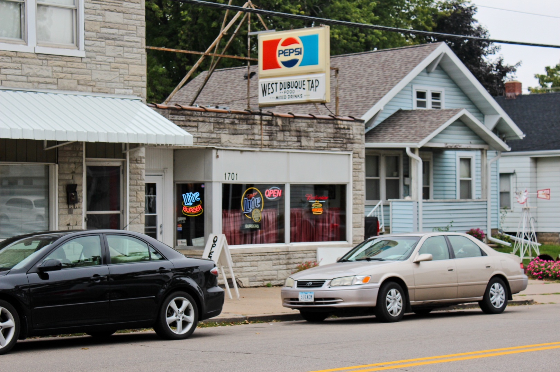
West Dubuque Tap
1701 asbury road
Notes:
The store is targeting older people.
The first impression is that it is run down because the exterior looks old
If you can’t tell by the name, walking into the store lets you know it’s a bar
3 good elements: not easy to park so it makes driving difficult, on a main road, they have a big sign
3 bad elements: odd placement for a bar, not easy to find, looks shady
I would make the windows a little bigger and let in the natural lighting. Make the entrance more noticeable.

