Slide 1
University Avenue

Slide 5
Happy Joes
Target market – Families
First Impression – Old Building, Huge Happy Joes Sign that is appealing
Inside – Pictures on walls, Televisions, good vibe
Best Elements – Great taste, Mix and match kinds of pizzas in one, Birthday parties
Worst Elements – Expensive, Inconvenient, Old building
Improvement – Lower prices

Slide 7
Indulgence Salon and Spa
Upscale, family oriented, but mainly women middle aged/older
Thought it was a furniture store, but after that thought it was very fancy
Fancy, relaxing, lots of space for different services such as hair cuts, waxing, massages, manicures, pedicures, nice waiting area, good atmosphere, classy lamps
3 best elements = great atmosphere, professional setup, size
3 worst elements= could not tell what it was from far away, big drapes, too dark to see in
Improve: make it clearer from afar and brighter
Notes:
Indulgence salon & spa
1044 university avenue
Upscale, family oriented, but mainly women middle aged/older
Thought it was a furniture store, but after that thought it was very fancy
Fancy, relaxing, lots of space for different services such as hair cuts, waxing, massages, manicures, pedicures, nice waiting area, good atmosphere, classy lamps
3 best elements = great atmosphere, professional setup, size
3 worst elements= could not tell what it was from far away, big drapes, too dark to see in
Improve: make it clearer from afar and brighter

Slide 8
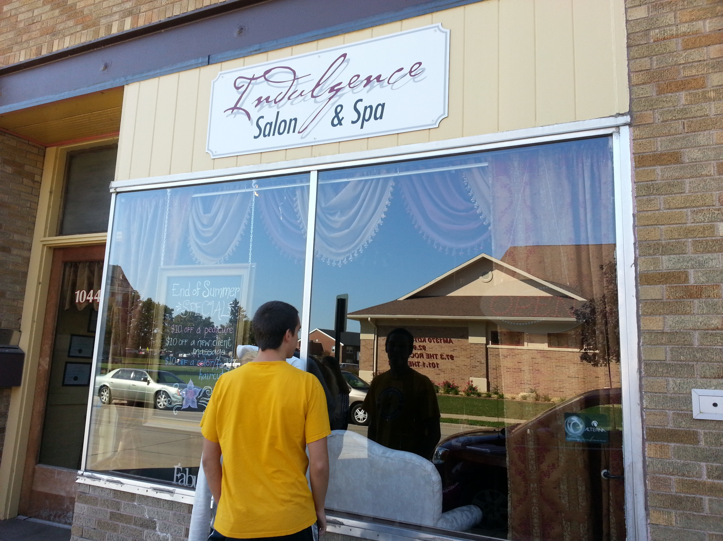

Slide 9
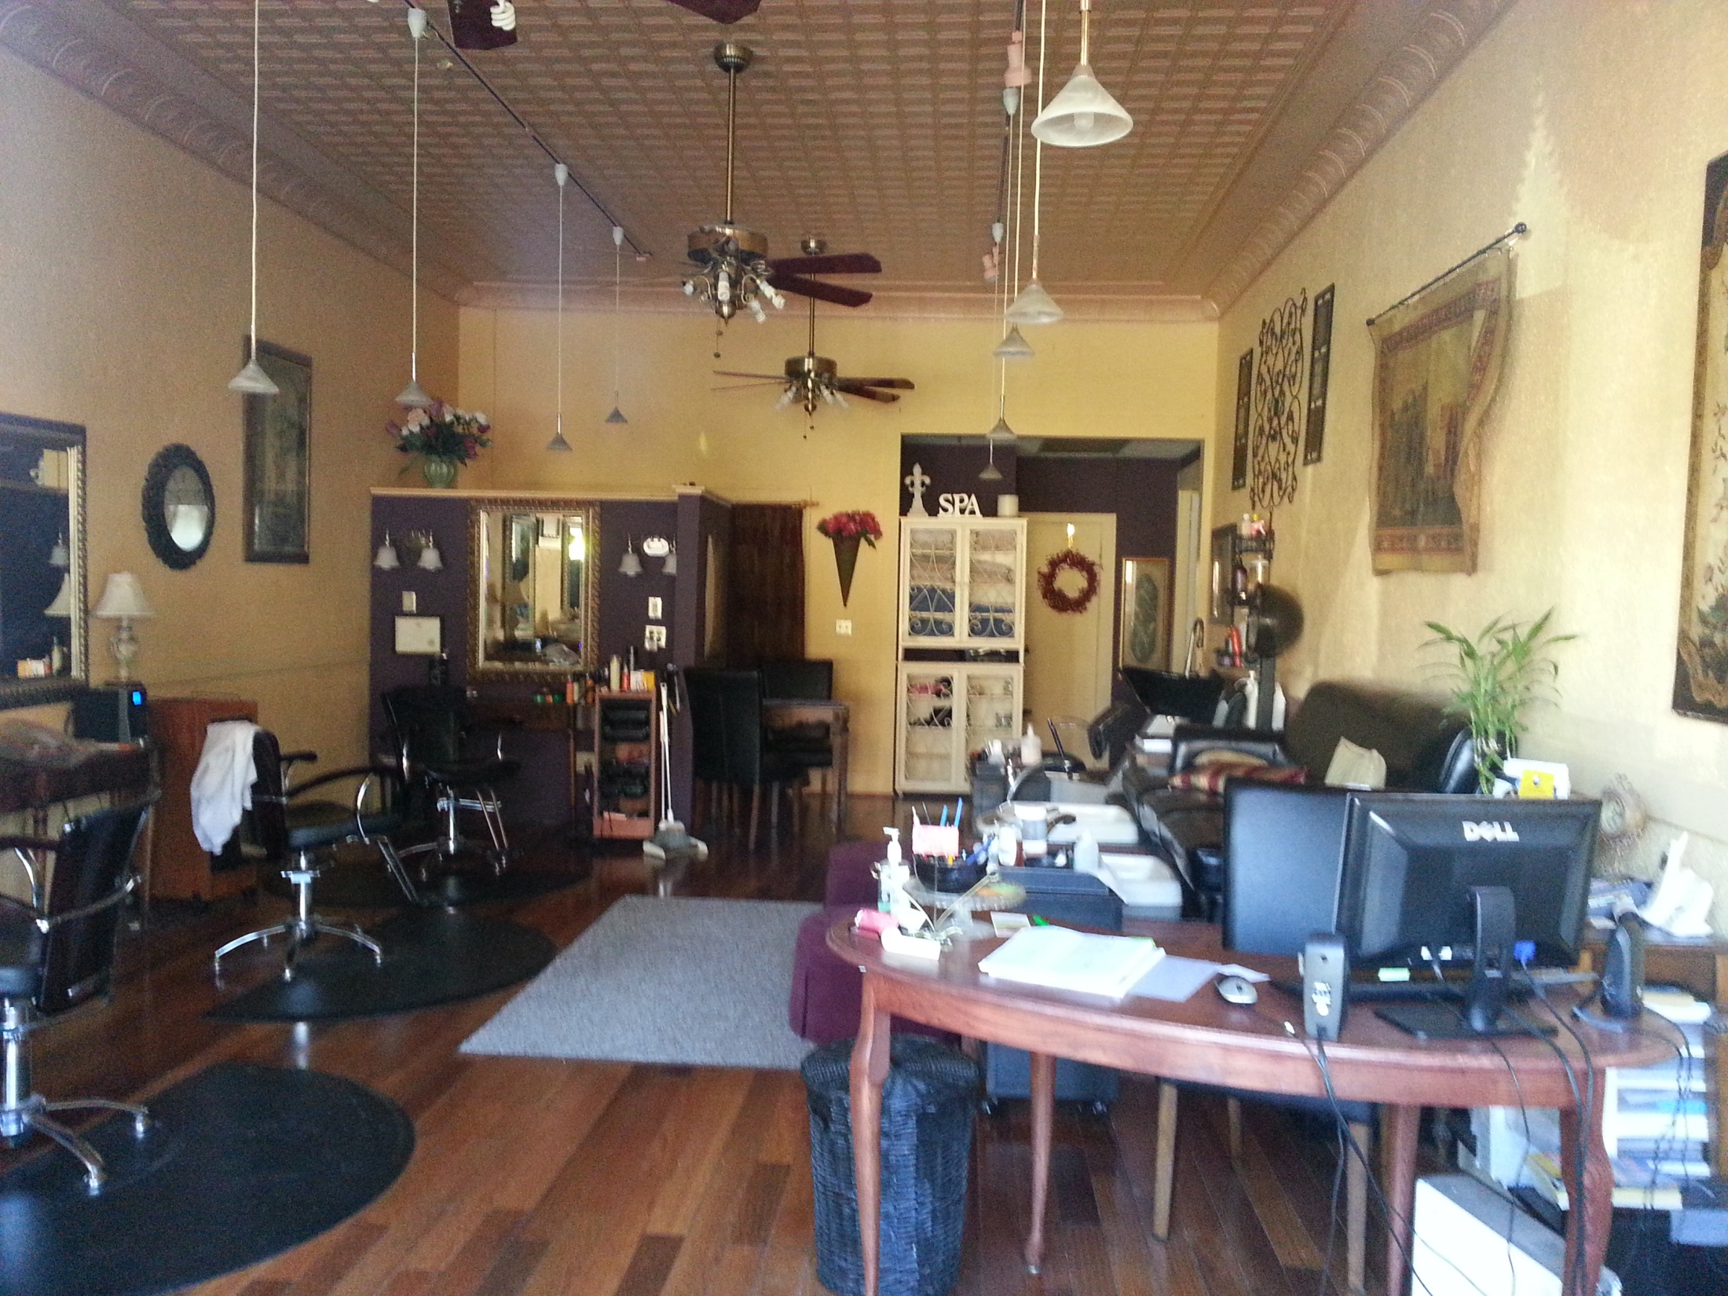

Slide 10
Asana
First impression: run down
Second impression: pretty nice, more impressed than exterior
Good and bad elements of window: open and can see inside, nothing in the window
Improve on the windows and exterior in general to attract people

Slide 11
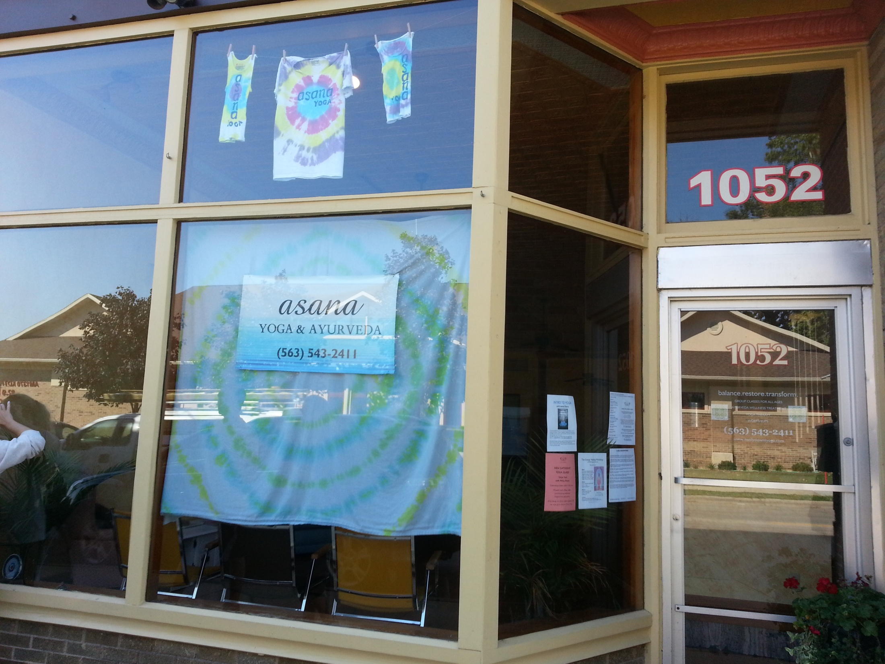

Slide 12
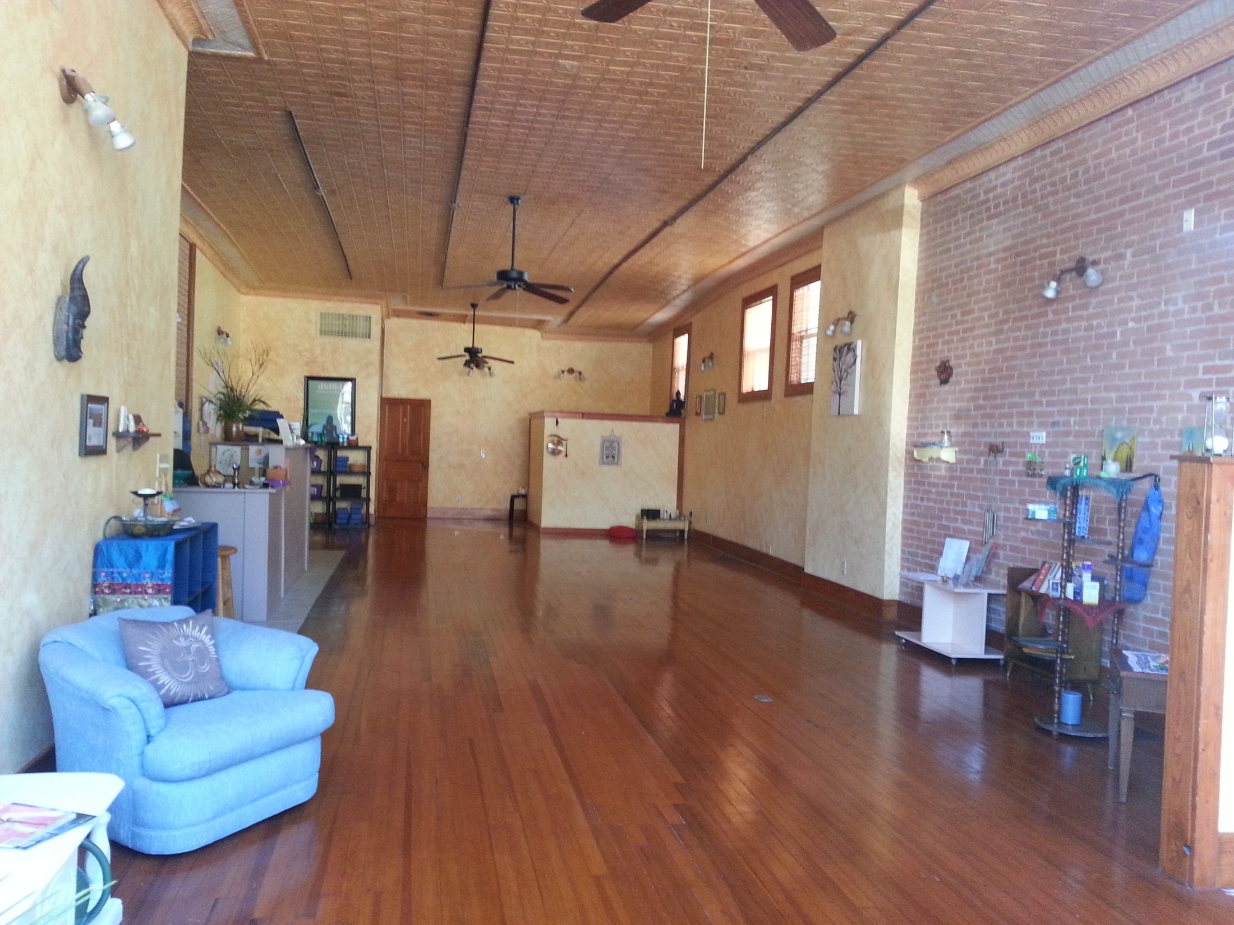

Slide 13
Reality Check
Extreme Sporting (Skateboarding, snowboarding, related fashions)
Very bland sign
Bland exterior
Nice interior
Well placed products made the design work
Improve exterior especially the sign

Slide 14
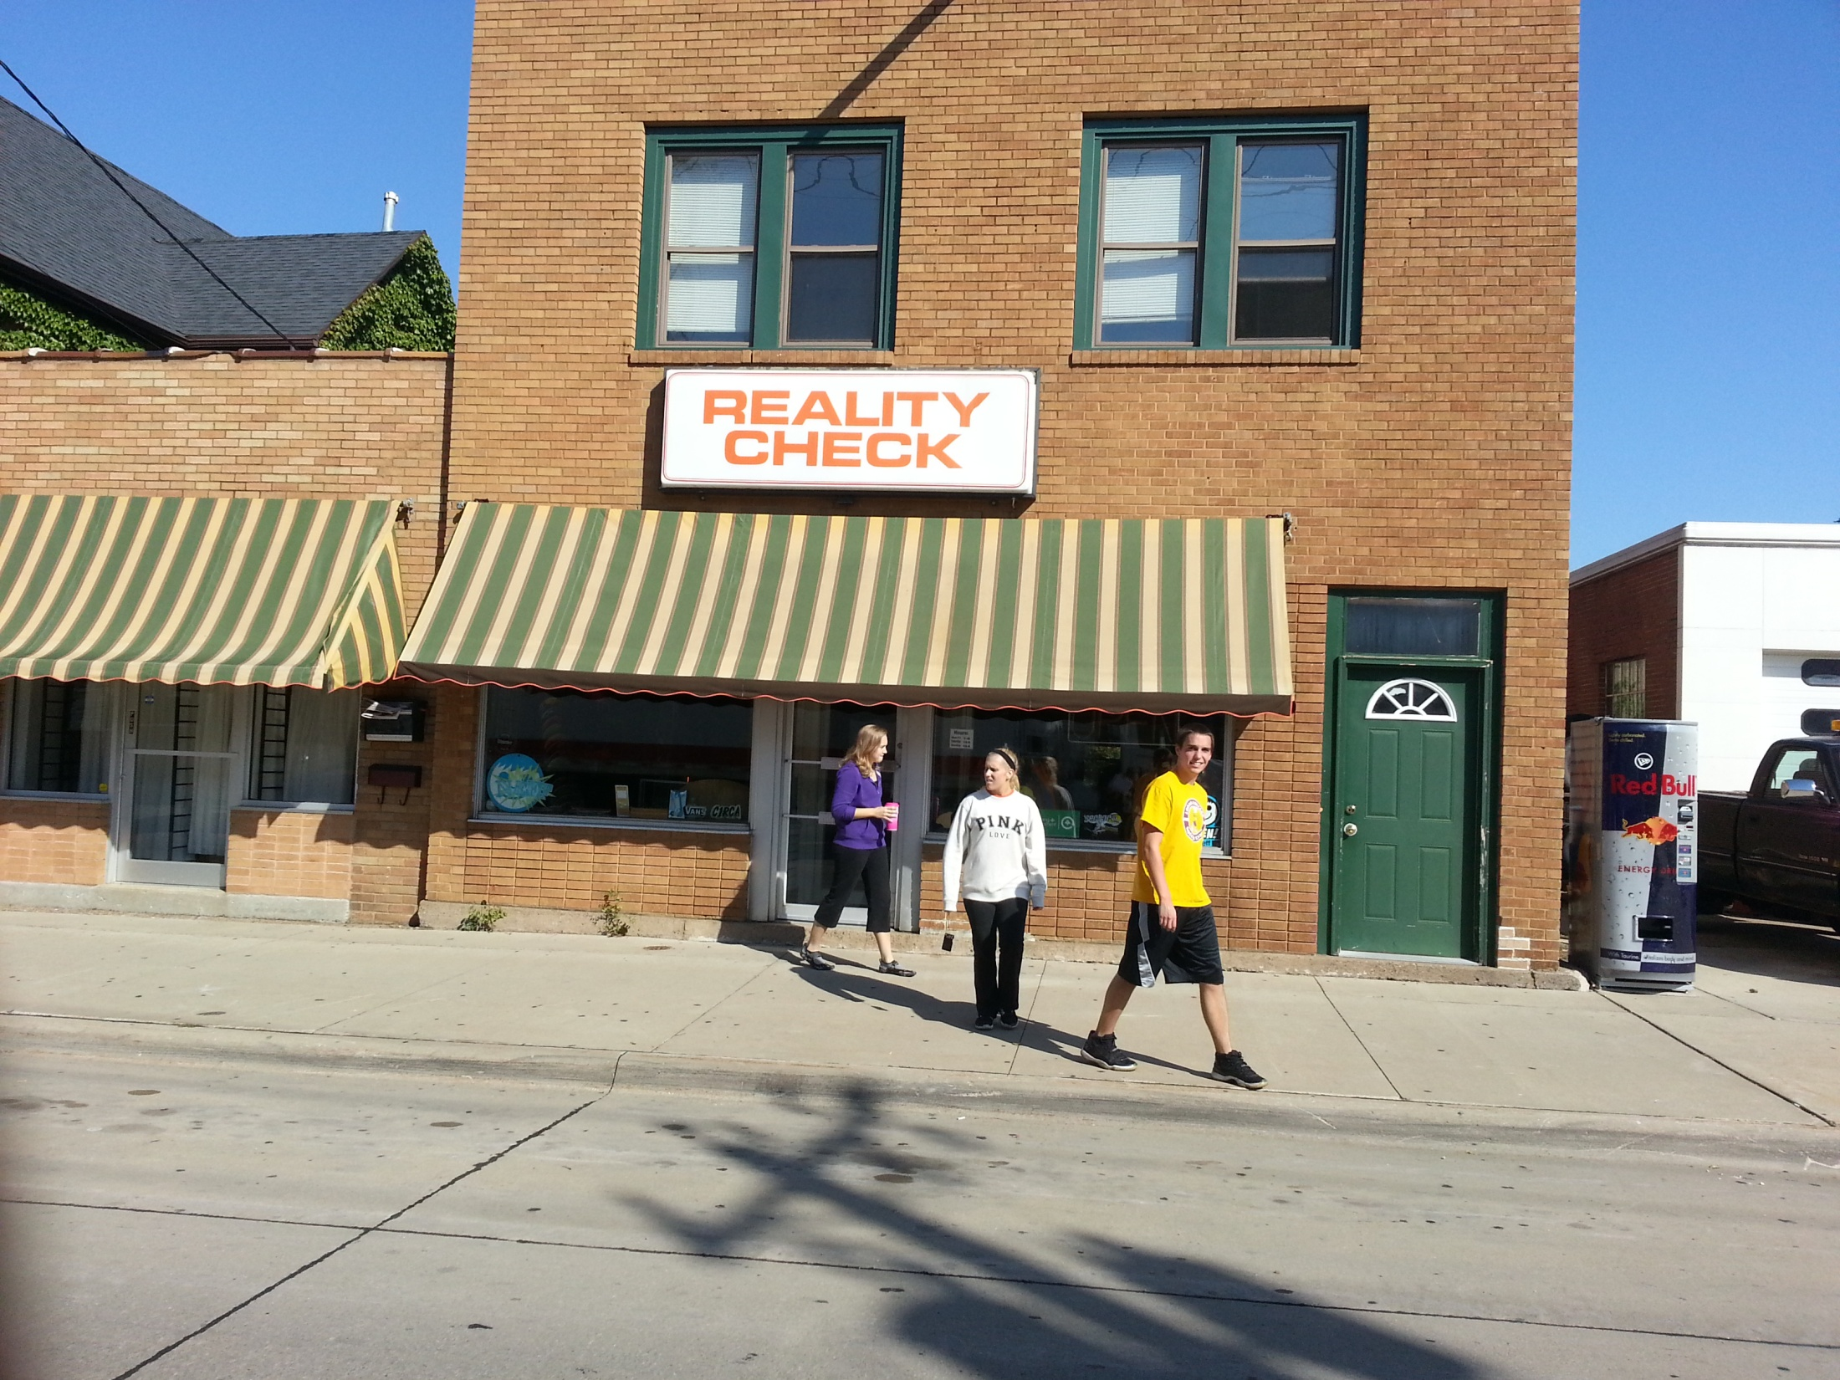

Slide 15
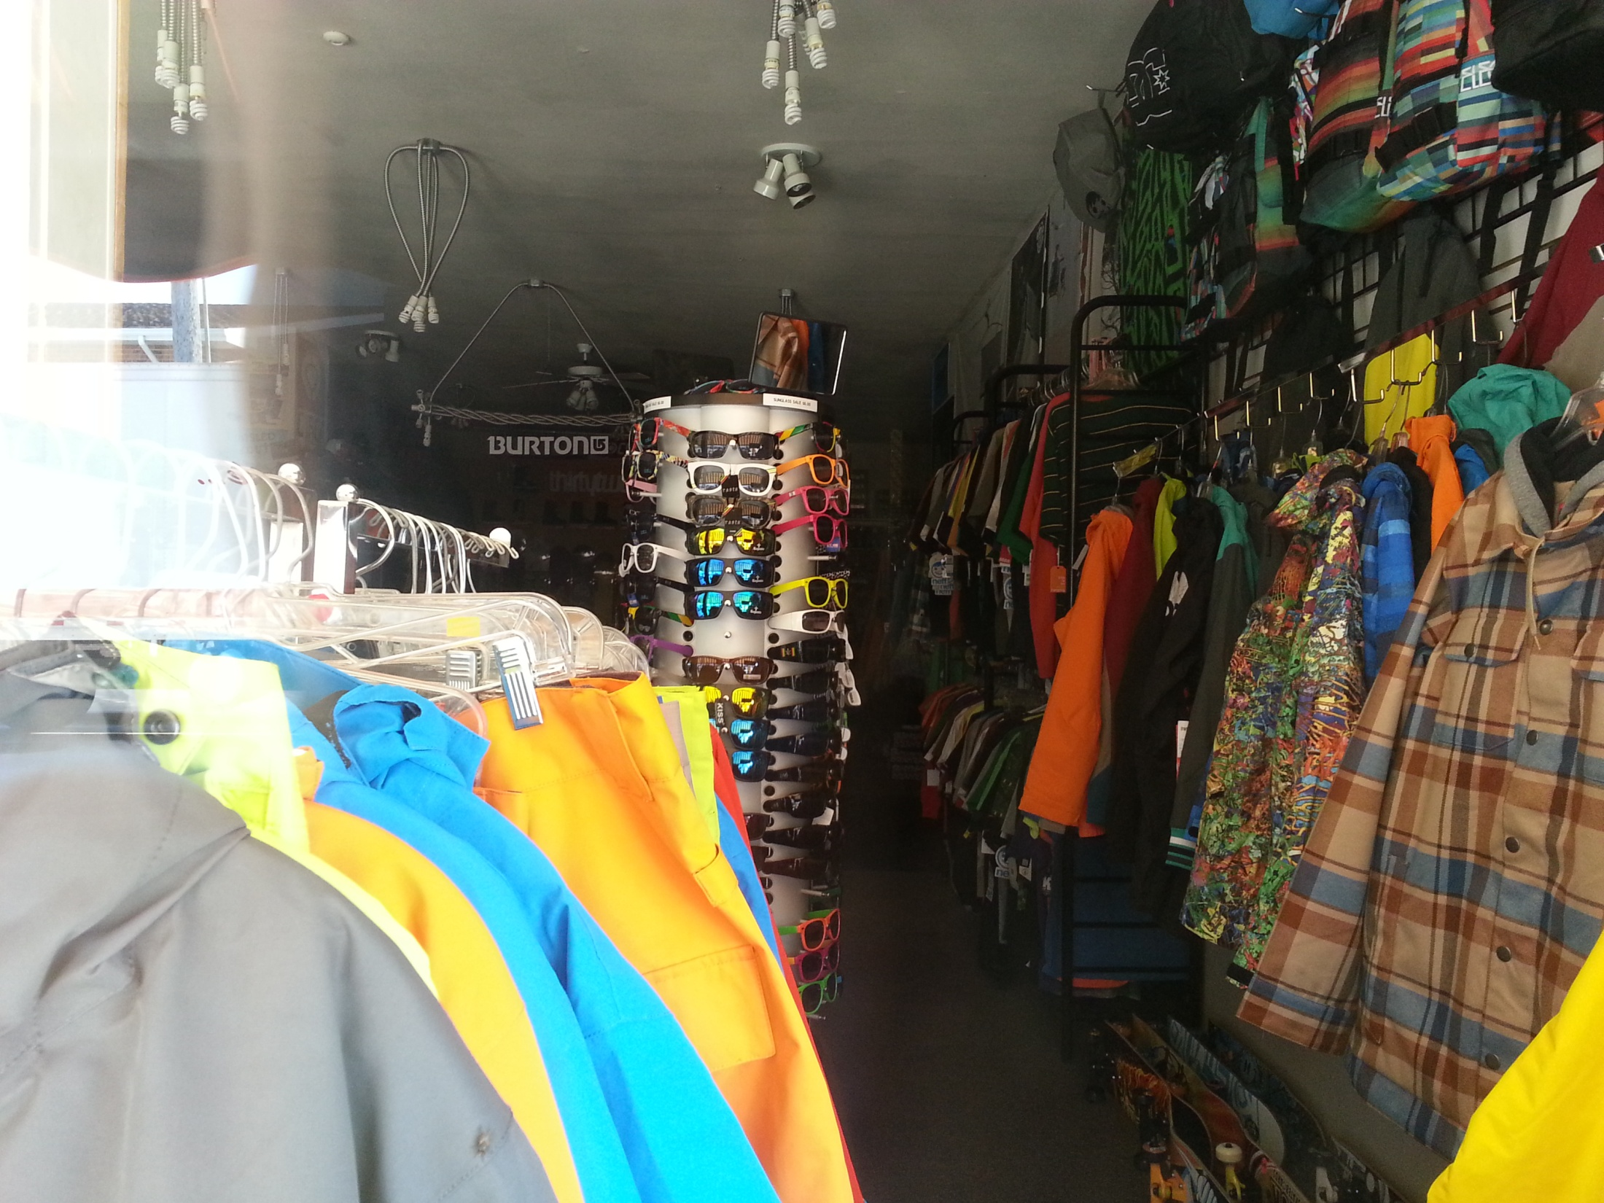

Slide 16
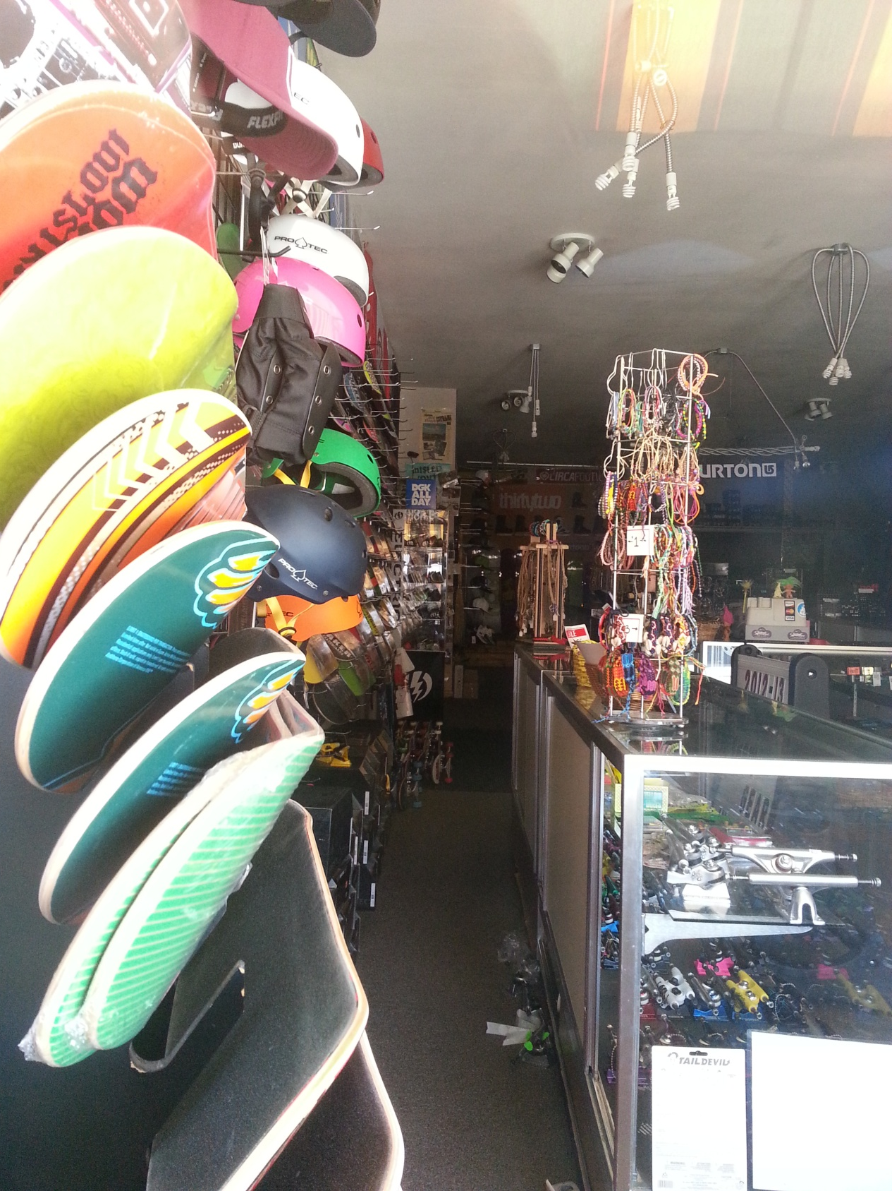

Slide 17
