Slide 1
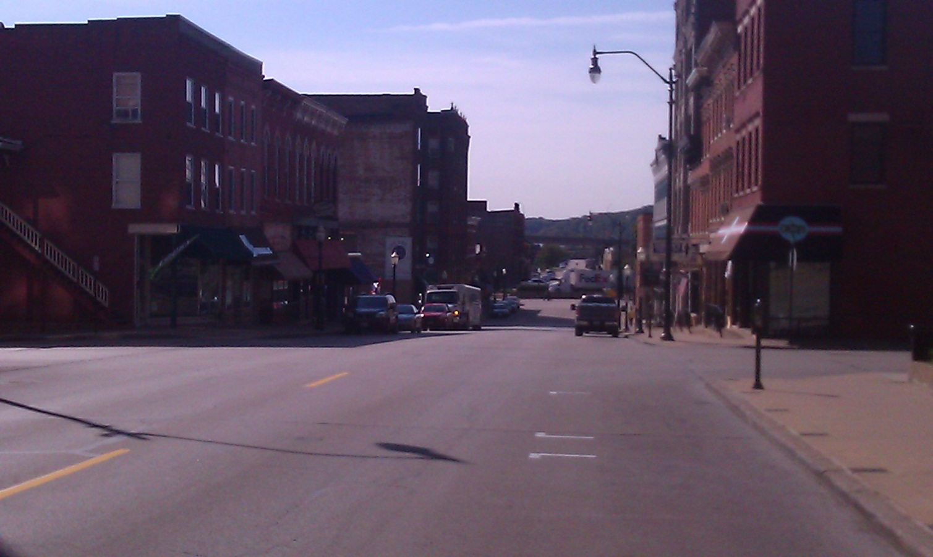
Downtown Dubuque Shopping Area
Ayush Joshi, Steven McDonough, Bo Anderson & Kyle Kirchhoff

Slide 2
Downtown Area Map

Slide 3
Mission Thrift Store
Notes:
This is the picture of the front of the store. It wasn’t flashy but did a good job of catching people’s attention with its bold title.

Slide 4
Mission Thrift Store - Information
Location: 398 Main Street, Dubuque IA
Front Window:
Items sold: Used Goods
Target Market: Low income people(men/women) of all ages living in the city area
Pros: Furniture, Hidden Treasure, Shop Keeper
Cons: Window, Price Labeling, Customer Service

Slide 5
Mason Dixon Saloon

Slide 6
Mason Dixon Saloon - Information
Location: 163 Main Street, Dubuque IA
Front Window: Two large windows showing the inside with several beer lights and a Hawkeyes banner
Services: Bar & Grill and nightclub/bar during weekend nights
Target Market: College students and middle aged adults
Pros: Large Windows, Location, Bar Sign
Cons: Name/Image, Too Plain, Basement

Slide 7
Corked

Slide 8
Corked - Information
Location: 269 Main Street, Dubuque IA
Front Window:
Services: Chocolate Shop
Target Market: Upper-Middle class adults and couples
Pros: Awning, flower pots & windows
Cons: Complicated Doors, Next to Chocolate Shop, next to Taven

Slide 9
HJ’s Fashion Emporium

Slide 10
HJ’s Fashion Emporium - Information
Location: 163 Main Street, Dubuque IA
Services: Bar & Grill and nightclub/bar during weekend nights
Target Market: College students and middle aged adults
Pros: Nice window displays, Main Street
Cons: Next to Tavern, misleadingly small

Slide 11
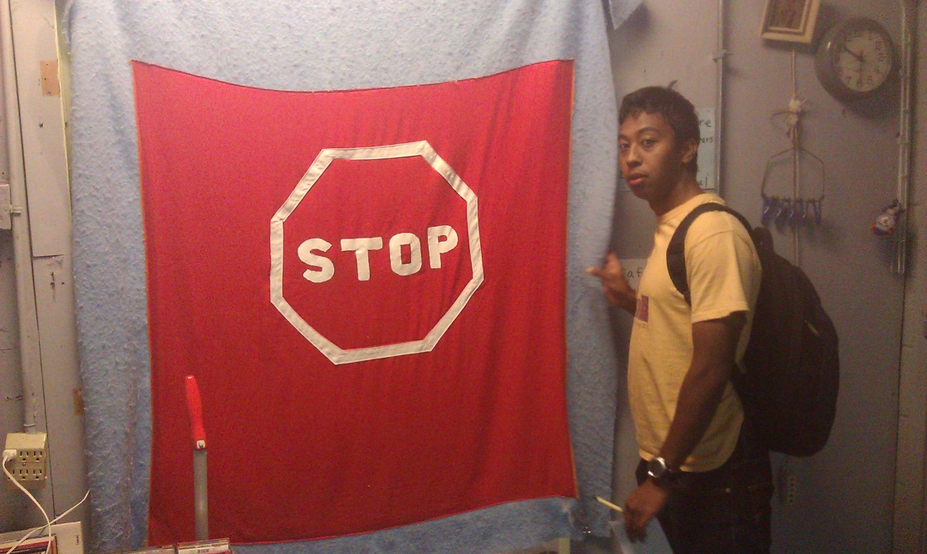
Random Photos

Slide 12
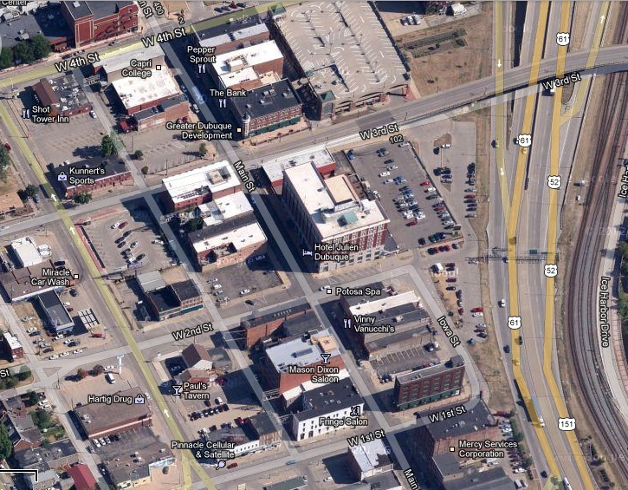
The End

