Slide 1
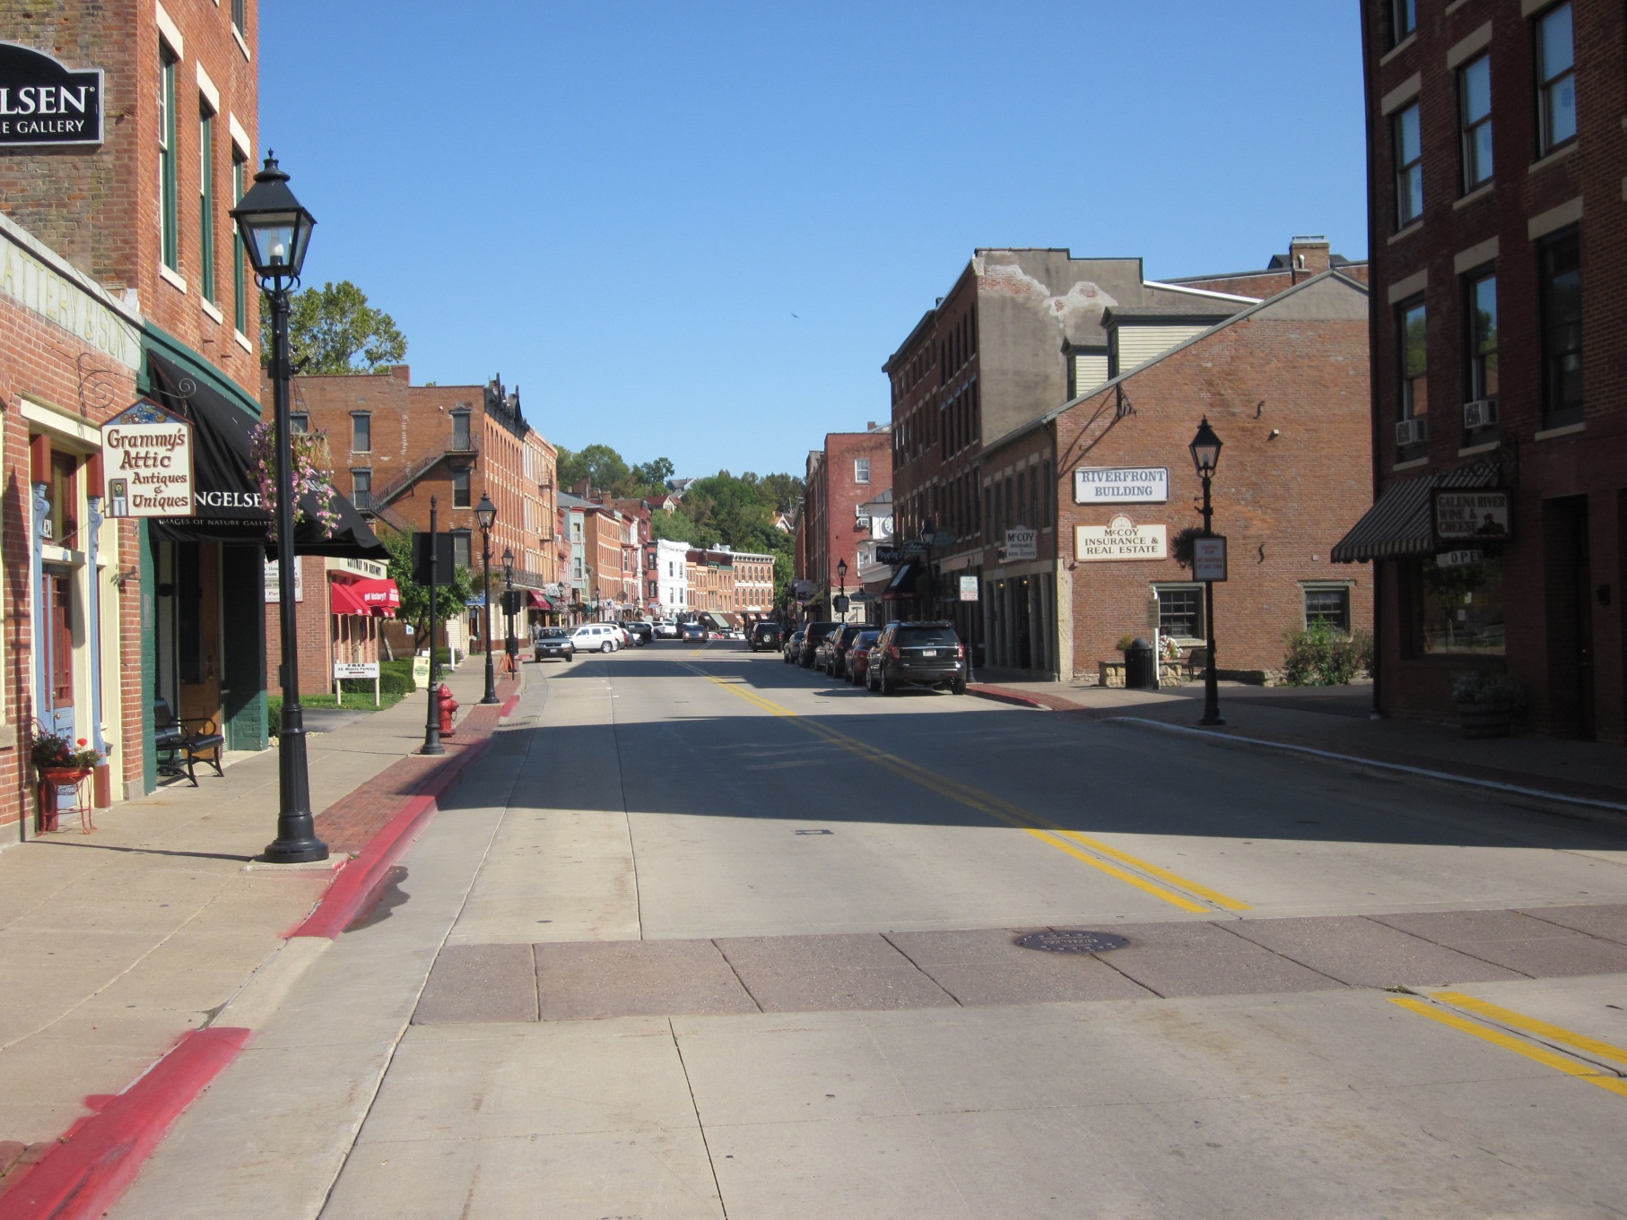
Galena Shopping District

Slide 2
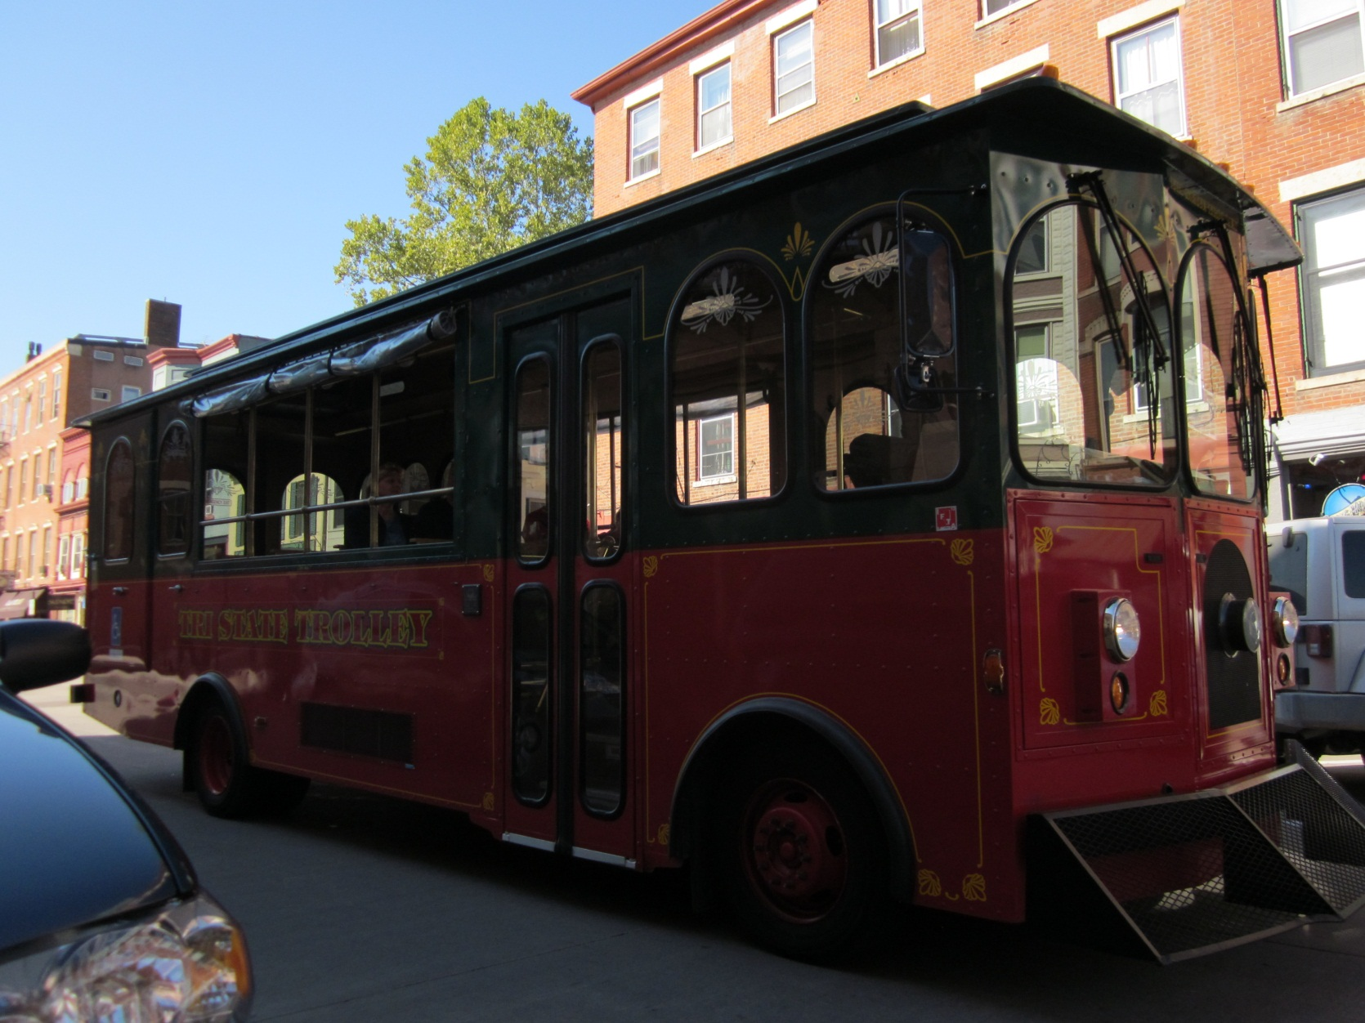
Tri State Trolley

Slide 3
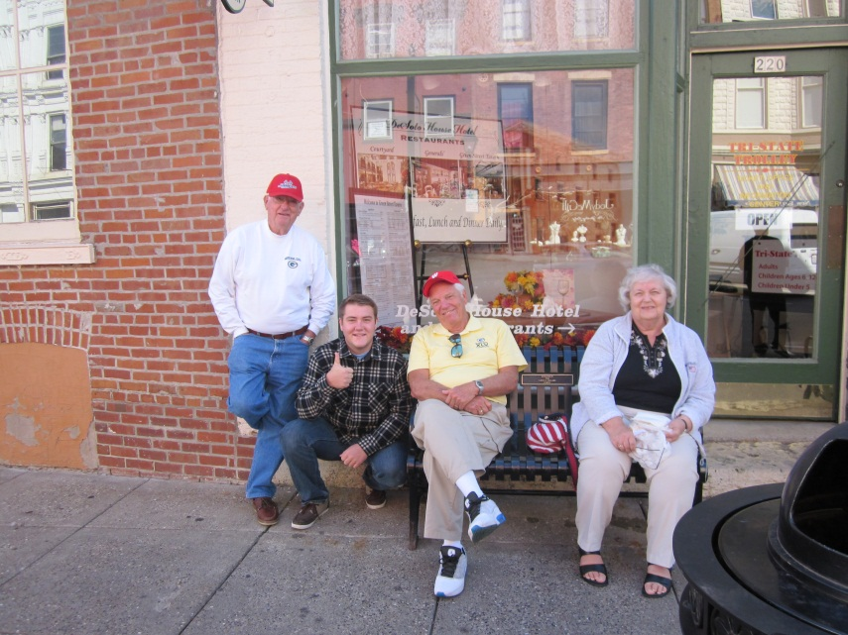
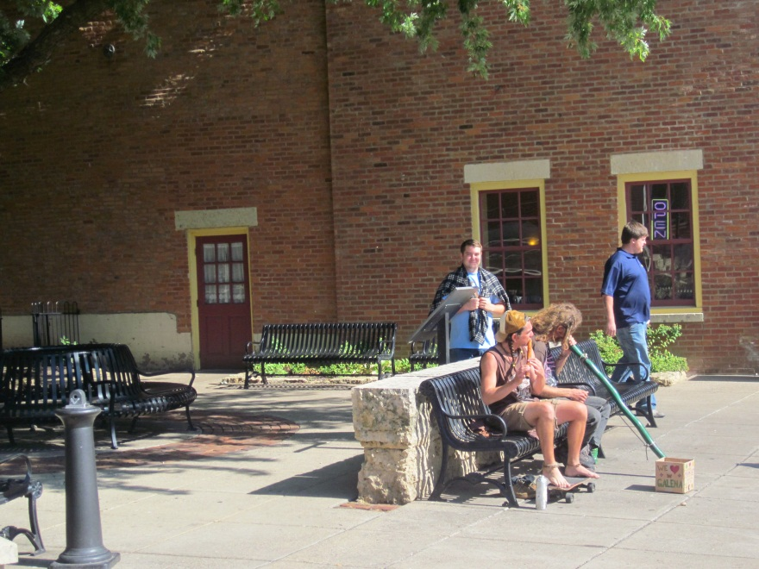
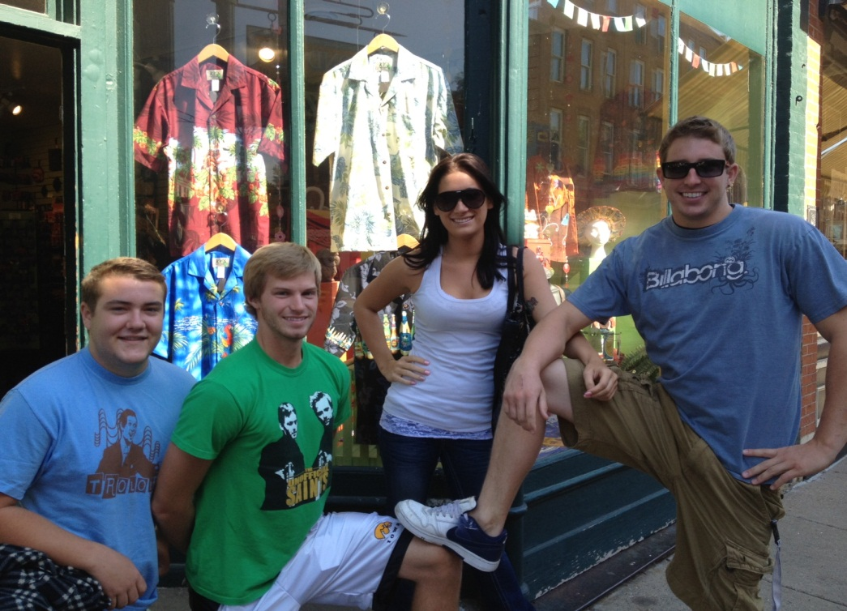
The Locals

Slide 4
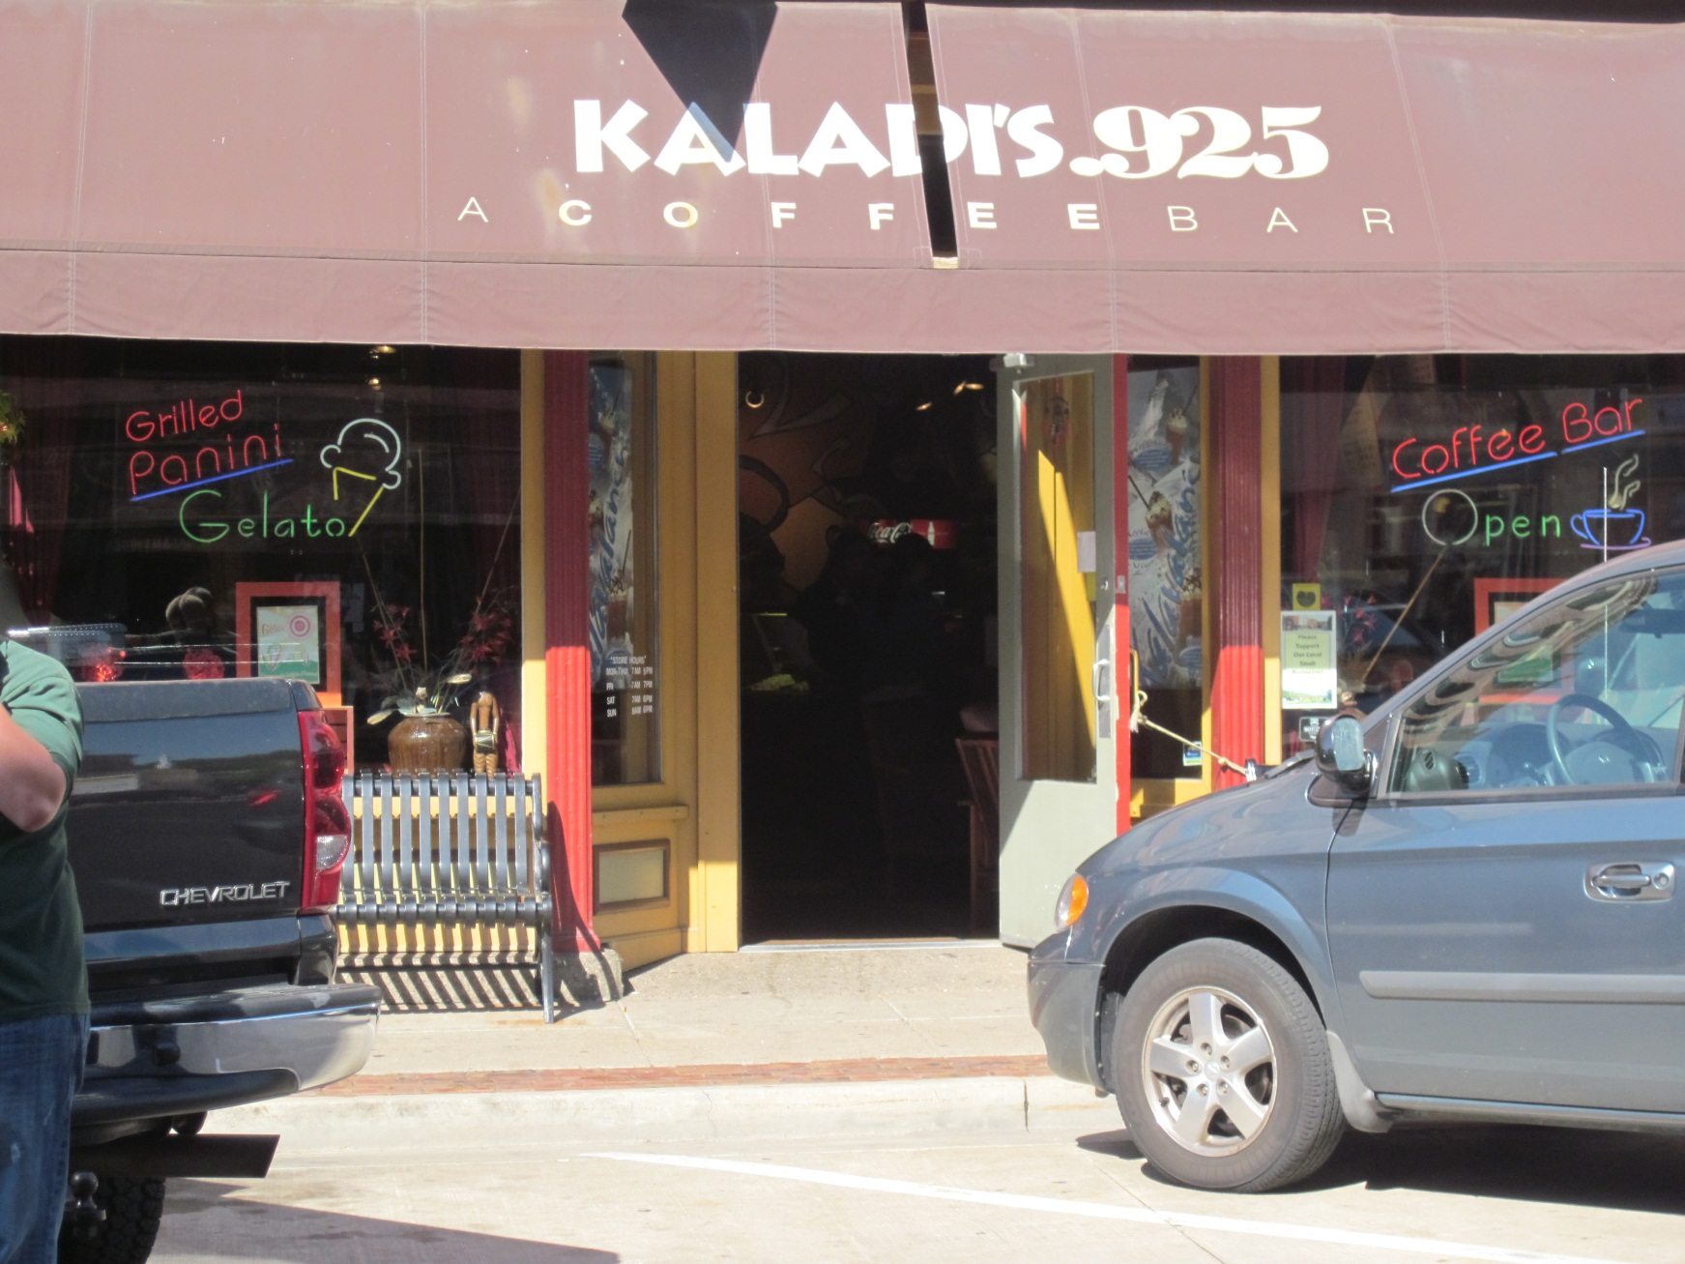
Kaladi’s .925 A coffee bar
Notes:
• Name of store/shop:
- Kaladi’s .925 A coffee bar
• Location of store/shop:
- Downtown Shop district, Galena IL
• Who is the store/shop designed to appeal to - what “target market”? think income group(s), geographic group(s), gender(s), demographic group(s), age group(s).
-The store appeals to most ages because they served Gelato along with juices, and other caffeinated beverages. The inside is a good place to get internet, read, and drink coffee or have a treat. Although it is a place that is appealing to all different groups, the prices on their menu were not cheap so it’s not a store that every person can afford to get their daily coffee.
• What is the first impression you get from this store/shop?
-The shop smelled like really fresh coffee beans and was dimly lit. It had a very similar setting to most Starbucks coffee shops. Smooth jazz music was playing which created a very calm atmosphere for the customers.
• What do you learn when you inspected it more closely?
-After observing the setting and what was on the menu, we decided to order some gelato because it looked really good; I had the mango flavor.
• What are the 3 best elements of the store/shop/window? Explain.
-The sign clearly states what the shop is selling with the awning and neon signs.
-There is a bench outside the front window which must be really nice to eat gelato on during the summer.
-The doors were propped open which gives the passing consumer a welcoming impression.
• What are the 3 worst elements of the store/shop/window? Explain.
-The only thing that I can think of that isn’t really good about this storefront is that the awning over the front is a little bit faded from sun and rain. Other than this the storefront is really pleasant.
• How would you improve this store/shop/window?
-To improve the storefront I would have some clever structure outside like a giant coffee bean. I would also put out a chalkboard with special offers and updates on new flavors.

Slide 5
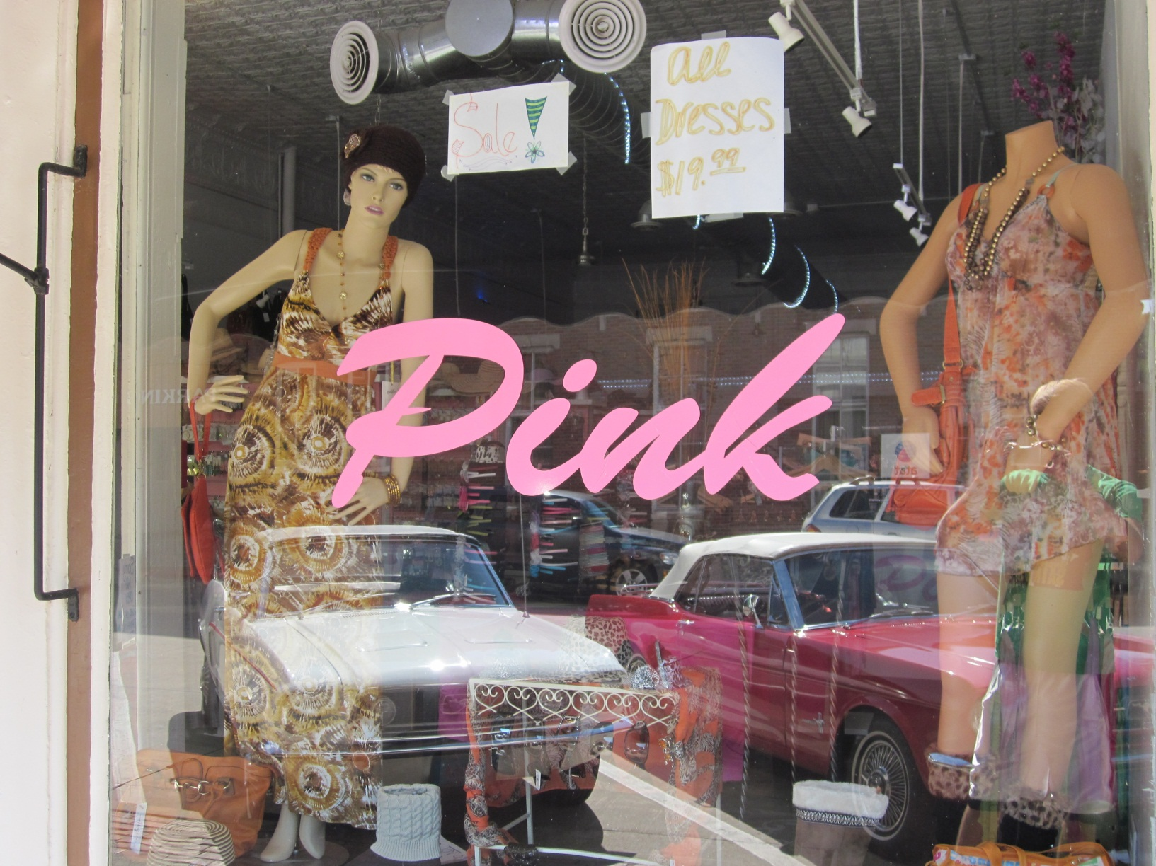
Pink
Notes:
We visited the shopping district of Galena Friday morning, and one of the specific shops was called “Pink”. The store itself seemed to most appeal towards female audiences with an age demographic of teenage years. The appeal is definitely for shoppers willing to spend more, even though the approach is to sell items on clearance of their original prices to make shoppers still think like they’re saving money. The items sold will appeal to younger teenagers especially, and will get their parents to spend money on them.
The initial impression I get is that this isn’t someplace I would like to personally shop. The design would push away any non-feminine shoppers because of its name and display. Because of that the store doesn’t confuse any of its shoppers from avoiding the store. Upon closer inspection you can learn that the age group isn’t just restricted to younger women, but women from 20 years old to 30’s.
Three things I like about the storefront display is the simple yet elegant lettering for the title, which will draw female audiences in. The use of mannequins with poses for display also sell the approach, and the various martini and margarita glasses with the women in them are more appealing to girls over 21, appropriately. That being said, there are only two mannequins to the window, which seems lazy, and besides the dresses on them and the glasses, I don’t really know what is being featured at this store. Also the paper sheets taped up to the window seem lazy. If I were to improve this shop, I would glitz up the window even more than it already is, with more clothing, fancier ads and a stronger sense of allure.

Slide 6
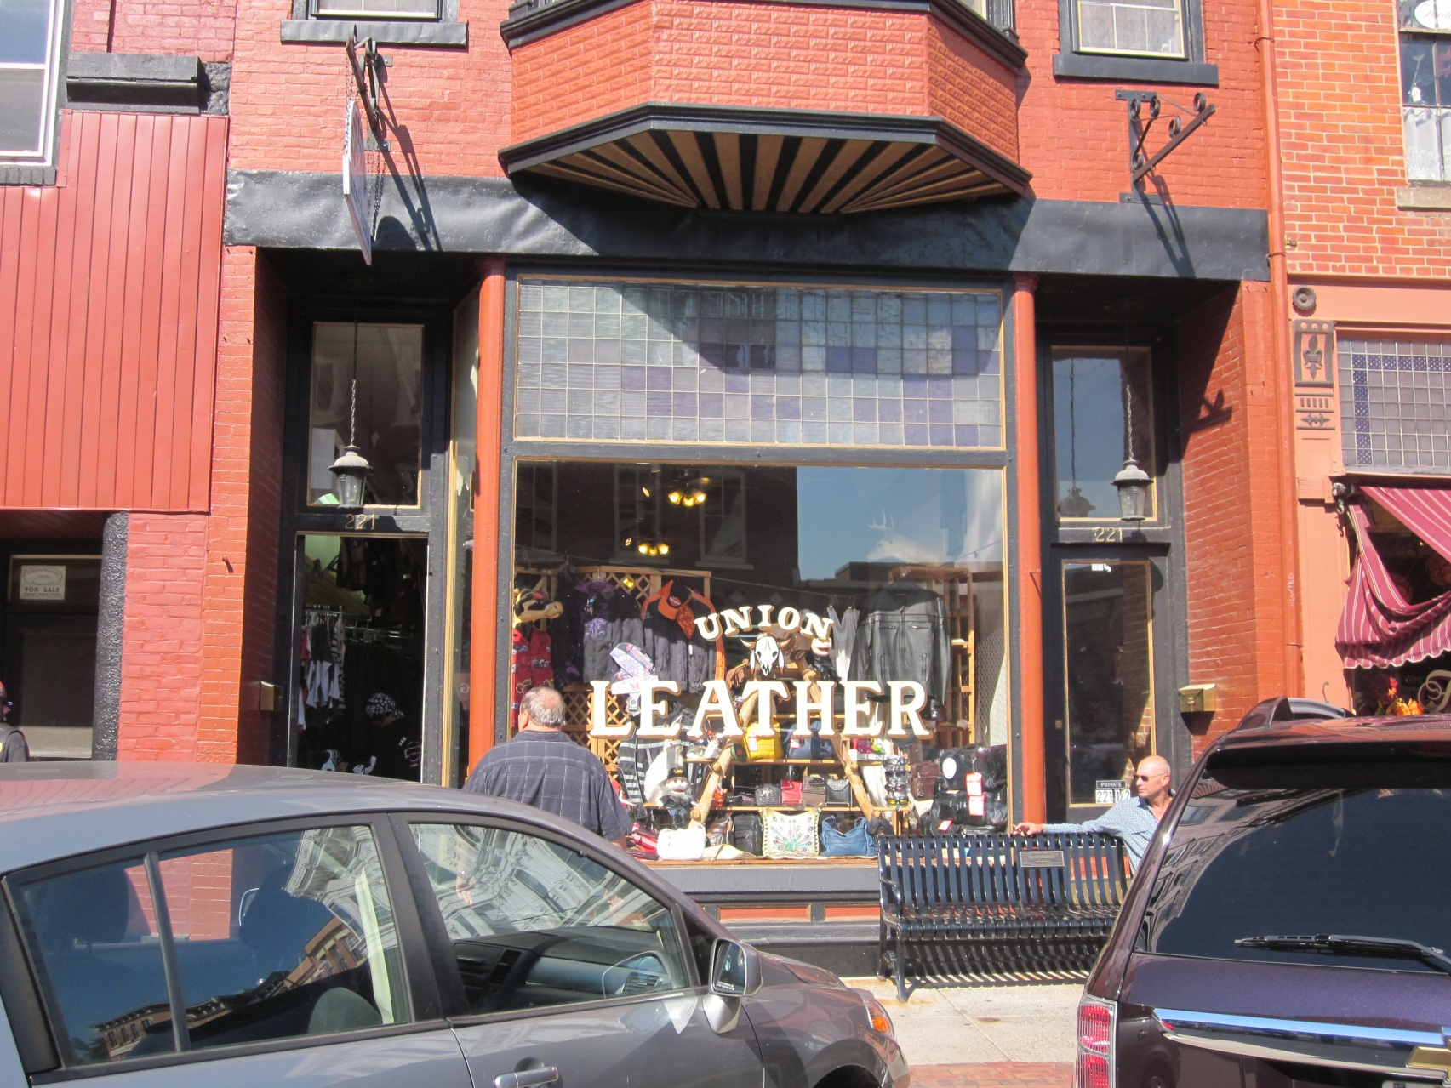
Union Leather
Notes:
Name of store/shop: Union Leather
Location of store/shop: Main St. in Downtown Galena
Who is the store/shop designed to appeal to: The general demographic the store seemed to target were middle to older adults, specifically those who enjoy a nice ride on their Harley Davidson motorcycles. The prices of the shop were moderately high, but for bikers the main goal is to have a proper fit and look good so price is not usually a huge factor. It would seem to more of a male targeted store, but there seemed to be an equal amount of females in the store as well.
What is the first impression you get from this store/shop? I immediately thought about motorcycles when I first saw the store, not only because of the leather, but also due to the group of bikers congregating outside of the shop when I first came across it.
What do you learn when you inspect it more closely? When I went inside, I found there was a wide selection of leather clothing, but also many different crafts and artistic pieces on display and for sale.
What are the 3 best elements of the store/shop/window? The three best aspects are the bold lettering for “leather,” the wide variety of products displayed, and rustic looking glass squares just above the window. The bolding of “leather” lets people know up front the main focus of the shop as far as products and services. The variety of products also is useful since people can see right away what the designs and styles for the clothing along with other products. The glass squares above the window are also useful because they give an aged, western saloon look to the shop that goes along well with the skull in the front of the window. This theme is very fitting for the shop considering cowboys of the old western were known for leather clothing styles and that is a main focus of the shop.
What are the 3 worst elements of the store/shop/window? One aspect of the store that was not ideal was the mass amount of items in the front window. While I did already mention this as a positive aspect, they could afford to remove some of the items because it gives they shop a very busy and almost cluttered look. Another aspect of the shop that was not favorable was the layout inside. It was very tightly packed and hard to pass by people without bumping into them.
How would you improve this store/shop/window? To improve this shop, my first idea would be to find a location that is slightly larger so customers would not be crowded on top of each other and the window would be larger, enabling the owners to spread the display and relieve the clustered look. If a new location would be out of the financial limitations, I would at least remove the multiples of some products from the display and utilize storage places in the back of the shop better so customers would be able to navigate the shop more easily.

Slide 7
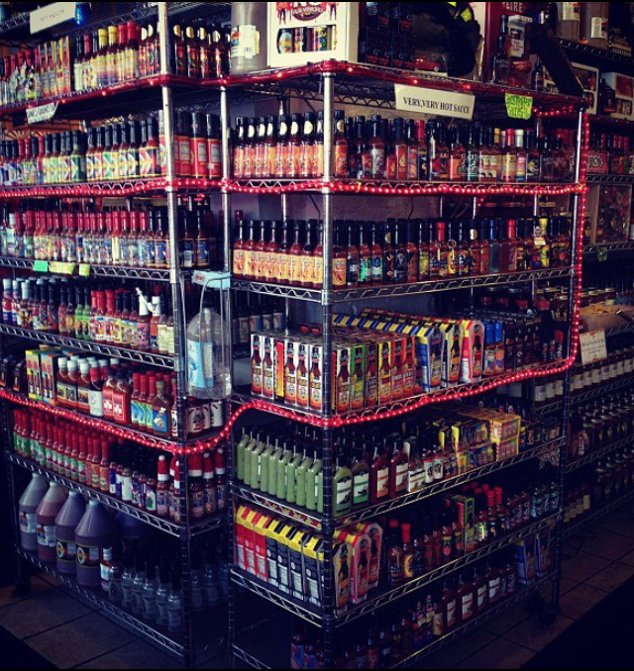
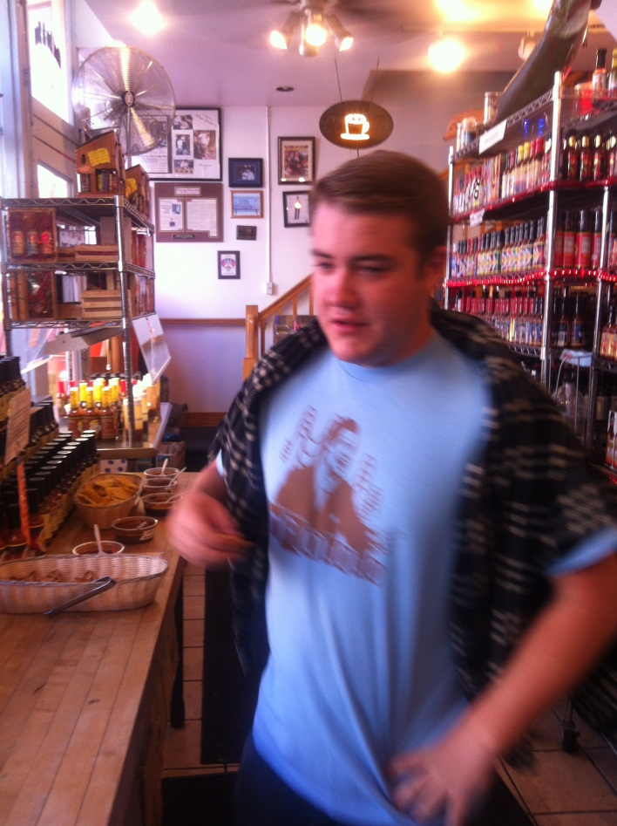
Galena Canning
Notes:
Name of store / shop: Galena Canning Company
Location of the Store / shop : 106 S. Main Street, Galena, Illinois, 61036
Who is the store / shop designated to appeal to – what target market?
The target market would be individual who live in the surrounding areas around Galena, whom also shops in galena on a regular basis. Also, those individuals who travel to Galena for vacation. Getting more specific, they are targeting consumers that have a steady income of approximately $25,000+ a year (on the low end). More so, the shop is targeting those individuals who enjoy using various types of dipping sauces. On a more specific note, they are targeting both males and females. Their products have a wide range in regards to price; the most expensive product would be Blair’s 2007 Halloween reserve (the hottest liquid in the store) ($530.00) to their least expensive item, which is $5.99 and that is a wide variety of single bottled sauces. As you can see, there is a wide variety of sauces that could appeal to anyone.
First impression to the store:
My first impression to the store was that I could not believe how much variety they had in regards to sauces. I remember thinking that there is literally something here for everyone. Not only was I impressed with the fact that there was so much variety within the products, the customer service was excellent. Whatever questions we had, they quickly came up with answers too and directed us to products in which we liked and was in our price range. Overall, I was generally impressed with the store and ended up purchasing some products.
What did I learn when I inspected it more closely?
Truthfully, I only thought there were a few types of hot sauce on the market, after going into the store, I learned that there were thousands of brands and varieties available. Not only were there so many brands available, the fact that we took into account of the hotness of tobacco hot sauce and compared it to the most expensive and intense hot sauce there, it was a ridiculously outrageous number hotter than tobacco. That was the second thing I learned, that tobacco was not the hottest hot sauce on the market.
3 best elements of the store:
First, is the variety the store has to offer, whatever you like, they will probably have it. The second is the great customer service. Third and finally, the way they had gotten our attention. We saw, through the window, the colors and countless types of sauces, jams, dipping sauces that were available, so we had to enter.
3 worst elements of the store:
The worst part of the store was the amount of choices, once you had found something you liked, you found something else you liked as well and ended up leaving with more than you planned. Second, the prices of certain items were too high. Lastly, if you intended to try products before you purchased them, they didn’t offer any beverage to help quench your thirst.
How would you improve the store?
The only thing I would do to improve the store, I would offer small quantities of a beverage, mostly water because if you intend to try some hot sauces and you try some that are way to hot for you, what are you going to do? Go somewhere else to purchase a beverage? That would be my only improvement to the store because I left a satisfied customer.

