Slide 1
Celtic Tiger
Cole Mariottini
Steven Avenarius
Elizabeth Eversole
Steve Wilke

Slide 2
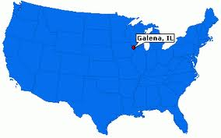
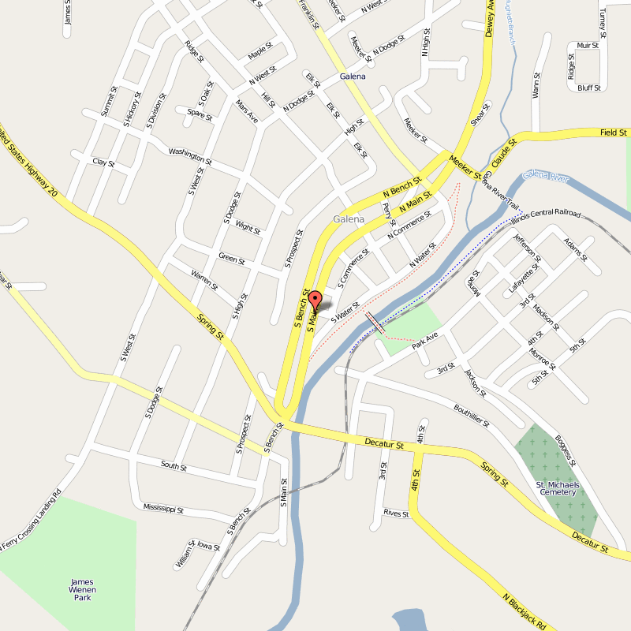
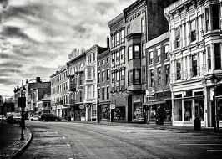
Galena of long ago

Slide 3
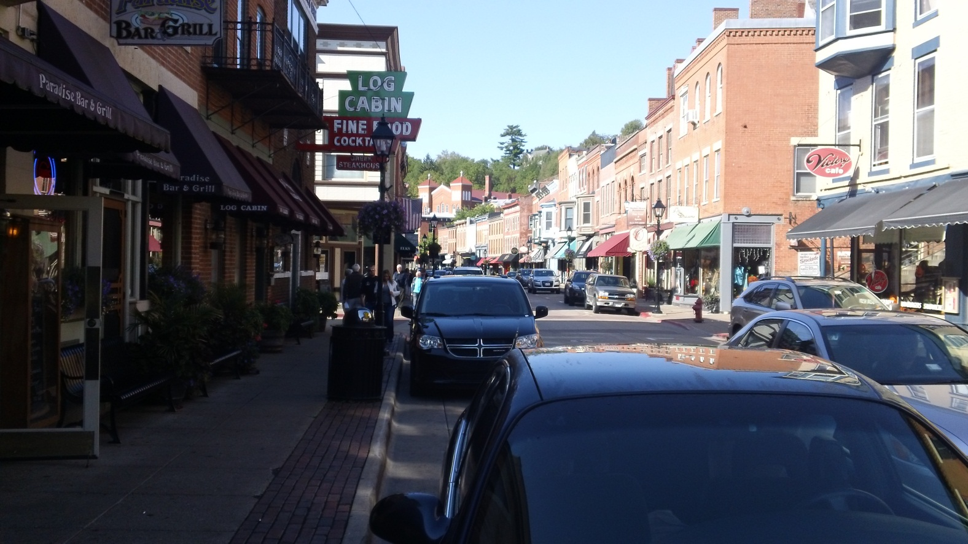
Window shopping Galena, IL

Slide 4
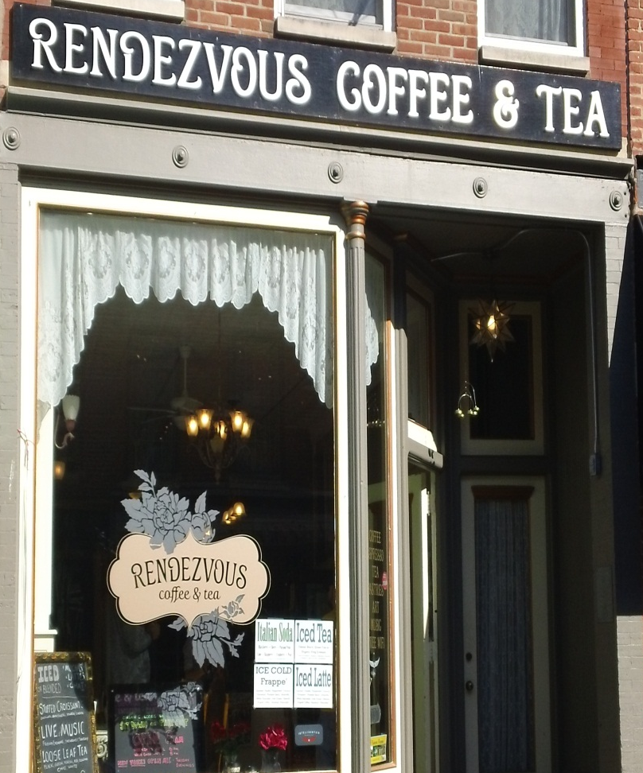
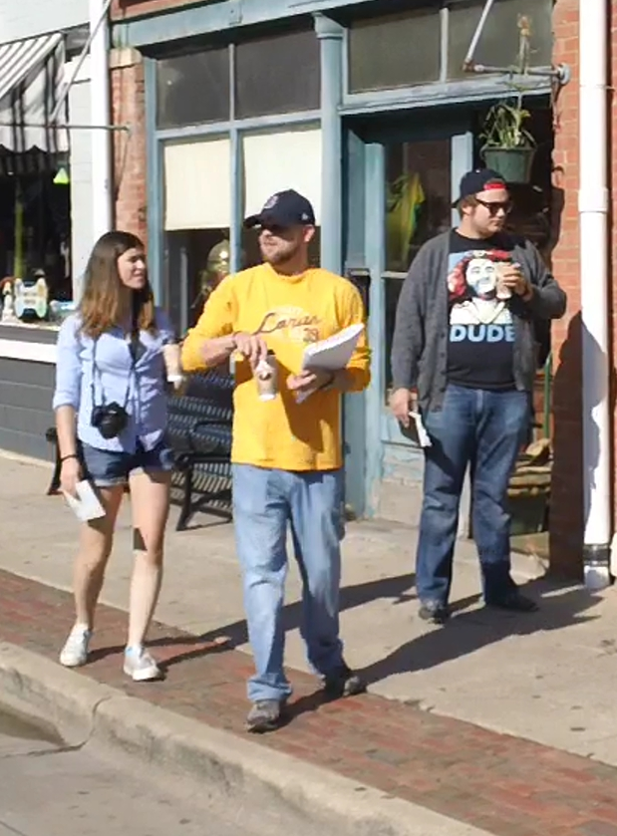
A little coffee to start the morning off right

Slide 5
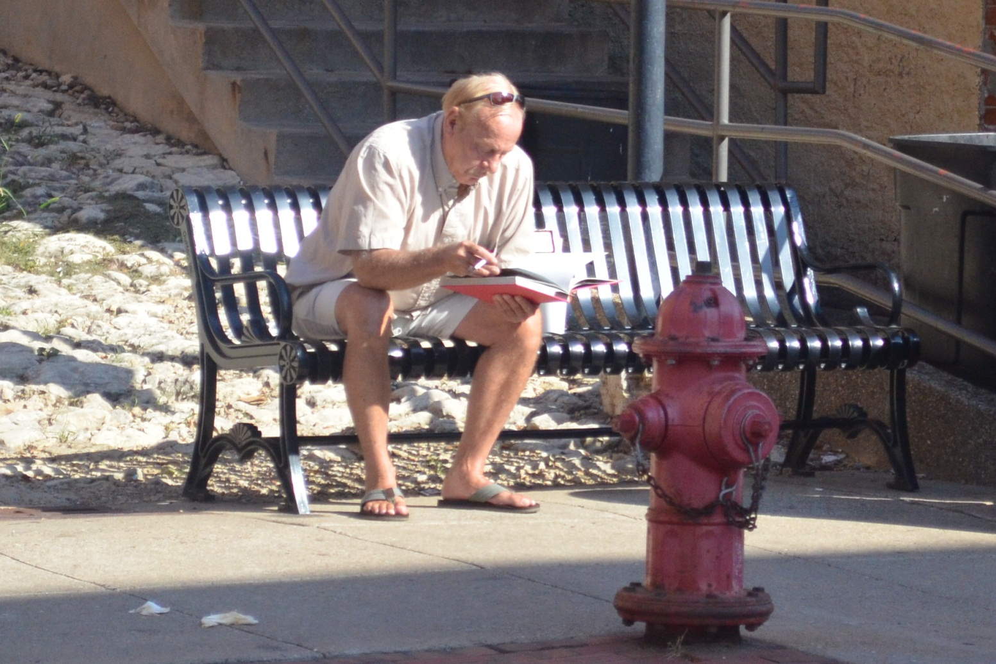
This man obviously has too much to do today

Slide 6
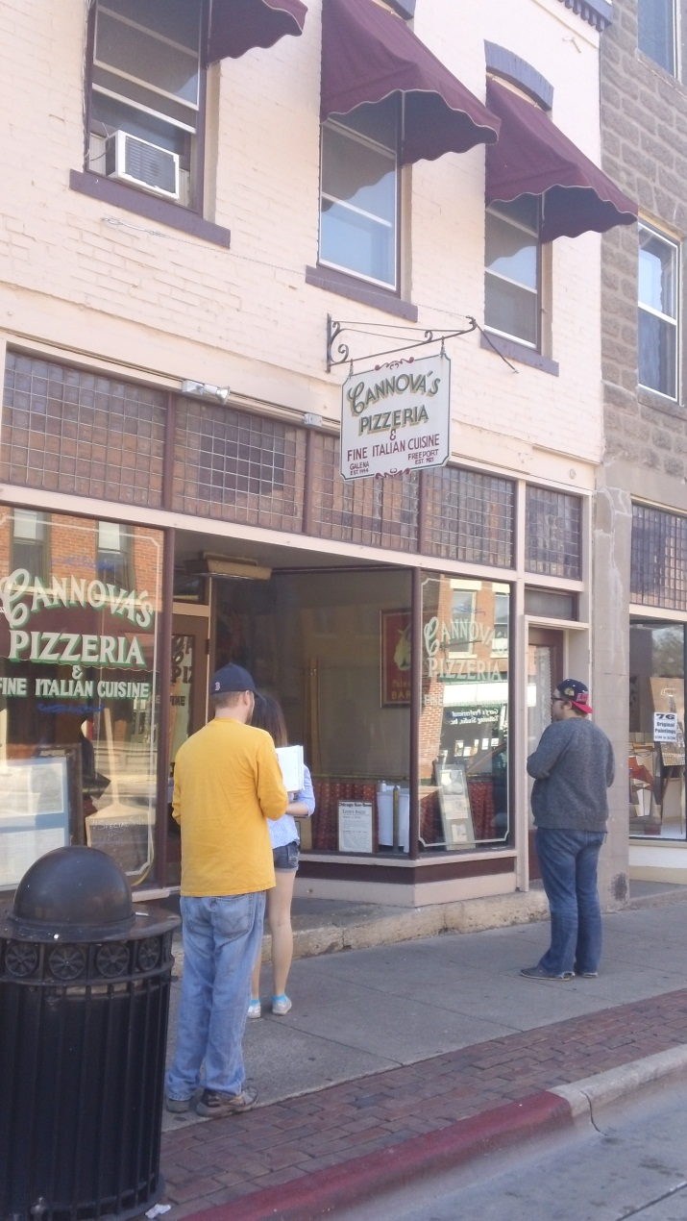
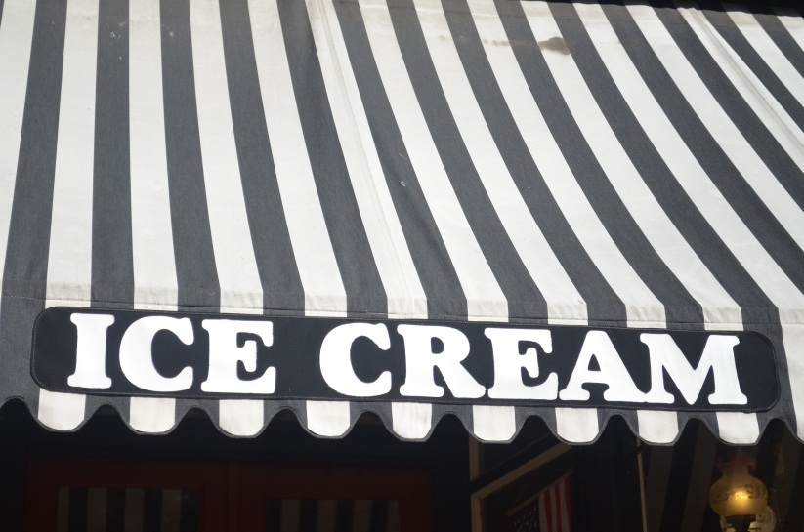
Is it too early for Pizza and Ice Cream?

Slide 7
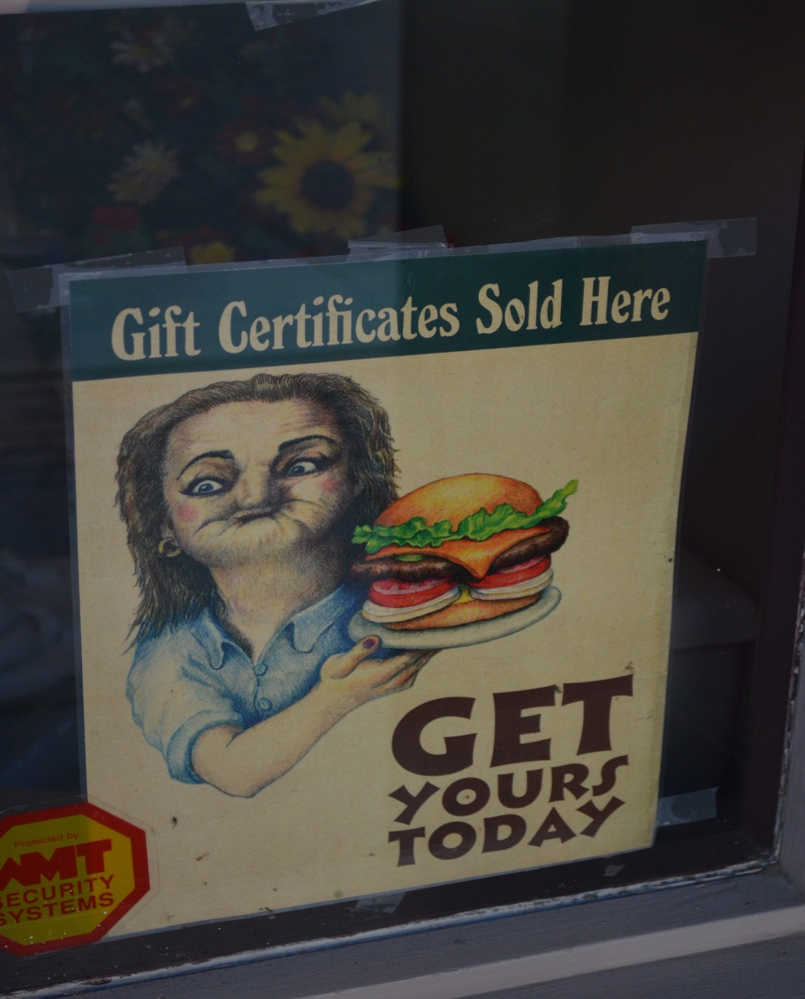
This sign should be in front of a dentist office not a burger joint

Slide 8
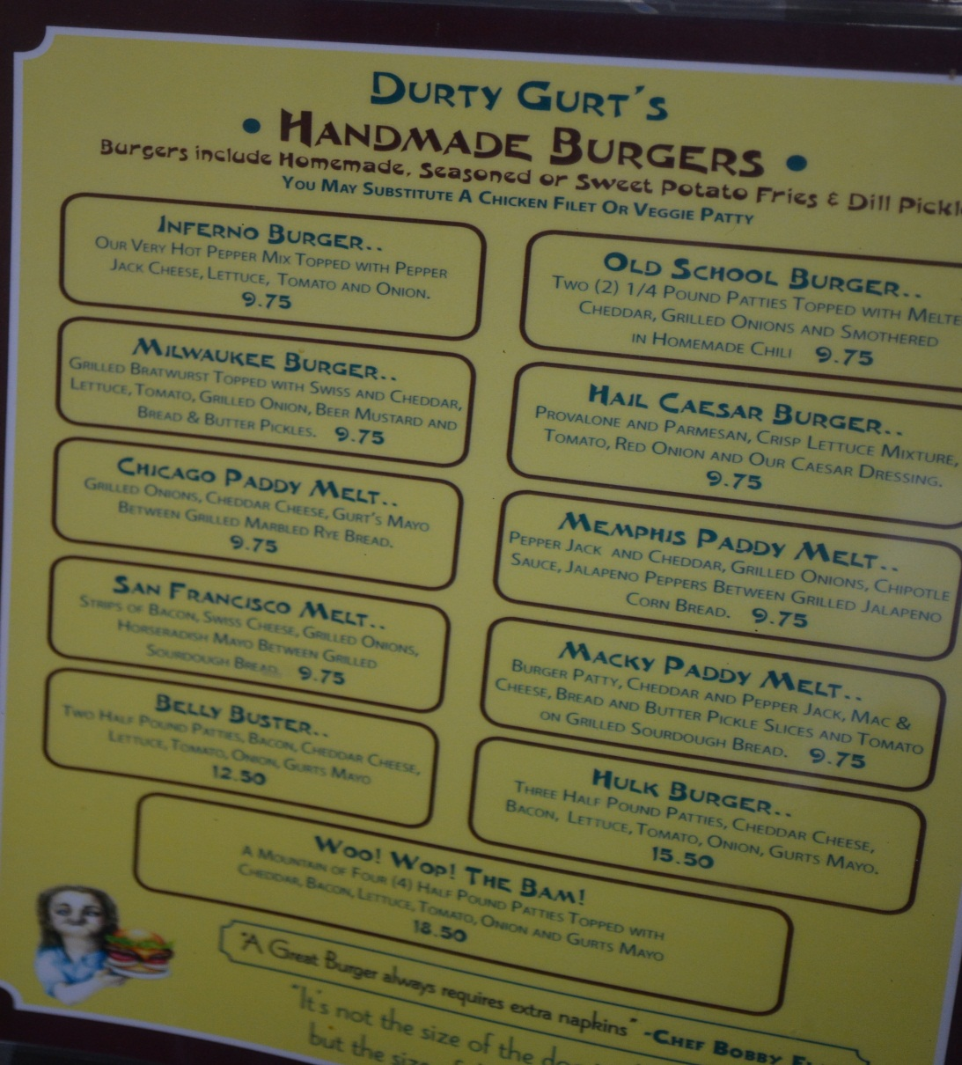
For this kind of money, I hope they have gold in them

Slide 9
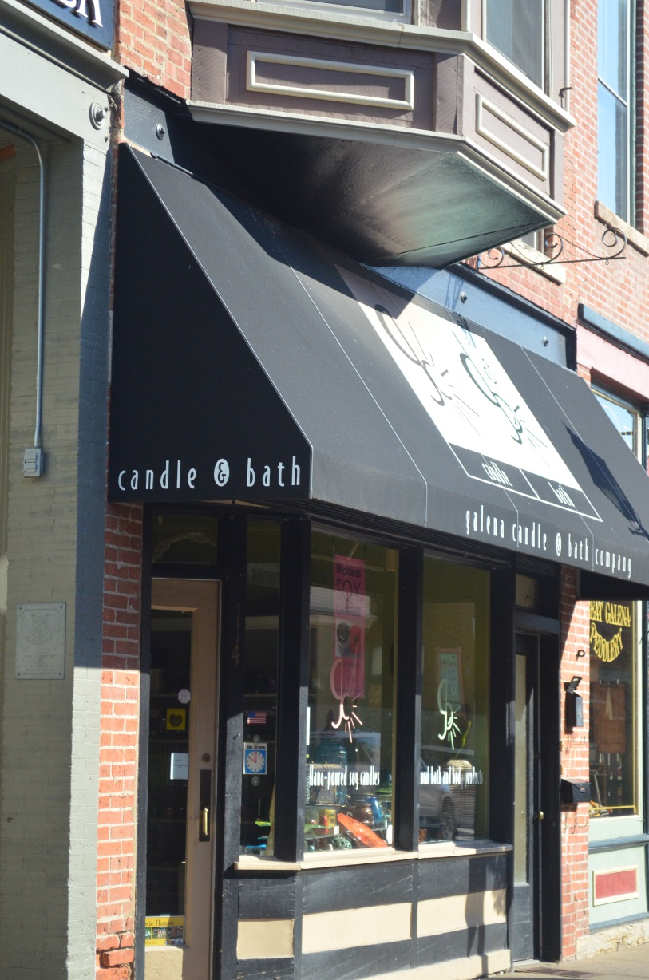
Something for the other senses to enjoy. I think they had a fan blowing the smell of great candles into the street.

Slide 10
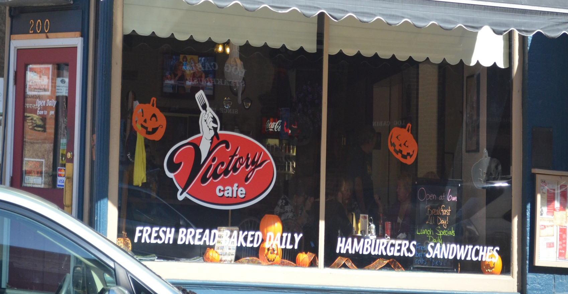
Food every where you look

Slide 11
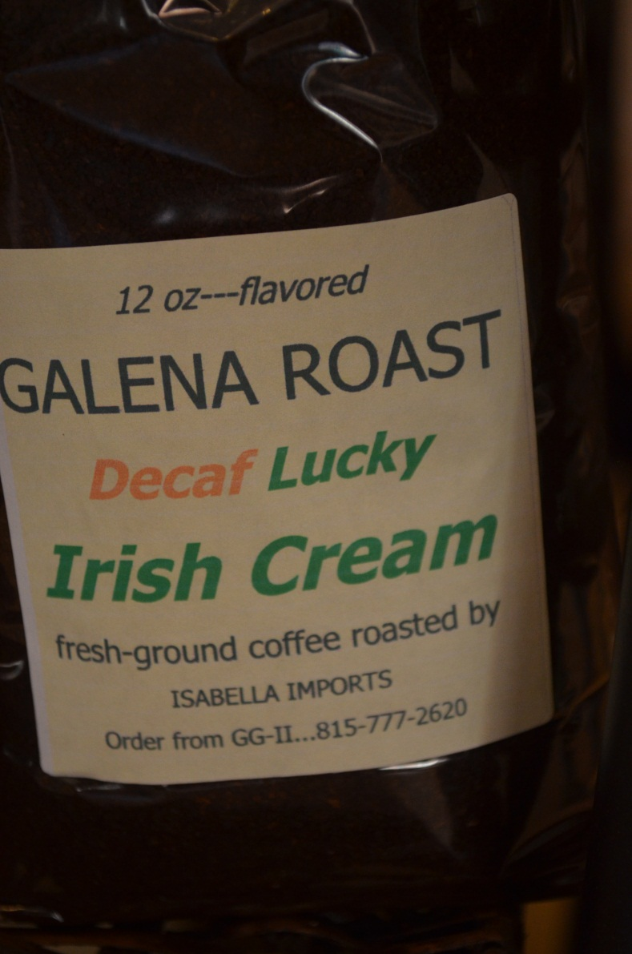
We just had to add this to the project ☺

Slide 12
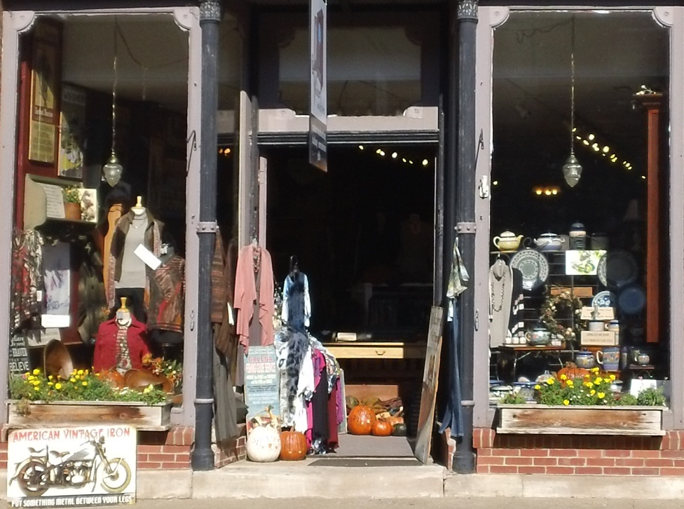
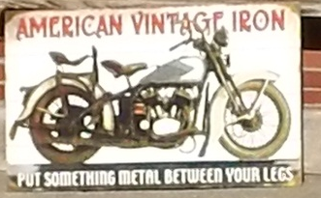
Hmmm? Not sure what they’re shooting for here?

Slide 13
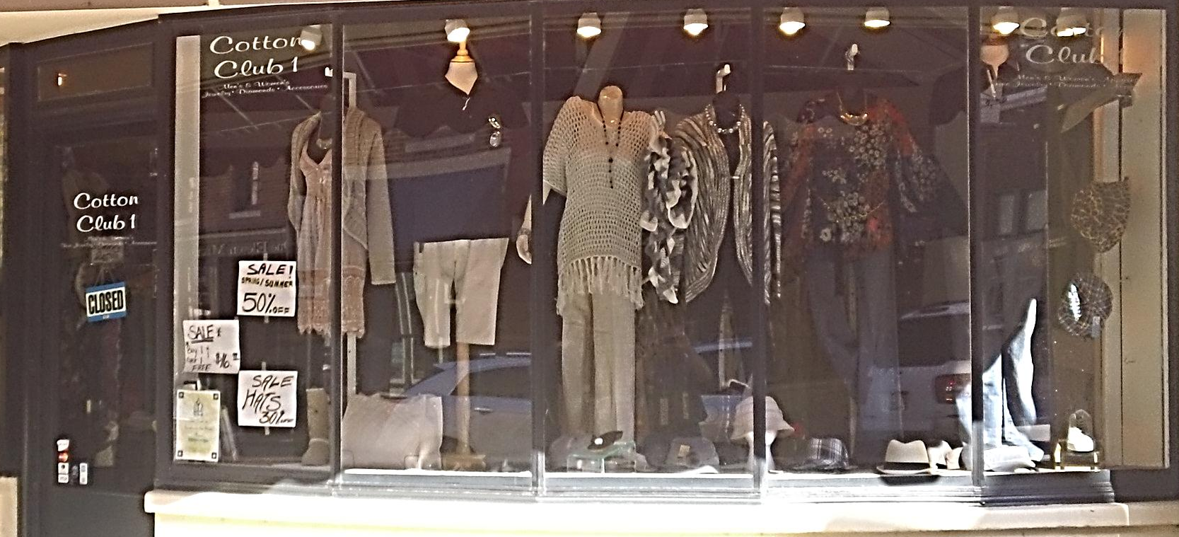
Does a SALE sign in front of a store attract people to stop?

Slide 14
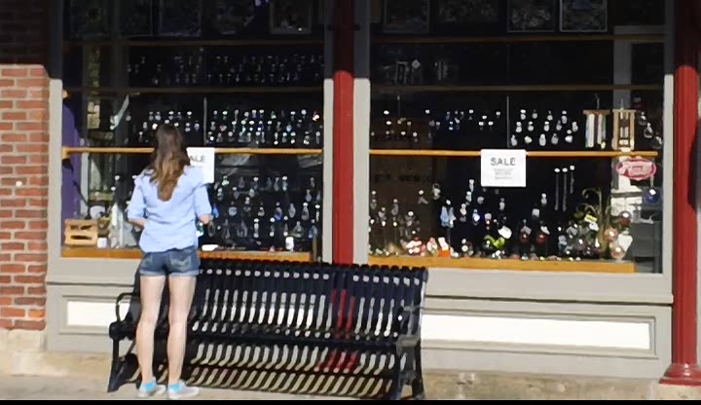
Worked on Elizabeth

Slide 15
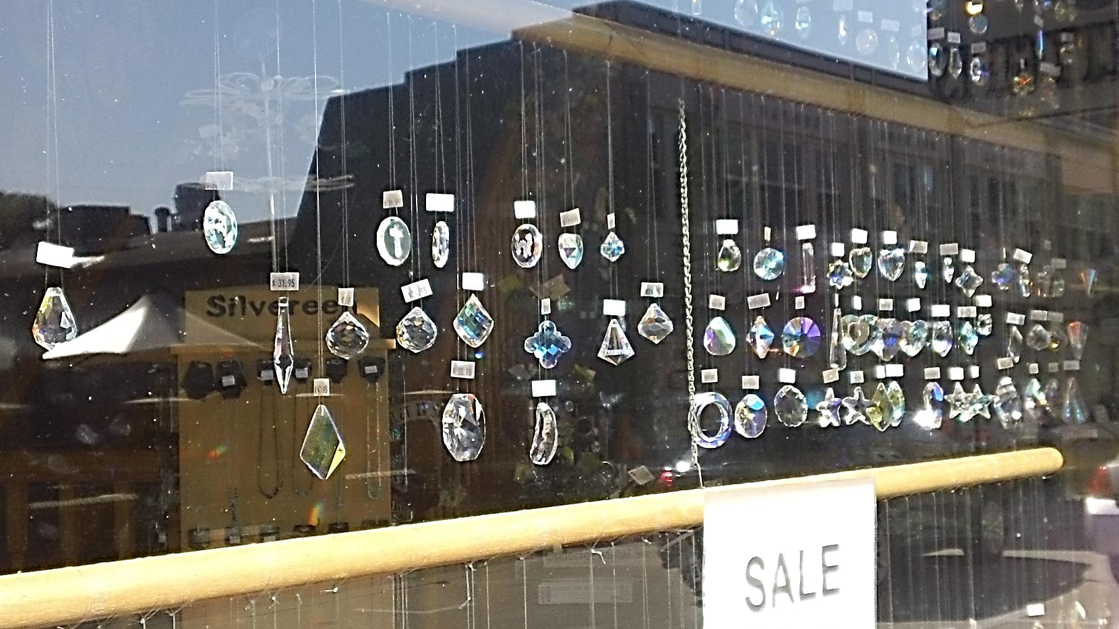
What caught her eye?

Slide 16
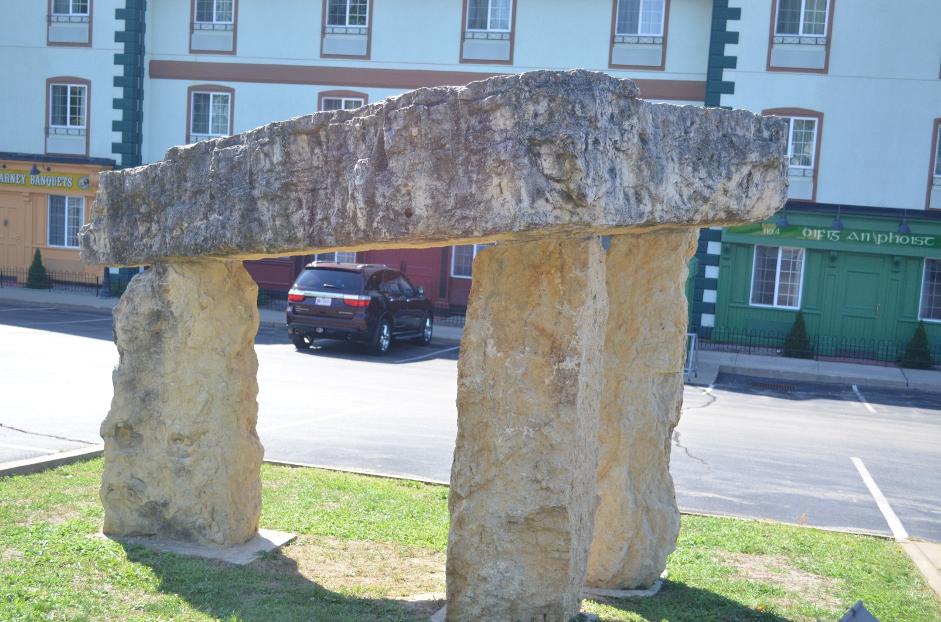
A little Irish flair

Slide 17
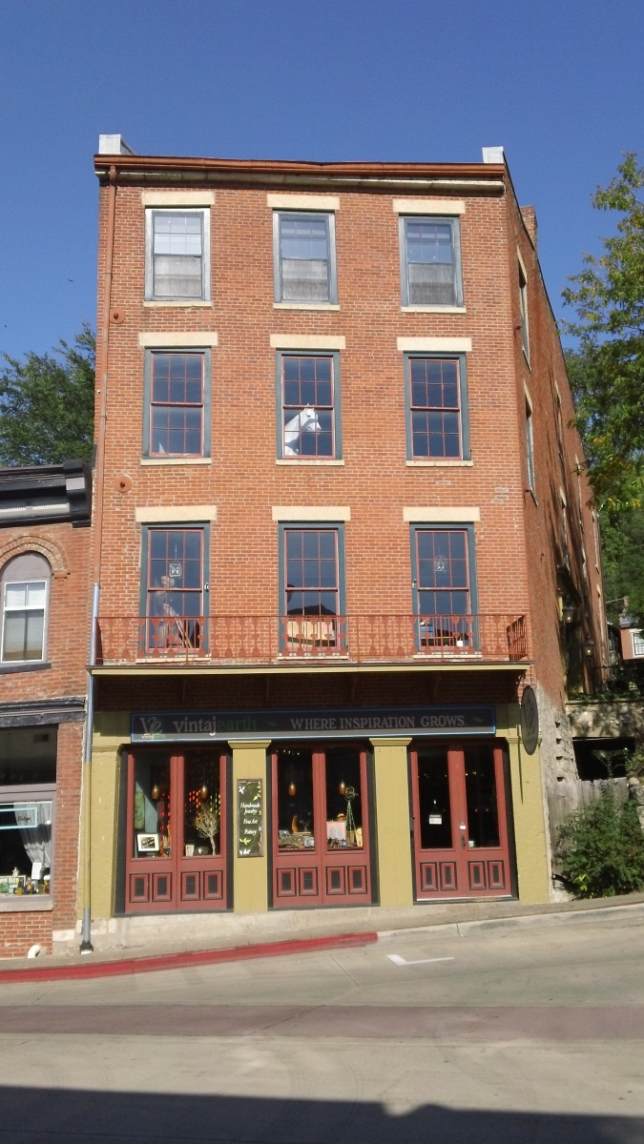
Does anyone else see a horse?

Slide 18
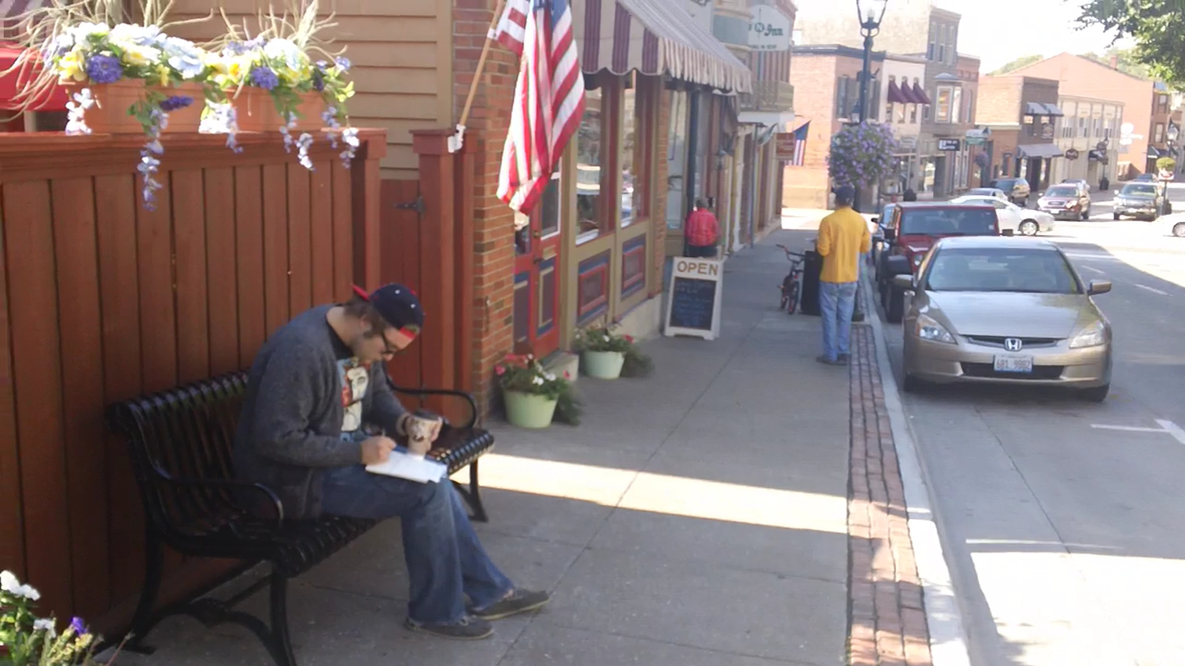
Cole taking notes along the way

Slide 19
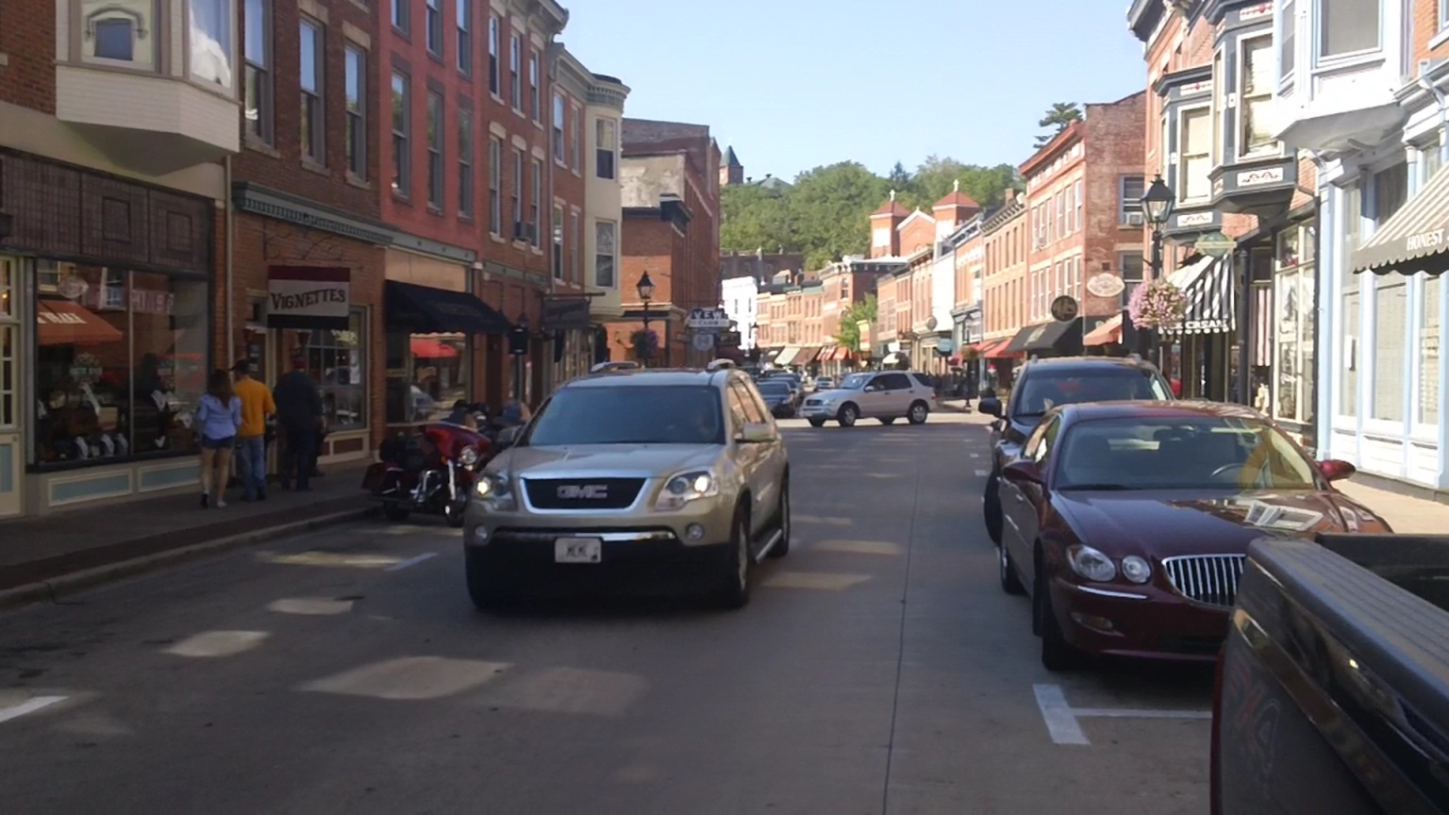
Fair amount of traffic for a Friday

Slide 20
We hope you enjoyed our little trip to Galena, Illinois.
We look forward to your presentation.
http://galena.org/

