Slide 1
Retail Survey—
Bluff Street Group
Mike Considine
Griffin Weihe
Erica Frana
Hannah Kass-Aten

Slide 2
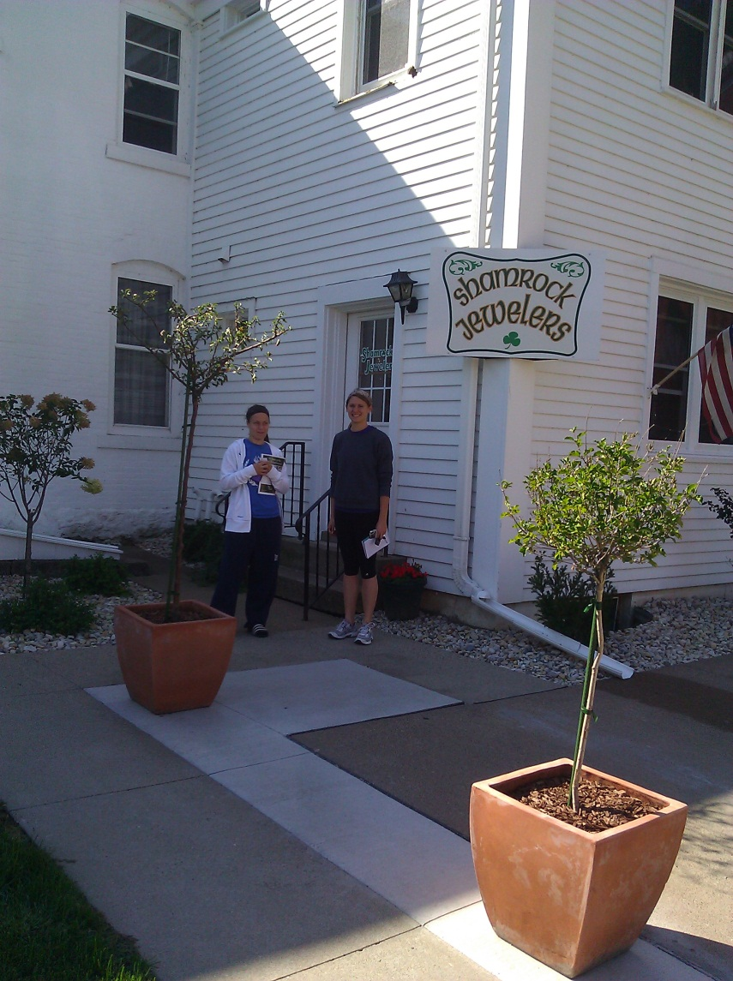
Shamrock Jewelers
432 West 4th Street, Dubuque, IA
Best 3 Qualities:
Large ‘Irish’ sign
Background Irish music
Green color
Worst 3 Qualities;
Location
Lack of Irish theme
Lack of window display

Slide 3
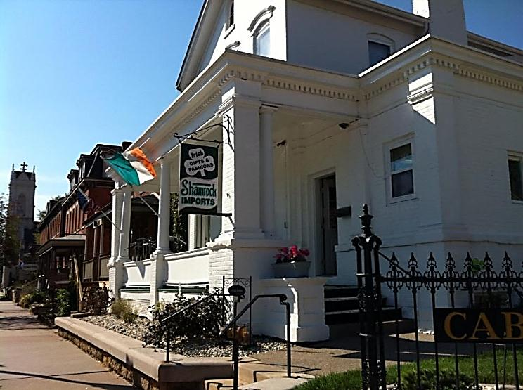
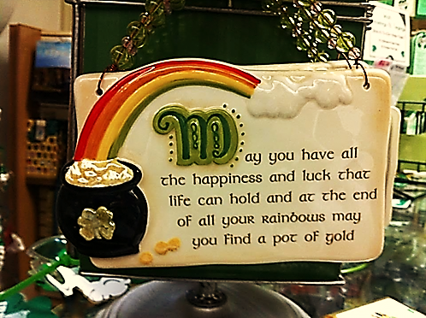
393 Bluff Street
Shamrock Imports
Best Qualities:
1) location
2) variety
3) Friendly staff
Improvements:
1) Expand non-tourist items
2) Move the location of the non-tourist items
3) Decorate the exterior to fit the Irish theme

Slide 4
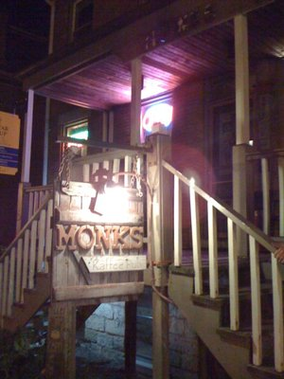
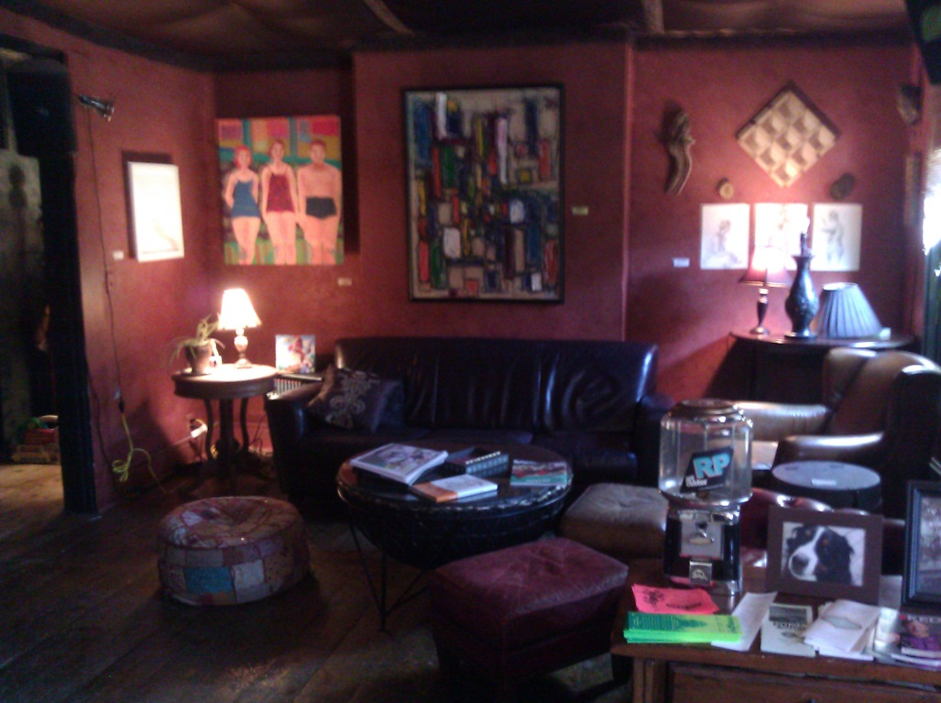
Monks Kaffee Pub
Coffee shop by day
Bar/Night club by night
Local music talents play small concerts in basement
Unique artwork/culture
Named after owner’s dog

Slide 5
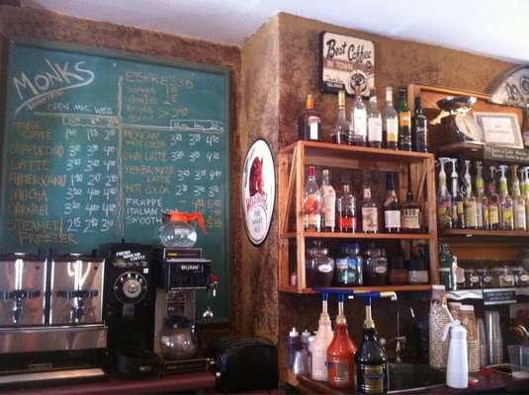
More Monks
Irish coffees are their specialty!
Small food selection (chips, bagels, burritos)
1 beer on tap that changes monthly
75 bottle selections
Domestic cans and microbrews
Great friendly service!

Slide 6
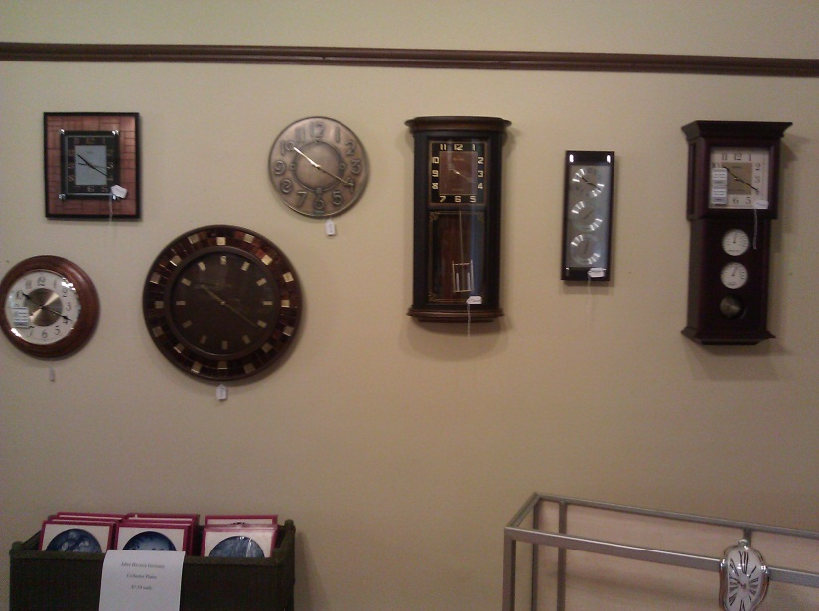
Bluff Street Time Shop
Best Qualities:
Selection of Watches
Atmosphere
Friendly Owner
Worst Qualities:
-Size of Shop
- Marketing (Never Heard of this place)
- Outside of Store ( No Idea what shop was)

