Slide 1
Managerial Accounting
Chapter 1
Introduction to managerial accounting

Slide 2
Chapter Objectives
Differences between Managerial and Financial Accounting
How does managerial accounting support the key functions of management
Understand the role of ethics, internal controls and Sarbanes-Oxley
Define and understand the different types of cost

Slide 3
What is Managerial Accounting?
Decision-Making Orientation
The purpose of managerial accounting is to provide useful information to internal managers to help them make decisions.

Slide 4
Managerial vs Financial Accounting
Managerial accounting
Financial Accounting
Focuses on internal reporting
Forward looking
Measures and analyzes financial and non-financial information
Not restricted by GAAP
Influences behavior of managers and employees
Focuses on reporting to external parties
Historical focus
Measures and records business transactions
Prepared according to GAAP
Influences behavior of investors (outsiders)

Slide 5
Types of Organizations
Manufacturing
Merchandising
Service Companies
Purchase raw materials from suppliers
Covert them into finished products
Sell goods that Manufacturer’s produce
Wholesalers sell to businesses
Retailers sell to consumers
Provide a service to customers

Slide 6
Functions of Management
Planning
Implementing
controlling

Slide 7
Planning
Future oriented
Establish goals or objectives
Long term and short term
What tactics do we need to achieve these goals
Develop a Budget
Lay out the plan in monetary or financial terms
Organize the plan and ensure the resources to carry it out

Slide 8
Implementing
Put the plan into action
Managers responsibilities
Lead
Direct
Motivate

Slide 9
Controlling
Managers keep track of progress and adjust the plan if necessary
Compare actual results to planned results (budget)
Take corrective action to get back on track

Slide 10
COSTS

Slide 11
Cost Terminology
What is a cost object?
Anything you want to know the cost of
Cost of buying something
Cost of going somewhere
Out of Pocket Cost
Actual cash payment
Opportunity Cost
Cost of not doing something
Choosing to do one thing over another

Slide 12
Variable vs Fixed
Variable
Fixed
Change in direct proportion to activity
Per unit cost
May increase in total but per unit remains the same
Remain constant regardless of activity
Total remains the same but per unit cost changes based on activity

Slide 13
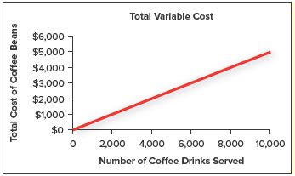
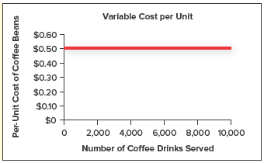
Variable Costs
Costs that change IN TOTAL in direct proportion to changes in activity
Per unit cost remains constant

Slide 14
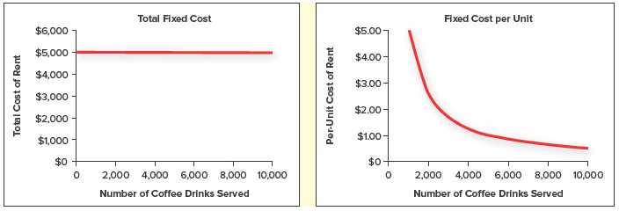
Fixed Costs
Costs that remain the same in total regardless of activity level
Per unit, fixed costs decrease with increases in activity level

Slide 15
Product vs Period
Manufacturing
nonmanufacturing
All the costs associated with producing or manufacturing a physical product
Direct materials
Direct labor
Manufacturing overhead
Costs associated with running the business
Marketing or selling expenses
General and administrative expenses

Slide 16
Direct vs Indirect
Direct
indirect
Directly and reasonably traced
Tuition and books
Cannot be traced
Not worth the effort of tracing
Gas to get to class
Supplies

Slide 17
Direct Materials
Material inputs that can be tied directly to a job
Building a house:
Drywall
Lumber
Fixtures
Appliances

Slide 18
Direct Labor
Hands on work that goes directly into producing a product
Building a house
Plumbing
Framing the home

Slide 19
Manufacturing Overhead
All manufacturing costs other than direct materials and direct labor
“Indirect” costs
Building a home
Insurance
Depreciation on equipment
Supplies or overhead such as screws, nails, etc.
Notes:
In Class Problem #1

Slide 20
PRIME COSTS
Direct Materials + Direct Labor
Primary parts of the product
CONVERSION COSTS
Direct Labor + Manufacturing Overhead
What it takes to transrform or convert materials into a finished product

Slide 21
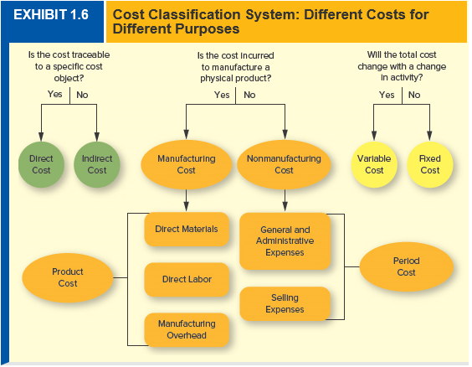
Notes:
In Class Problem #2 and 3

Slide 22
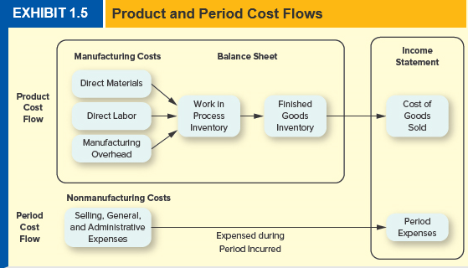

Slide 23
Relevant vs Irrelevant Costs
Relevant
irrelevant
Potential to influence a decision
Occur in the future
Differ between various alternatives
Will not influence a decision
Sunk costs – costs that are already incurred
Notes:
In Class Problem #4

Slide 24
Why are ethics important to accounting?
Ethics refers to the standards of conduct for judging right from wrong, honest from dishonest, and fair from unfair. Many situations in business require accountants and managers to weigh the pros and cons of alternatives before making final decisions.
Provide an ethical and respectful work environment
Provide accurate and fair information for investors
ENRON SCANDAL

Slide 25
Sarbanes Oxley (SOX) Act of 2002
Renew investor confidence
Reduce the opportunity for error and fraud
Counteract the incentive to commit fraud
Stiffer monetary penalties
Potential jail time
Emphasize the character of managers and employees
Code of ethics
Confidential tip lines
Whistle blower protection
Notes:
ENRON CEO Jeff Skilling received a 24 year prison sentence (since been reduced by 10 years) and required to reimburse ENRON victims for $42 million

Slide 26
Sarbanes Oxley (SOX) Act of 2002
Intends to reduce opportunities for error and fraud
Management must review all internal controls and issue reports on the effectiveness of controls
Incentives for committing fraud
Stiffer penalties (both monetary and jail time) for committing fraud
Cannot be avoided by filing bankruptcy
Character of Managers and Employees
Companies must adopt a code of ethics for senior financial officers
Audit committees must create tip lines for employees to use
Federal employees receive whistle-blower protection

Slide 27
Sustainability Accounting
Ability to meet the needs of today without sacrificing the ability of future generations to meet their own needs
Triple Bottom Line (3 P’s)
People
Profit
Planet

