Slide 1
Cost Behavior
Chapter 5
Managerial accounting

Slide 2
Chapter Objectives
Identify costs as variable, fixed, step or mixed
Prepare a scattergraph to estimate the relationship between total cost and activity
Use the high-low method to estimate cost behavior
Use least squares regression to estimate cost behavior
Prepare and interpret a contribution margin income statement

Slide 3
What is Cost Behavior?
The way total cost behaves, or changes when some measure of activity changes
Number of units produced
Customers served
Direct labor hours worked
Machine hours used

Slide 4
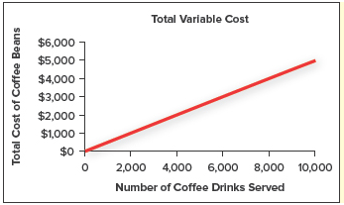
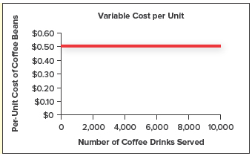
Variable Costs
Costs that change IN TOTAL in direct proportion to changes in activity
Per unit cost remains constant

Slide 5
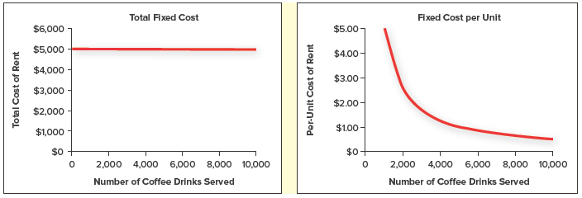
Fixed Costs
Costs that remain the same in total regardless of activity level
Per unit, fixed costs decrease with increases in activity level

Slide 6
Relevant Range
The range of activity over which we expect our assumptions about cost behavior to hold true
A fixed cost may only be fixed for a limited range of activity
What if we have maxed out the production of a piece of equipment?
Need to purchase another piece of equipment and fixed costs will increase
Relevant range would be the capacity of the machine to produce before needing to purchase additional equipment.

Slide 7
Cost Driver
A factor that influences or contributes to a cost
Hours worked (labor hours)
Machine hours
Units produced
Customers served
What causes our costs to change?

Slide 8
Step Costs
Fixed over a range of activity and then increase in a step-like fashion when capacity is reached.
Can be categorized as:
Step-Variable Costs
Step-Fixed Costs
Notes:
Keg at a party

Slide 9
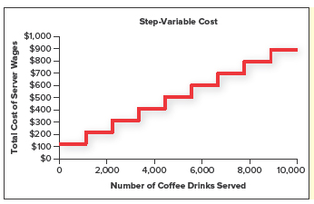
Step-Variable Costs
Fixed over a fairly narrow range of activity and rise in multiple steps across the relevant range.

Slide 10
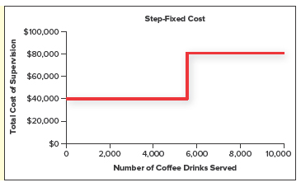
Step-Fixed Costs
Fixed over a much wider range of activity than step-variable costs
Cost of supervision
1 supervisor can handle the supervision of 6,000 units
Their salary is $40,000
If we produce 8,000 units we need another supervisor
Total fixed cost is now $80,000 ($40,000 x 2)

Slide 11
Mixed Costs
Have both a fixed and variable component
Fixed portion represents the base amount
Will be constant regardless of activity
Variable portion will change
Increase base on activity of usage

Slide 12
Mixed Costs

Slide 13
Identify Type of Cost

Slide 14
Estimating Cost Behavior
Why should we do it?
Should we change our hours?
Should we make labor changes?
What will decisions like this do to our total cost?
What will they do to revenues?
How do these effect our profits?

Slide 15
Estimating Cost Behavior
Linear Assumption
Assuming the relationship between total cost and activity can be estimated by a straight line

Slide 16
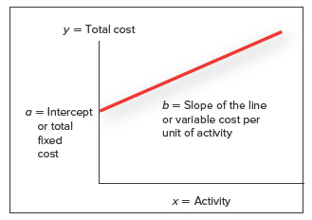
Linear Assumption
y = a + b(X)
Total Cost = Total Fixed Cost + (Variable Cost per unit x Activity)
y = Total Cost (dependent variable)
x = Activity (independent variable)
a = Total Fixed Cost (intercept)
b = How much will cost (y) change as activity (x) changes. The Slope of the line

Slide 17
Methods to Estimate Cost Behavior
Scattergraph
High-Low Method
Least-squares regression

Slide 18
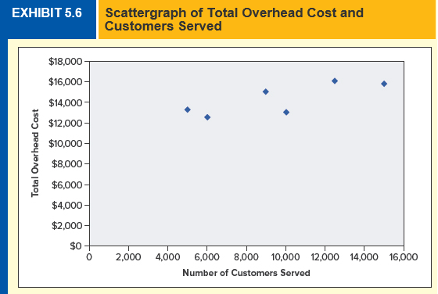
Scattergraph
Provides a visual representation of the relationship between total cost (y) and activity level (x)

Slide 19
Scattergraph
PROS
CONS
Gives a feel for the data
Answers preliminary questions
Gives an idea if linear assumption is true
Easy to spot outliers
Subjective
Inexact

Slide 20
High-Low Method
Calculates the line based on the two most extreme activity (x) data points
May be reasonable as long as the two data points fall within the relevant range and reflect the general trend

Slide 21
High-Low Method
How do we do it?
Select the two most extreme ACTIVITY(x) observations
The High and the Low amounts
Calculate the slope based on the high and low data points
Solve for total fixed cost (intercept) by plugging variable cost back into the linear cost equation

Slide 22
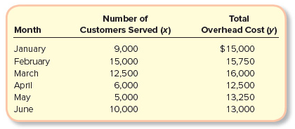
High-Low Method
Step 1: Find the extreme activity (x) points

Slide 23
High-Low Method
Step 2: Calculate the Slope
“Rise over Run”, the steepness of the line
Difference in total cost = $15000 - $5,000 = $10,000
Difference in activity = 15,750 – 13,250 = 2,500
Slope = $10,000 / 2,500 = $0.25

Slide 24
High-Low Method
Step 3: Solve for Total Fixed Costs (intercept) using the linear assumption equation
y = a + b(X)
Total Cost = Total Fixed Cost + (Variable Cost per unit x Activity)

Slide 25
High-Low Method
Step 3: Solve for Total Fixed Costs (intercept) using the linear assumption equation
y = a + b(X)
Total Cost = Total Fixed Cost + (Variable Cost per unit x Activity)
$15,750 = a + 0.25(15,000)
a = $12,000
Fixed Costs = $12,000

Slide 26
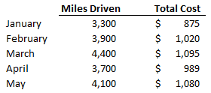
High Low Method
Joyce Murphy runs a courier service in downtown Seattle. She charges clients $0.50 per mile driven. Data for the first 5 months of 2018 is as follows:
How much is Joyce’s variable cost per mile?
How much are Joyce’s fixed costs per month?
What are total estimated costs if Joyce drives 4,200 miles?

Slide 27
High-Low Method
PROS
CONS
Simple to calculate
Only uses 2 data points
May not be representative of normal activity

Slide 28
Least Squares Regression Method
Statistical technique that uses all the data available to find the best fitting line
Can be calculated easily with a program like Excel but would be cumbersome to do by hand
General rule of thumb:
> 20 data points to get reliable results

Slide 29
Least Squares Regression Method
R-Square
Intercept
Coefficient of the x variable

Slide 30
Least Squares Regression Method
R-Square = Measure of the model’s goodness of fit
R-Square of 1 = Perfect fit
How much of the variability in cost can be explained by activity
R-Square = .75 means
75% of the change in cost can be explained by activity
25% related to another cost driver or activity

Slide 31
Least Squares Regression Method
Intercept
Estimate of the total fixed costs
Where does the line cross the y axis

Slide 32
Least Squares Regression Method
X-Coefficient
Slope of the line
Rise over Run
Estimate of the variable cost per unit

Slide 33
Least Squares Regression Model
Sherri’s Tan-O-Rama is a local tanning salon. Its regression output is as follows:
What are Sherri’s fixed costs per month?
What are Sherri’s variable costs per unit?
What is the total cost if 100 customers are served?

Slide 34
Summary of Linear Methods
Scattergraph
High-Low Method
Least Squares Regression
Uses a graph to visualize the relationship between total cost (y) and activity (x)
Total Fixed Cost = Intercept
Variable Cost/Unit = Slope of the line
Simple and intuitive
Subjective and inexact
Uses the highest and lowest x values to fit the line
Variable cost per unit =
(y1-y2)/(x1-x2)
Total Fixed Cost = Total Cost – Variable Cost
Simple and intuitive
Uses only 2 data points (may not represent the general data trend)
Uses a statistical package to find the line that minimizes the sum of squared errors
Total Fixed Cost = Intercept
Variable Cost per Unit = x Coefficient
Uses all data points
Easy to calculate in Excel
Requires more data and assumptions
Proper interpretation of results is critical

Slide 35
Contribution Margin Approach
Create a type of income statement called a:
Contribution Margin Income Statement
Only appropriate for internal use
Based on cost behavior
Separates costs into fixed and variable

Slide 36
Unit Contribution Margin
Unit Sales Price – Unit Variable Cost
How much does each additional unit contribute to fixed costs and profit?

Slide 37
Contribution Margin
Total Contribution Margin =
Sales Revenue – Total Variable Costs
OR
Unit Contribution Margin x # of Units
Amount that will be used to cover fixed costs then contribute to profit

Slide 38
Contribution Margin Ratio
Unit Contribution Margin / Unit Sales Price
Tells how much contribution margin is generated for every dollar of sales
If Contribution Margin Ratio is 65%, then for every dollar of sales, $0.65 can be contributed to fixed costs then profit

Slide 39
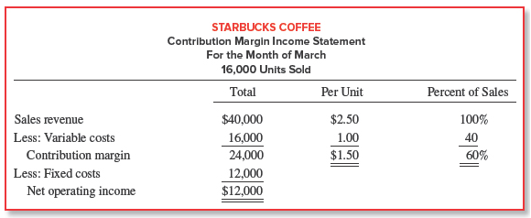
Contribution Margin Income Statement

Slide 40
Following is relevant information for Snowdon Sandwich Shop, a small business that serves sandwiches:
What is the unit contribution margin?
Assuming 600 sandwiches are sold:
What is total revenue?
What are total variable costs?
What are total fixed costs?
Prepare a Contribution Margin Income Statement

